Slide 1
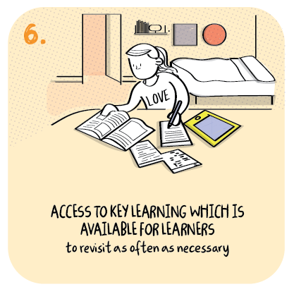

Supporting Gaelic during remote learning
Sandbank Primary School,
Argyll and Bute Council
>National overviews of practice<

Slide 2
Sandbank Primary School
Immersion in Gaelic cannot be offered therefore staff are being creative in their support of parents, who do not have the language, as they undertake remote learning.
Children are offered three live inputs daily to support language acquisition and parents are now more involved in methodologies than during in-school learning.
The school has developed their website to include sound files and relevant links to support parents.
The following information has been shared from the school to further illustrate their approach.

Slide 3
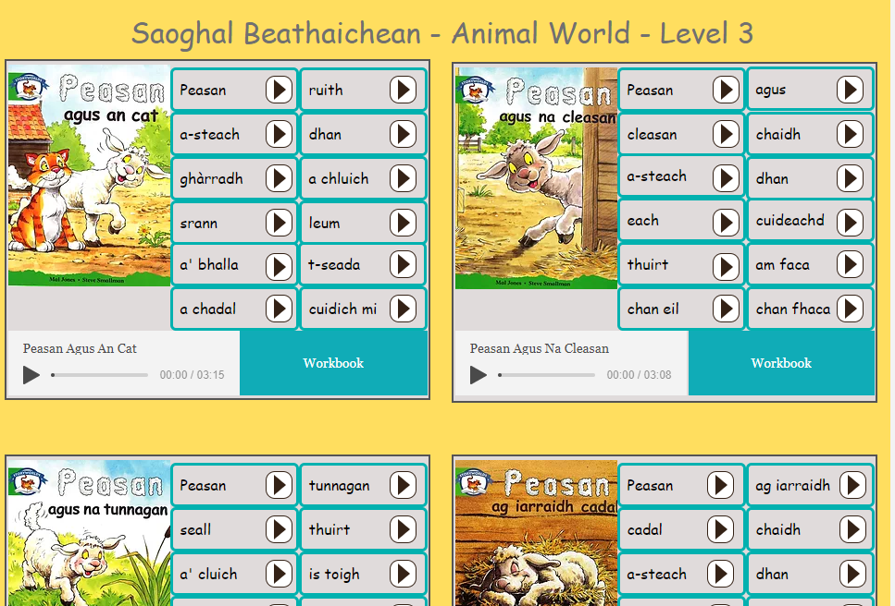
Sandbank Primary have shared information on their website: www.gaelichomelinkcowal.com
Our website was initially created around 2019 to support Gaelic learning at home and provide support for all families and community members. Since the lockdown period in early 2020 lots of new resources, sound files and links have been added to further enhance and support high quality learning in our Gaelic classes. Examples are as follows:
Sound files and videos developed and added to the website to keep Gaelic daily listening routines in place
The sound files can also be added to our Seesaw class pages as part of individual lessons and activities
Website is now supporting children with daily reading activities as part of remote learning
Sound files created for individual word sets and words. There is a link to each book which allows for live lessons to be projected onto all viewer’s screens, thus supporting children and parents throughout each lesson
A sound file of the full book allows children to follow the book while the book is being read to support pronunciation of tricky words. A workbook is also linked to allow the children to follow the plans that would be in place for comprehension in the classroom to be followed at home.

Slide 4
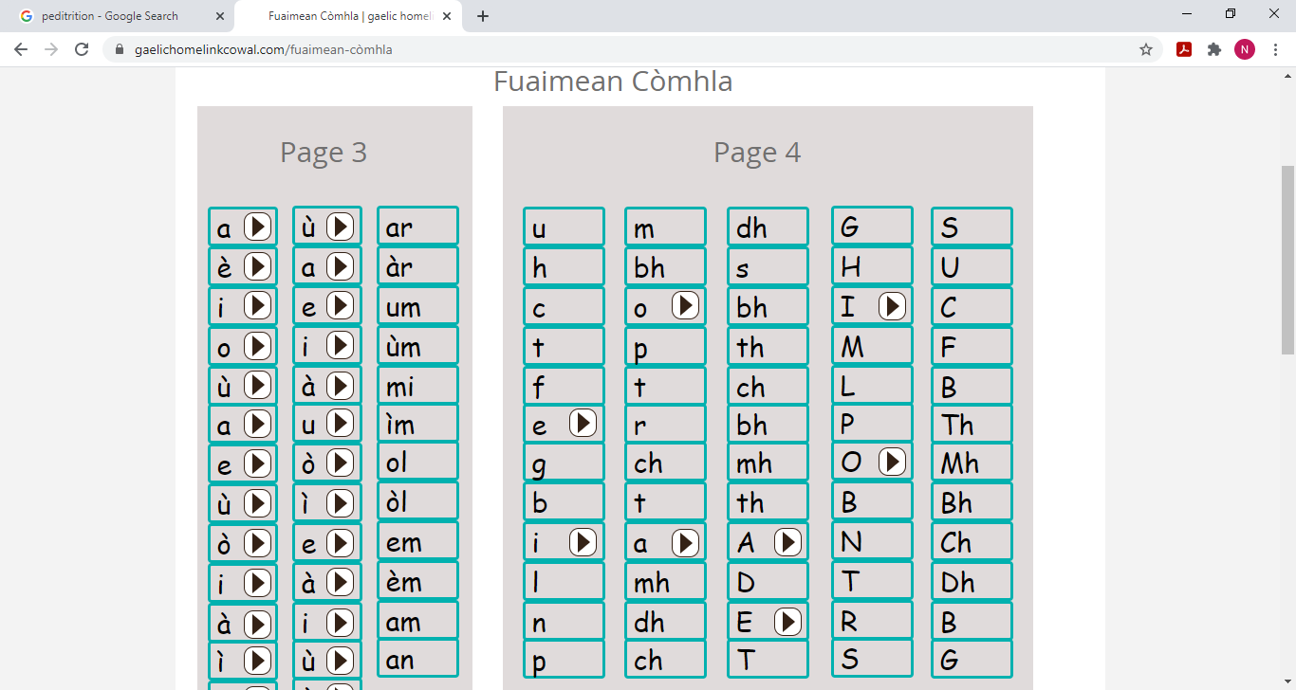
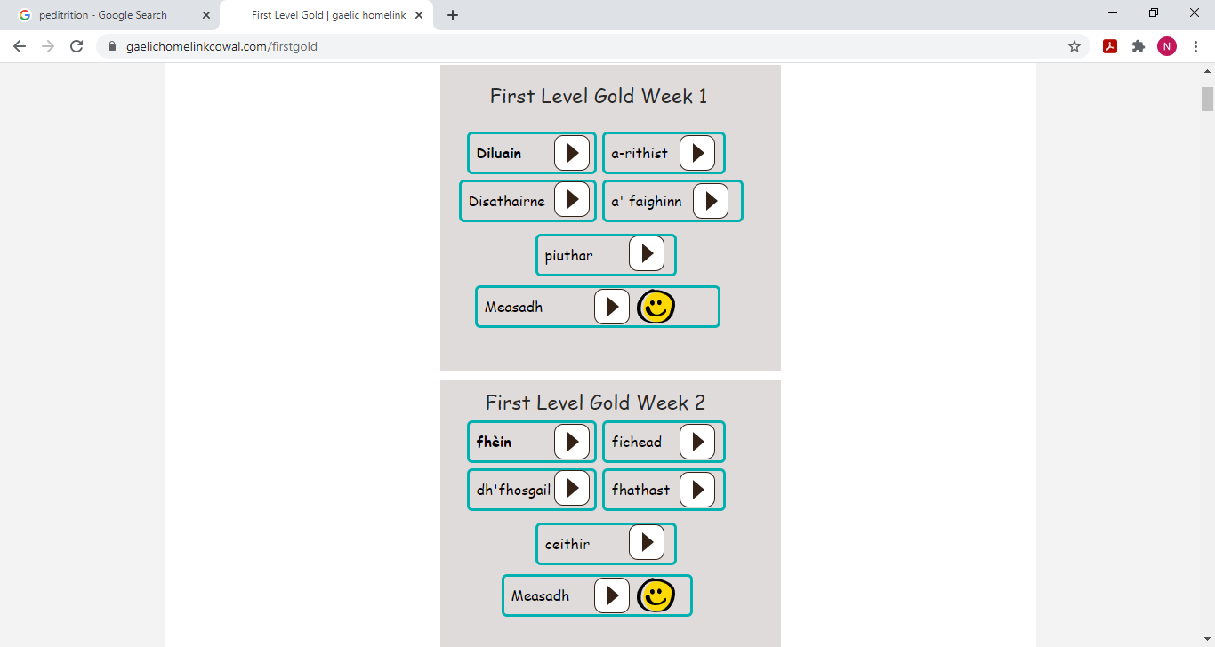
Phonics support has been developed on the website through sound files for the Gaelic Toe-by-toe scheme we have adapted for our learners.
Sound files have been developed for the Gaelic spelling scheme and organised into the school’s Gold, Silver and Bronze categories for each level to allow for clearer progression and tracking of pupil ability/need.

Slide 5
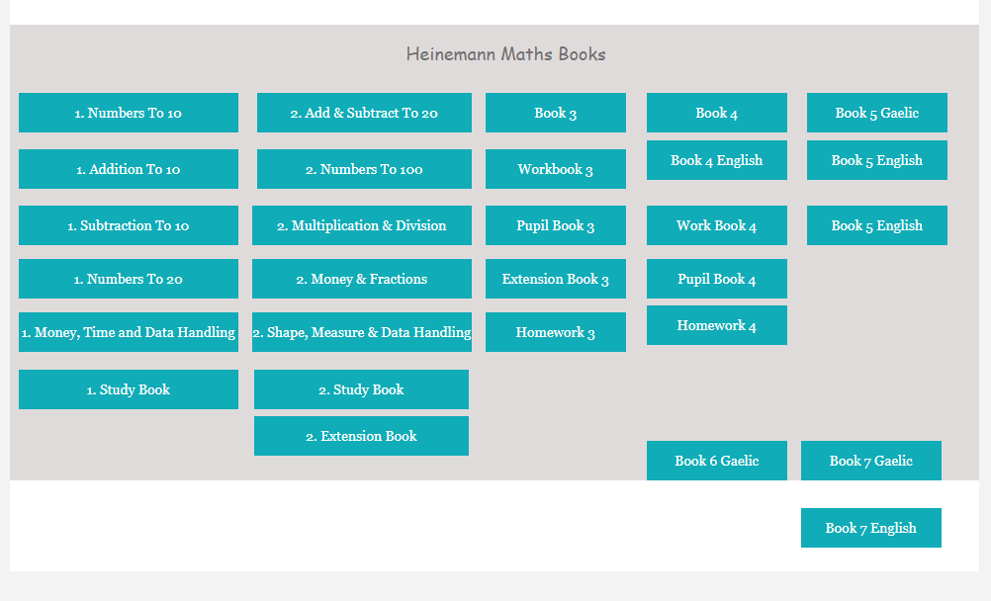
All Heinemann, Teejay and Active Maths workbooks have been made available to all teachers in English and Gaelic to support delivery of lessons and remote learning during lockdown.
The website is averaging roughly 260 site visits a week with Early/First Level as its main audience due to the content available.
Teachers have made themselves available through Google Meet and Google Classroom for any child to drop in and ask questions.
90% engagement in learning over early, first and second level primary classes and this will rise as 1 family had technology issue, which is now resolved.
100% of parents across all primary levels have been contacted as part of our remote learning provision.

