Slide 1
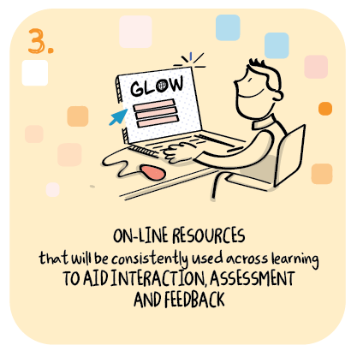

The role of feedback in developing consistent online resources
Redburn School,
North Lanarkshire Council
>National overviews of practice<

Slide 2
Redburn School – case study
Using parental feedback the school challenged themselves to think about they could present online learning experiences to learners and their families in a way that was accessible to them.
Having engaged with the virtual classroom produced by North Lanarkshire, Education and Families, the digital lead in school began the process of developing a virtual classroom for the pupils at Redburn. It was modelled on the authority format but initially selected the areas of literacy, numeracy and health and wellbeing. Utilising the symbols that are used to support communication across the school, a simple, one touch access to a wide variety of online resources and lesson activities was created.
Having established this as a format to present online learning experiences, teachers have been able to create class specific virtual classrooms where they have delivered a weekly programme of lessons targeted specifically to meet the needs of the pupils in their class.

Slide 3
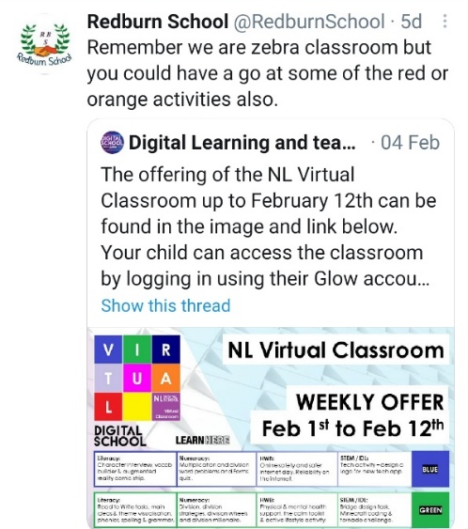
Redburn School – continued
The school has also vastly increased their use of video lessons as this was something parents had requested: these can also be accessed by families through the virtual classroom. As part of digital partnership arrangements with 5 other ASN schools these resources are available through teams to help them with their digital offer.
In addition to the school based activity Redburn's digital lead has also worked in partnership with the Digital Inclusion Lead in Education and Families. An ASN specific virtual classroom is now part of the generic local authority offer for all schools and ELC to access if appropriate.

