Slide 1
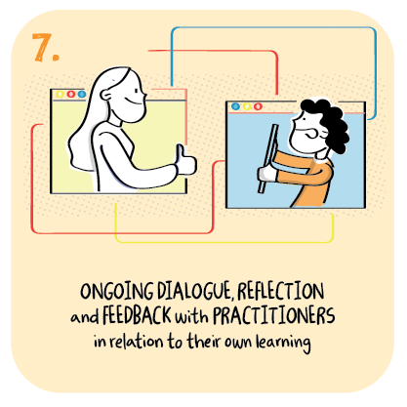

‘Parent Blethers’ at North West Community Campus (2-18)
North West Community Campus, Dumfries and Galloway Council
>National overviews of practice<

Slide 2
North West Community Campus
• The Senior Leadership Team (SLT) has established a format for parents/carers to meet with staff and each other to discuss their experiences of remote learning and share ideas and suggestions around how the delivery could be improved. This is part of the school’s approach to increasing parental engagement, an area staff have identified as an improvement priority. • The ‘Parent Blether’ sessions last for approximately 30 minutes and are hosted online. A principal teacher from the secondary sector leads the conversations and then collates the feedback for the rest of the leadership team. This information is analysed and shared with staff during staff meetings. • To date there have been four sessions, each attended by approximately 16 parents, representing all sectors. The SLT plan to extend this approach and have invited more staff to facilitate the discussions. • The SLT view this initiative as a positive start to reaching a wider group of parents/carers. The informal and brief format is designed to make attendees feel comfortable and encourage them to contribute their ideas.

