Slide 1
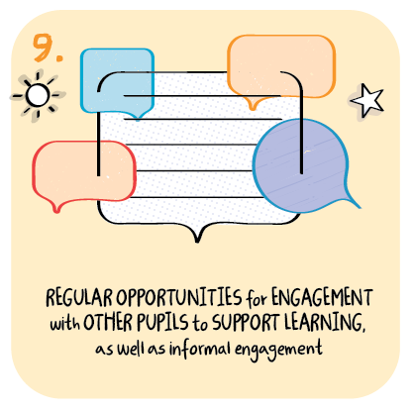

Engagement with other learners
Stonelaw High School, South Lanarkshire Council
>National overviews of practice<

Slide 2
Stonelaw High School
Depute heads meet with young people from each year group each week.
These interactions provide young people with the opportunity to give feedback on what is working well or not in their learning.
Young people can use a Google Form to do this, or can discuss this as part of a whole class conversation.
This helps young people to feel that they are still part of their class, and allows the deputes to check in with young people.
A focus on tracking the participation of young people in remote learning is in place, which is regularly monitored by staff, with interventions being planned if required. This is helping to ensure that young people are accessing resources.
The school’s approach to overcome specific barriers which young people may face in this challenging context is working well.
Systems which were already in existence have been modified, partners across the learning community continue to be involved to ensure that young people who may need additional help and or support continue to receive it.

