Slide 1
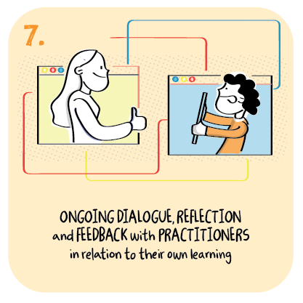

Ongoing feedback and dialogue about learning using a variety of methods
Barrhead High School, East Renfrewshire Council
>National overviews of practice<

Slide 2
Barrhead High School
Staff are using a range of approaches to assess young people’s learning. These include: Graphics tablet to show workings; self-paced Kahoots; posing a question at the end of the lesson to gauge engagement and feedback; use of the hands-up function to gauge opinion or feedback; self-assessment via Literacy Planet website; and use of collaboration Google slides to complete questions (Learners all given their own slides).
While they are answering questions, the teacher can give instant feedback and young people can amend their answers accordingly.
Young people can also give feedback on other pupils’ work using the marking scheme uploaded.); and Wordwall to increase engagement through fun, interactive tasks which are self-marking but allow staff to look at work for feedback.
Multi-layered, bespoke strategies are in place to support vulnerable young people and those who require additional support with their learning. These include regular check-ins with staff, online ‘base time’ (as normal), nurture groups, and close work with personal support assistants (PSAs) in live lessons and through Google Classroom.
The school has provided much support for PSAs to help them support young people well digitally. The school’s social justice manager is also available to meet individual pupils for a walk if required.
Subject teachers are available to support young people with their learning for at least fifteen minutes during every period of the school day. This may be through live chat or the chat pane. Staff members, such as the school librarian, are also joining specific classes online.

