Slide 1
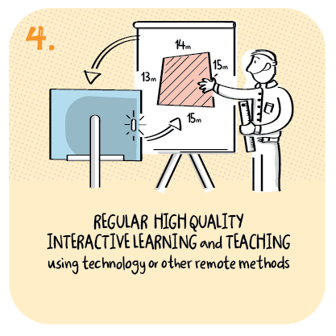

Using virtual classrooms
Grandtully and Kenmore Primary Schools, Perth and Kinross Council
>National overviews of practice<

Slide 2
Grandtully and Kenmore partnership schools
Senior leaders helpfully guide staff to plan a balance of live learning and independent activity, along with screen and non-screen time learning. Staff try to follow the school routines or timetable where possible.
Staff have set up “virtual classrooms” for each class, with different classrooms for different curricular areas, including outdoor learning and Spanish. The virtual classrooms that have been set up by staff are proving very effective.
Staff provide a mixture of live, pre-recorded lessons and non-screen activities for pupils daily; all of these are very popular with families.
Staff utilise different formats such as audio and video, to support needs of learners. Given the nature of the composite and multi-composite classes, staff differentiate learning to suit individual needs, including supporting children’s independence in learning.
The following slides have been shared by the schools

Slide 3
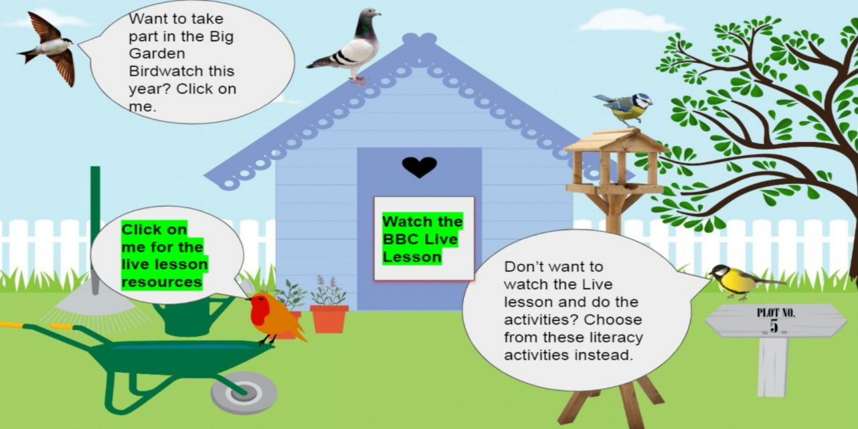

Slide 4
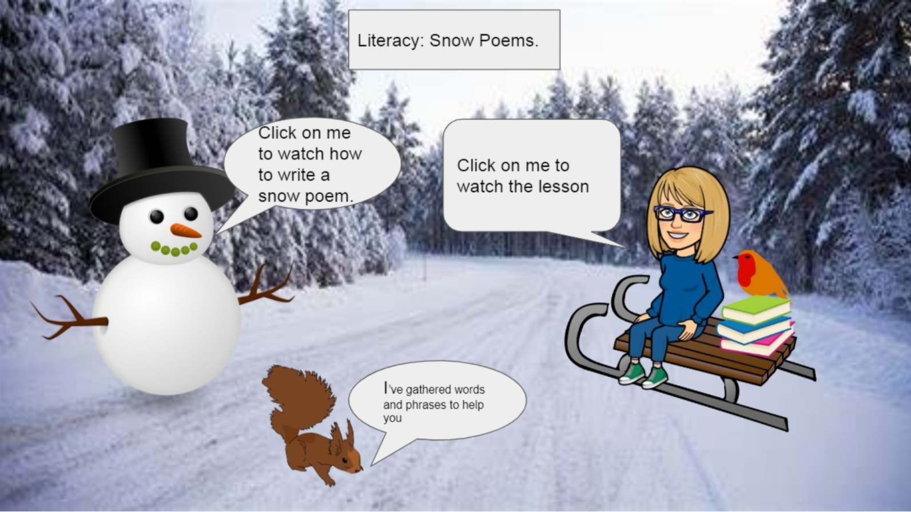

Slide 5
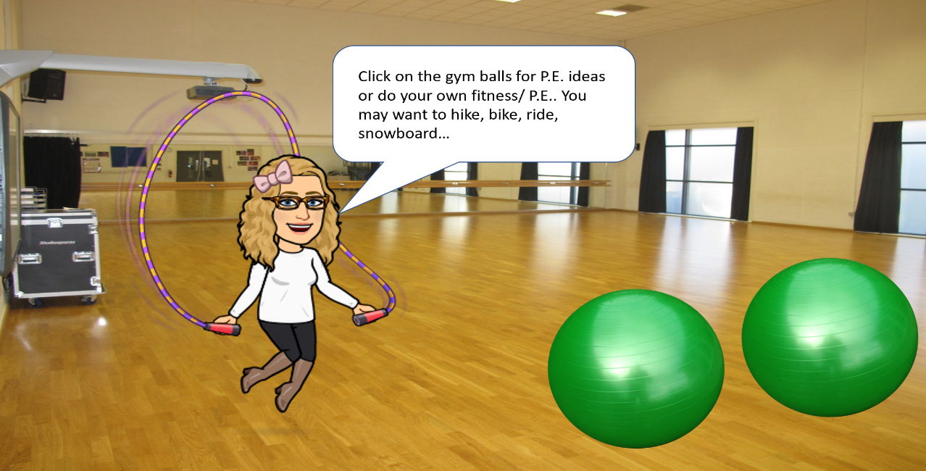

Slide 6
