Slide 1

Inspection Advice on Gaelic Education
Comhairle air Foghlam Gàidhlig
Do
Key Messages
Airson luchd-ionnsachaidh na h-Alba, le luchd-foghlaim Alba For Scotland's learners, with Scotland's educators

Slide 2
The Advice on Gaelic Education provides important information on the national context, and describes best practice to support senior leaders, practitioners and education authorities in evaluating and planning for improvement in Gaelic Education. It is based on evidence from inspections, reviews and other statutory functions, covering all sectors of Gaelic Education; and other engagements with a wide range of stakeholders.
HM Inspectors use the Advice to support scrutiny activities.
Airson luchd-ionnsachaidh na h-Alba, le luchd-foghlaim Alba For Scotland's learners, with Scotland's educators

Slide 3
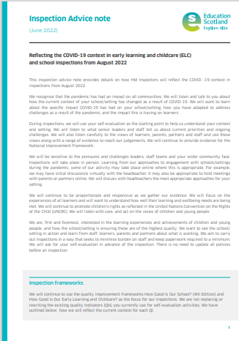
Gathering quantitative and qualitative data
The Advice on Gaelic Education and Statutory Guidance should be
used with the suite of quality frameworks How good is our ..? to contextualise these to the Gaelic sector.
These frameworks set out the standards we use to evaluate and report on quality and improvement in Scottish education. They incorporate key legislation and policy
For Scotland's learners, with Scotland's educators
Airson luchd-ionnsachaidh na h-Alba, le luchd-foghlaim Alba For Scotland's learners, with Scotland's educators

Slide 4
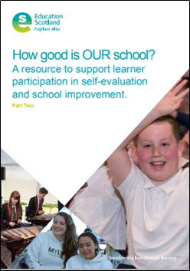
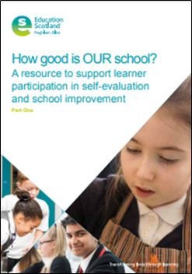
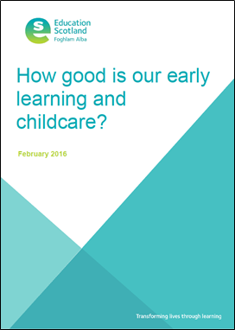
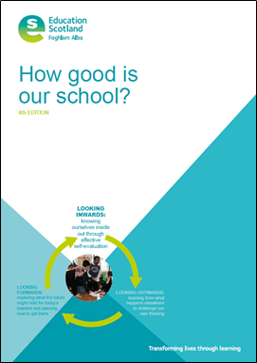
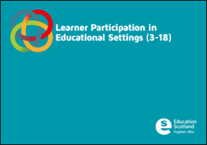
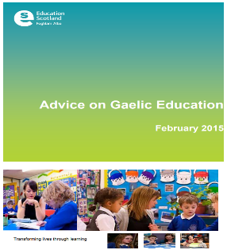
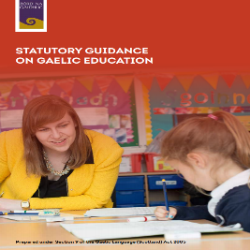
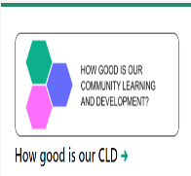
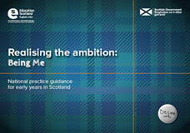
Quality frameworks How good is our..?
For Scotland's learners, with Scotland's educators
Airson luchd-ionnsachaidh na h-Alba, le luchd-foghlaim Alba For Scotland's learners, with Scotland's educators

Slide 5

Effective self-evaluation
Effective self-evaluation underpins the work of any successful establishment. At the heart of self-evaluation there are three questions:
How are we doing in our Gaelic provisions?
How do we know?
What are we going to do now for Gaelic?
The driving force of a successful improvement strategy is self-evaluation. An organisation that has the capacity to examine all that it does critically in the light of genuine evidence - including data on pupil performance - and sets targets for its own developments, will be an improving one"
Michael Fullan
Airson luchd-ionnsachaidh na h-Alba, le luchd-foghlaim Alba For Scotland's learners, with Scotland's educators

Slide 6
Gaelic Medium Education
Key messages
Gaelic Medium Education is based on the principles of immersion with children accruing all the benefits of bilingualism.
The early stage of learning through the medium of Gaelic, and where no other language is used, is referred to as ‘total immersion’. This is followed by an ‘immersion phase’ up to and including the senior phase.
Airson luchd-ionnsachaidh na h-Alba, le luchd-foghlaim Alba For Scotland's learners, with Scotland's educators

Slide 7
Gaelic Medium Education
Key messages
Children and young people need to be equally confident in the use of Gaelic and English and able to use both languages in a full range of situations within and out with school.
All Gaelic Medium Education provisions, whether in free-standing provision known as Gaelic schools or Gaelic Medium schools or when delivered alongside English medium, have as an underlying foundation the principles of immersion.
Airson luchd-ionnsachaidh na h-Alba, le luchd-foghlaim Alba For Scotland's learners, with Scotland's educators

Slide 8
Gaelic Medium Education: engagement with parents
Key messages
Early engagement with parents to inform them of the benefits of Gaelic Medium Education, and its link to the benefits of bilingualism, is essential in securing the future of the language.
Children’s fluency in Gaelic is enhanced by using the language out with school. Parents need to have clear information on how to support their children’s education.
Airson luchd-ionnsachaidh na h-Alba, le luchd-foghlaim Alba For Scotland's learners, with Scotland's educators

Slide 9
Gaelic Medium Education: career-long professional learning
Key messages
Teachers need access to high-quality career-long professional learning (CLPL) to support them with Gaelic Medium Education.
Airson luchd-ionnsachaidh na h-Alba, le luchd-foghlaim Alba For Scotland's learners, with Scotland's educators

Slide 10
Gaelic Medium Education: total immersion, including assessment
Key messages
Children and young people need to experience high-quality total immersion as part of Gaelic Medium Education until they have a secure foundation in the language and a level of fluency that will enable them to build on the progress made in Gaelic.
Teachers’ monitoring and tracking of progress and achievement needs to ensure that children have received sufficient total immersion.
Airson luchd-ionnsachaidh na h-Alba, le luchd-foghlaim Alba For Scotland's learners, with Scotland's educators

Slide 11
Gaelic Medium Education: total immersion, including assessment
Key messages
A range of approaches are used in total immersion to enable children to hear and absorb high-quality Gaelic.
In delivering learning in the total immersion playroom and classroom, staff need to make use of the principles of curriculum design to ensure learning which is progressive and coherent.
The Curriculum for Excellence Benchmarks for literacy and Gàidhlig have a key role in helping children to demonstrate their progress with the curricular levels for literacy and Gàidhlig.
Airson luchd-ionnsachaidh na h-Alba, le luchd-foghlaim Alba For Scotland's learners, with Scotland's educators

Slide 12
Gaelic Medium Education: the immersion phase (immersion in the Broad General Education from end of P3/beginning of P4 onwards)
Key messages
In the immersion phase, the curriculum in its entirety continues to be taught through the medium of Gaelic across all four aspects of learning.
In the immersion phase, children begin to read and write skills in English language and to learn at a quicker pace across the curricular areas and contexts.
Airson luchd-ionnsachaidh na h-Alba, le luchd-foghlaim Alba For Scotland's learners, with Scotland's educators

Slide 13
Gaelic Medium Education: the immersion phase (immersion in the Broad General Education from end of P3/beginning of P4 onwards)
Key messages
Teachers plan children’s learning to develop vocabulary, phrases and syntax connected to the different areas of the curriculum, language skills, grammar and an appreciation of bilingualism and Gaelic language and culture.
In the immersion phase teachers lead learning in all curriculum areas, including the newly introduced English, through the medium of Gaelic.
When Gaelic Medium Education is being delivered successfully, the immersion phase is planned progressively to operate throughout primary and into secondary.
Airson luchd-ionnsachaidh na h-Alba, le luchd-foghlaim Alba For Scotland's learners, with Scotland's educators

Slide 14
Gaelic Medium Education: the immersion phase (immersion in the Broad General Education from end of P3/beginning of P4 onwards)
Key messages
In secondary, Gaelic immersion pathways are taken forward within a broad general curriculum, up to the end of S3 as a minimum entitlement, leading to qualifications in and through Gaelic.
There is a high expectation that young people will continue in Gaelic Medium Education to achieve awards and qualifications in and through Gaelic in the senior phase leading to post-school positive destinations in the Gaelic sector.
Airson luchd-ionnsachaidh na h-Alba, le luchd-foghlaim Alba For Scotland's learners, with Scotland's educators

Slide 15
Gaelic Medium Education: secondary stages
Key messages
The rationale for the curriculum needs to be based on a shared understanding of Gaelic Medium Education and bilingualism.
Staff, young people, parents and partners need to be clear on the purpose and value of Gaelic Medium Education.
The Gaelic Medium curriculum from S1 to S3, and into the senior phase, remains one based on the principles of immersion.
Airson luchd-ionnsachaidh na h-Alba, le luchd-foghlaim Alba For Scotland's learners, with Scotland's educators

Slide 16
Gaelic Medium Education: secondary stages
Key messages
Young people need to experience a continuum of learning pathways in the broad general education and the senior phase, with opportunities to develop their fluency across all four contexts of the curriculum.
To allow progression in immersion, schools need to aim to deliver a sufficient proportion of the curriculum through the medium of Gaelic.
Airson luchd-ionnsachaidh na h-Alba, le luchd-foghlaim Alba For Scotland's learners, with Scotland's educators

Slide 17
Gaelic Medium Education: secondary stages
Key messages
Gaelic Medium Education needs to be a compulsory part of the broad general education up to the end of S3, after which learners move into the senior phase from S4-S6 that offers a range of qualifications and awards in and through Gaelic.
The “1+2 Approach to Language Learning in Scotland” should be used in schools with Gaelic Medium provision to enable all young people in English medium education to learn Gaelic as an additional language. This includes celebrating Gaelic as an official language of Scotland, and the rationale for collective ownership of its promotion and protection, along with its associated culture and heritage.
Airson luchd-ionnsachaidh na h-Alba, le luchd-foghlaim Alba For Scotland's learners, with Scotland's educators

Slide 18
Gaelic Medium Education: improving fluency with a planned programme for language, grammar and vocabulary
Key messages
During the total immersion phase, the development of grammar and specialist vocabulary is embedded within learning and play through the use of high-quality Gaelic all of the time.
Later and at the immersion stages, children will become more aware of the development of particular language areas. Teachers plan progression for points of grammar and specialist vocabulary in programmes and courses across the curricular areas and contexts of the curriculum.
It is important that schools continue the practice of having a policy on how to sensitively correct children’s and young people’s language errors so that these errors do not become the norm.
Airson luchd-ionnsachaidh na h-Alba, le luchd-foghlaim Alba For Scotland's learners, with Scotland's educators

Slide 19
Gaelic Medium Education: transitions
Key messages
Schools and partners need to collaborate in planning learning 3-18 for Gaelic Medium Education to ensure continuity and progression in learning across all curriculum areas particularly into P1, between P7 and S1 and from the broad general education into the senior phase.
Airson luchd-ionnsachaidh na h-Alba, le luchd-foghlaim Alba For Scotland's learners, with Scotland's educators

Slide 20
Gaelic Medium Education: A 1 + 2 Approach to Language Learning
Key messages
A 1+2 Approach to Language Learning in Scotland children will firstly be immersed in Gaelic using the Curriculum for Excellence Experiences and Outcomes at the early and first levels.
At P3/P4, children will begin to address the Curriculum for Excellence Experiences and Outcomes relating to literacy and English.
Children will learn a second additional language, L3, no later than P5.
Airson luchd-ionnsachaidh na h-Alba, le luchd-foghlaim Alba For Scotland's learners, with Scotland's educators

Slide 21
Gaelic Medium Education: creating an ethos for Gaelic in Gaelic Medium schools and other settings
Key messages
All Gaelic Medium provisions need to aim to have a permeating ethos that is conducive to learning Gaelic. For this, all staff, children, young people and parents have a meaningful contribution to make.
All members of a school’s community need to have a positive and inclusive attitude to the Gaelic language and to those who speak it and are learning the language.
Airson luchd-ionnsachaidh na h-Alba, le luchd-foghlaim Alba For Scotland's learners, with Scotland's educators

Slide 22
Gaelic Medium Education: creating an ethos for Gaelic in Gaelic Medium schools and other settings
Key messages
When Gaelic and English Medium provision are together in the one school, all children need to have an opportunity to learn about Gaelic language, culture and heritage as part of Scotland’s identity.
Children and young people need to be encouraged to speak and use Gaelic for a range of purposes, in the development of their learning across the curriculum, and add to the ethos for Gaelic in a school.
Airson luchd-ionnsachaidh na h-Alba, le luchd-foghlaim Alba For Scotland's learners, with Scotland's educators

Slide 23
Gaelic Medium Education: learners with additional needs
Key messages
Legislation places duties on local authorities, and other agencies, to provide additional support where needed to enable any child or young person to benefit from education.
At this stage in the development of Gaelic Medium Education, while it is desirable, there are still challenges in providing some of this support through the medium of Gaelic.
Airson luchd-ionnsachaidh na h-Alba, le luchd-foghlaim Alba For Scotland's learners, with Scotland's educators

Slide 24
Gaelic Medium Education: learners with additional needs
Key messages
Access to some identification of needs and support services may need to be accessed through the medium of English but for there to be an awareness of the approaches to Gaelic Medium Education.
The aims and goals of Curriculum for Excellence and the Children and Young People (Scotland) Act 2014 place a responsibility on all staff to meet the needs of all learners.
Airson luchd-ionnsachaidh na h-Alba, le luchd-foghlaim Alba For Scotland's learners, with Scotland's educators

Slide 25
Gaelic Learner Education
Key messages
In a ‘1+2 Approach’ children may learn Gaelic as their first or second additional language in English medium schools. All efforts need to be made to include Gaelic (Learners) in a 3-18 curriculum.
Language Learning in Scotland A 1+2 Approach Scottish Government Languages Working Group: Report and recommendations May 2012
Airson luchd-ionnsachaidh na h-Alba, le luchd-foghlaim Alba For Scotland's learners, with Scotland's educators

Slide 26
Gaelic Learner Education: curriculum 3-18 and Language Learning in Scotland: A 1+2 Approach.
Key messages
The standards for Gaelic Learner Education (GLE) 3-18 are based on the Curriculum for Excellence Experiences and Outcomes, from early to fourth level, and the specifications of the Scottish Qualifications Authority and other awards and qualifications.
Airson luchd-ionnsachaidh na h-Alba, le luchd-foghlaim Alba For Scotland's learners, with Scotland's educators

Slide 27
Gaelic Learner Education: curriculum 3-18 and Language Learning in Scotland: A 1+2 Approach.
Key messages
A 1+2 Approach for Language Learning affords an important framework for increasing the number of those learning Gaelic in English medium education.
Both Curriculum for Excellence and a 1+2 Approach promote learning Gaelic in the broad general education as a continuum of learning, with opportunities for awards and qualifications in the senior phase.
Airson luchd-ionnsachaidh na h-Alba, le luchd-foghlaim Alba For Scotland's learners, with Scotland's educators

Slide 28
Gaelic Learner Education: curriculum 3-18 and Language Learning in Scotland: A 1+2 Approach.
Key messages
Effective transition links between the primary and secondary sectors are key to building on language learning that has taken place at the primary stages.
The learning of an additional language, which might be Gaelic (Learners), is an entitlement for all as part of the broad general education up to the end of S3, within the curriculum area for languages.
Airson luchd-ionnsachaidh na h-Alba, le luchd-foghlaim Alba For Scotland's learners, with Scotland's educators

Slide 29
Learning about Gaelic language and culture
Key messages
Learning about the Gaelic language and culture is a central feature of learning about Scotland, and helps children and young people connect Gaelic to their knowledge and understanding of Scotland.
Airson luchd-ionnsachaidh na h-Alba, le luchd-foghlaim Alba For Scotland's learners, with Scotland's educators

Slide 30
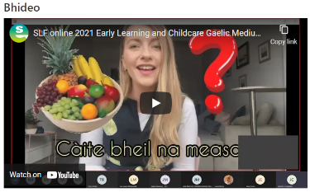
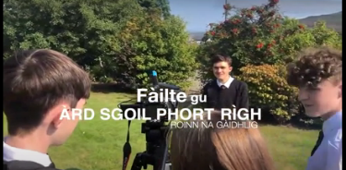
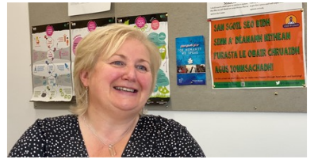
Sharing Effective Practice
Sharing scrutiny evidence on Gaelic Medium Education – early learning and childcare total immersion | Practice exemplars | National Improvement Hub
Sharing scrutiny evidence on Gaelic Medium Education - secondary curriculum | Practice exemplars | National Improvement Hub
Developing a Curriculum for Gaelic in Secondary – Greenfaulds High School | Practice exemplars | National Improvement Hub (education.gov.scot)
Airson luchd-ionnsachaidh na h-Alba, le luchd-foghlaim Alba For Scotland's learners, with Scotland's educators

Slide 31
Challenge questions
To what extent are senior leaders and staff critically engaging with the Advice on Gaelic Education and scrutiny findings to improve their outcomes for children and young people?
How do we ensure that improving provision for Gaelic is central to self-evaluation activity and part of impactful strategic planning for improvement?
What are our approaches to raising attainment and closing the poverty-related attainment gap across all areas of the curriculum?
How do we use our understanding of the social, economic and cultural context of the school to inform and shape planning for improvement?
In what ways do we gather and take account of a range of evidence on the quality of immersion we provide?
Airson luchd-ionnsachaidh na h-Alba, le luchd-foghlaim Alba For Scotland's learners, with Scotland's educators

Slide 32
Challenge questions
What actions are we taking to ensure learning and teaching is of a consistently high quality?
How effective is our use of digital technologies to enhance learning, deliver the curriculum and develop skills for learning, life and work?
What does equality and equity look like for the children and young people in Gaelic Medium and Learner Education?
The General Teaching Council for Scotland’s Professional Standards apply in English and Gaelic Medium Education, with four bespoke references to Gaelic across standards. How will you embed their use in your setting?
Airson luchd-ionnsachaidh na h-Alba, le luchd-foghlaim Alba For Scotland's learners, with Scotland's educators

Slide 33

Education Scotland, Longman House, 28 Longman Road, Inverness IV1 1SF
Airson luchd-ionnsachaidh na h-Alba, le luchd-foghlaim Alba For Scotland's learners, with Scotland's educators

