Slide 1
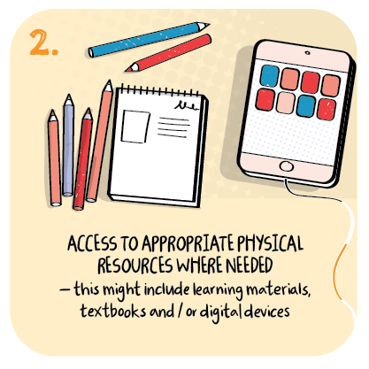

Access to physical resources
St Ninian’s Primary School, Glasgow City Council
>National overviews of practice<

Slide 2
St Ninian’s Primary School
The school provides paper packs of all materials, as well as writing materials such as jotters and pencils for all children as a matter of equity.
The headteacher used the Glasgow Accessibility Audit to identify and contact parents who do not have access to broadband and/or a digital device.
All children in P7 have iPads. The school is trying to supply as many digital devices as possible to all families.
The children in school in the ‘pods’ are doing the same learning as those at home, via school iPads.
After the experience of the previous lockdown, staff focused on digital skills for all children especially the children at the early stages, in case of another lockdown.

