Slide 1
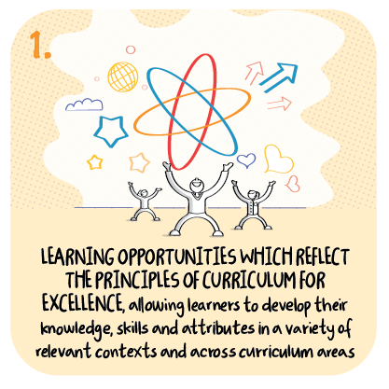

Wider curriculum delivery and plans for transition to secondary
St Stephen’s Primary School, Perth and Kinross Council
>National overviews of practice<

Slide 2
St Stephen’s Primary School
Whilst the remote delivery of literacy, numeracy, health and wellbeing and RERC was prioritised, commendably, opportunities for children to access learning include all areas of the curriculum.
This includes allowing children to choose aspects of the topic they would like to focus on and the method they wish to undertake and share their learning.
Staff are monitoring children’s work that is submitted, with a focus on feedback.
Senior leaders supportively encourage colleagues and are proactive in considering the best means for monitoring of learning experiences.
The following information has been shared from the school to further illustrate their approach.

Slide 3
Wider curriculum delivery
“In relation to the delivery of learning and teaching in 2021, we have developed strengths in ensuring that our provision went beyond the key curriculum areas of Languages, Mathematics, Health and Wellbeing and RERC. Colleagues have been able to provide a wider delivery in relation to the eight curricular areas. There are challenges with this, but it has been really good to see the innovative approaches from teachers in relation to art lessons, social studies and sciences.
There are certain cultural aspects of our curriculum, which by and large have had no significant impact to this phase. For example, the recitals of Scots and Burns poems yesterday online and their delivery at assembly on Friday online will largely be unchanged in comparison to this delivery in 2020 and previous years.
We have kept a routine to curriculum delivery insofar as Gospel whole school sessions are every Monday at 0930, we are now looking at how we devolve more of this to House Captains remotely to lead remotely, as they would be leading this if in the building.
In Early level children have enjoyed art lessons to tie in with local winter weather and writing tasks associated with this. Science lessons have also been delivered. We are focussing heavily on Sciences this year as a curricular area for development as a class teacher took part in the SSERC programme and we have since created our own progression framework.”

Slide 4
Wider curriculum delivery continued
“In First level, the focus is “Farm to Fork”. The class teacher has provided live planning lessons with learners. At these meetings, children identified areas of learning they are interested in. The class teacher has then looked at wider curriculum delivery through SeeSaw. The plans have subsequently led into health and wellbeing, technology and art. Learners have created – line drawings – 3D farm maps – which in turn has fed into writing and creating instructions for making healthy sandwiches. Feedback from the teacher is that engagement levels are high and that there has been wider family learning owing to the nature of the areas of creative learning experiences in the kitchen. She has then planned for looking at enterprise opportunities for jobs on the farm and linking this to our local area. Today saw food label scavenger hunts, to create active experiences and then record these digitally.
In Second level, the classes have had “virtual school trips” as the trip to Alloway will not go ahead. One teacher has used digital technology and photography in art lessons. This has allowed art lessons where children do not have access to art supplies at home.
Another class are focussing on a comparison study of Scotland with Spain – this supports our 1 plus 2 programme. They also have looked at art in relation to Spanish artists.
In school learning for vulnerable and key worker children has allowed for strong areas of health and wellbeing link to cooking.”

Slide 5
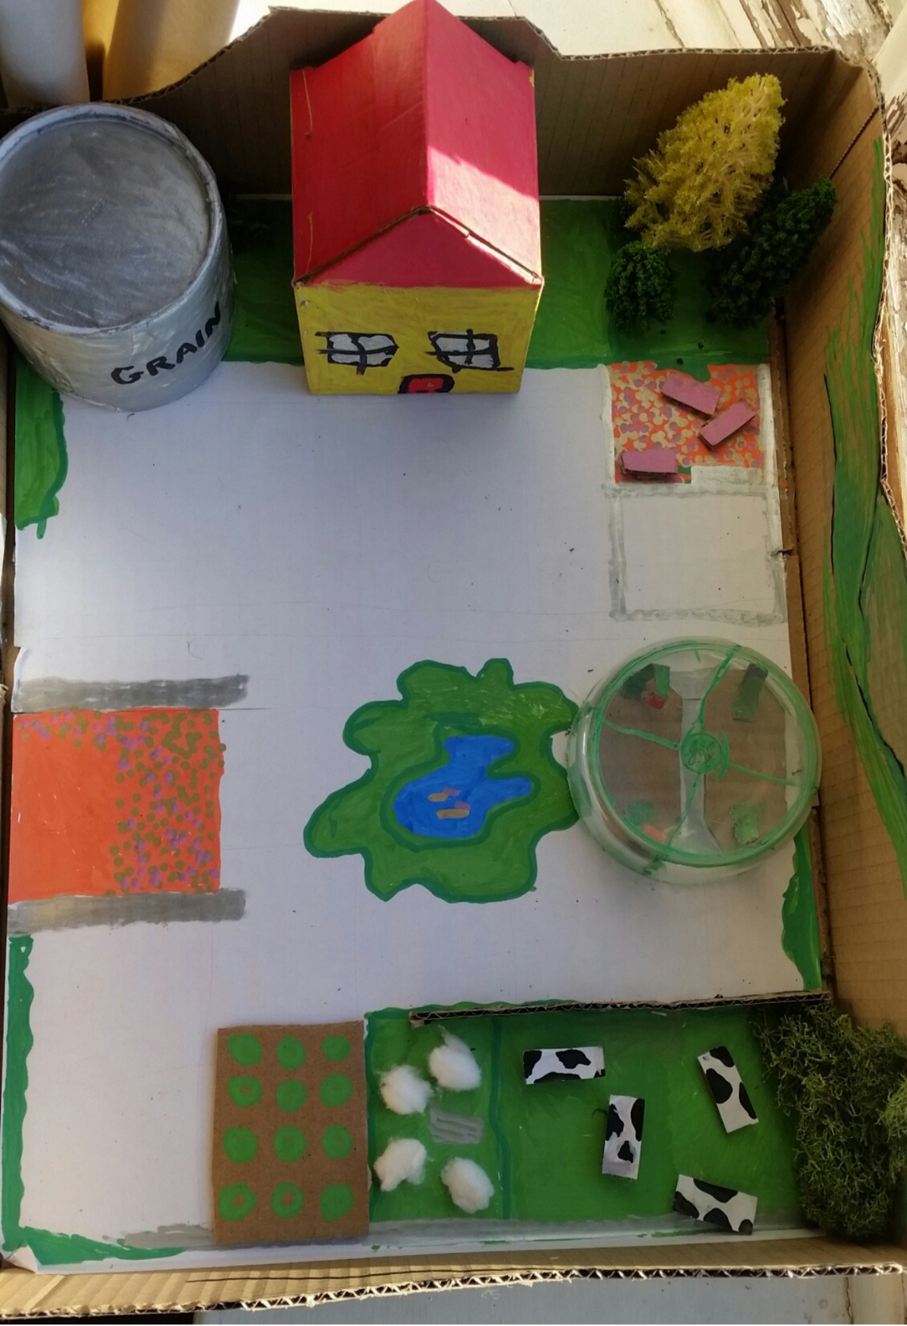
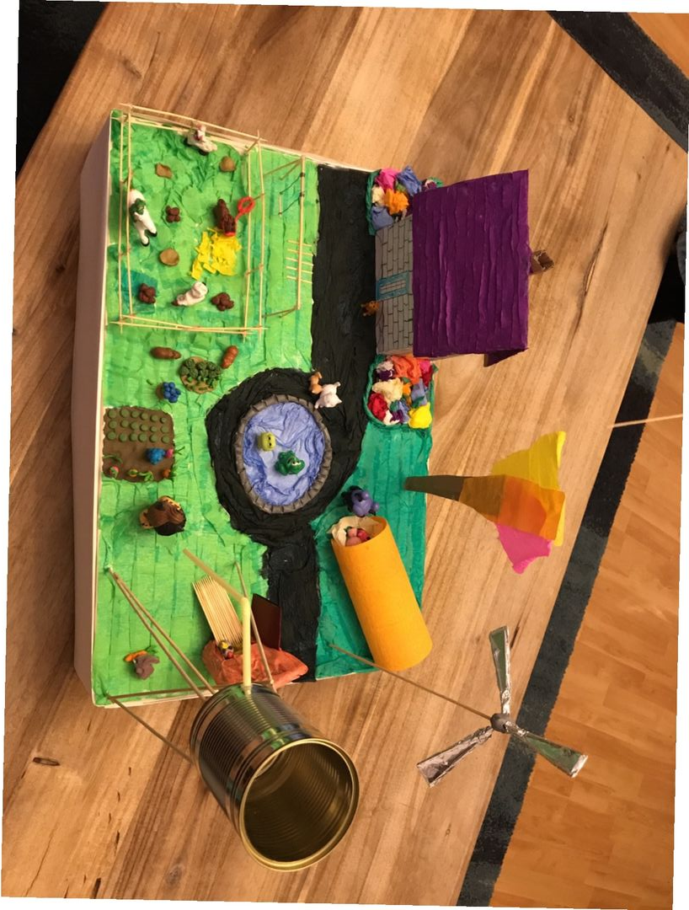
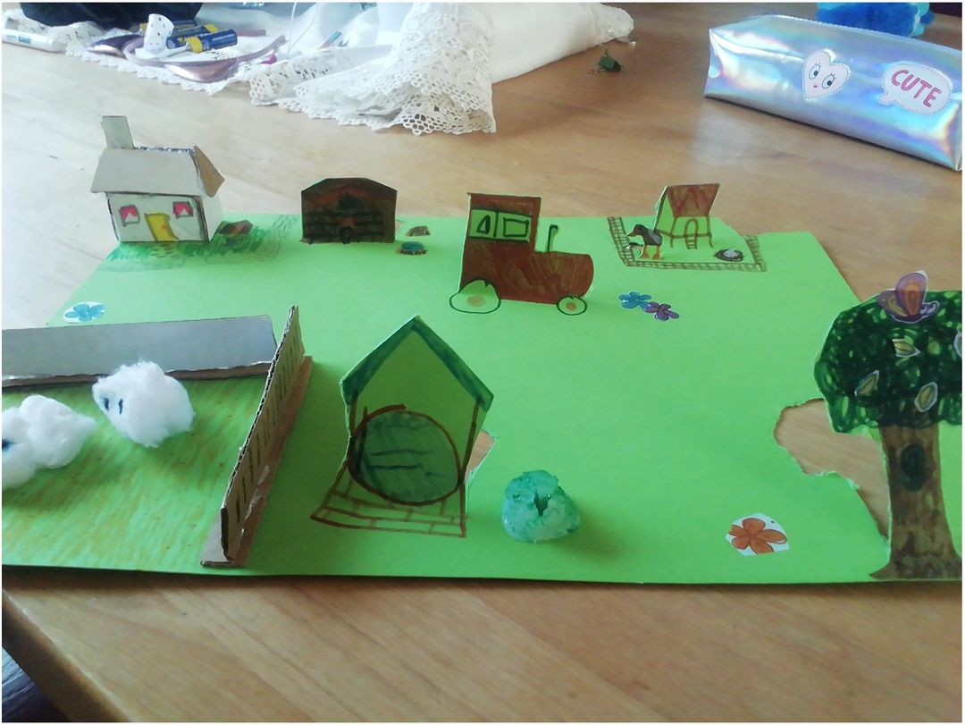
Examples of 3D farm maps that children at P2/3/4 created:

Slide 6
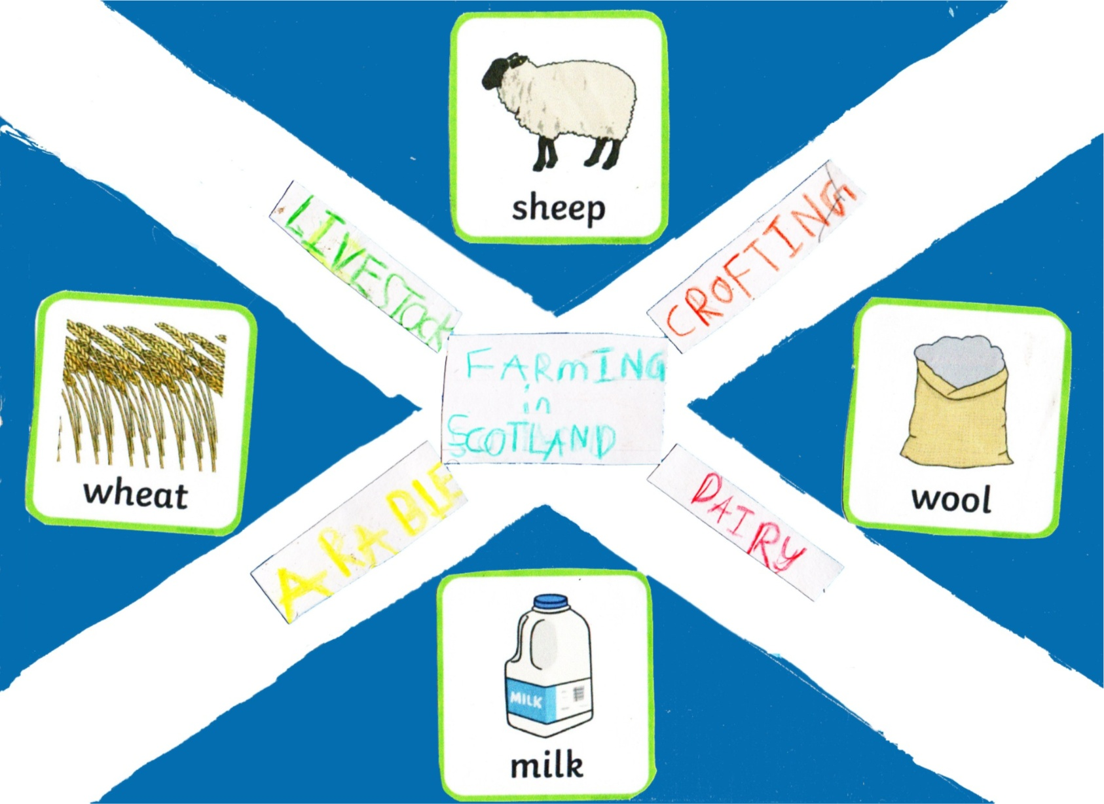
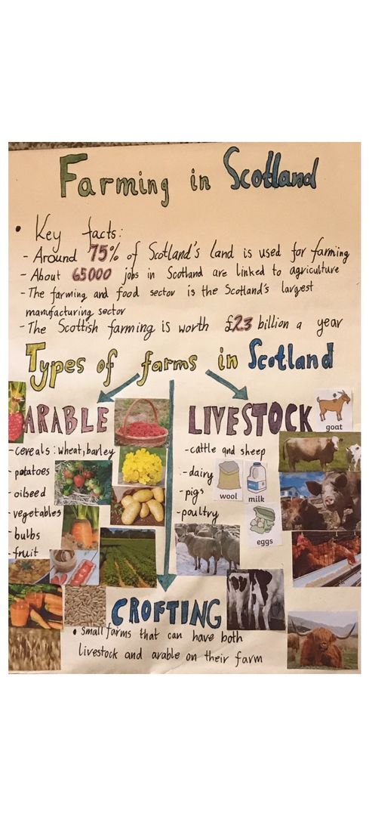
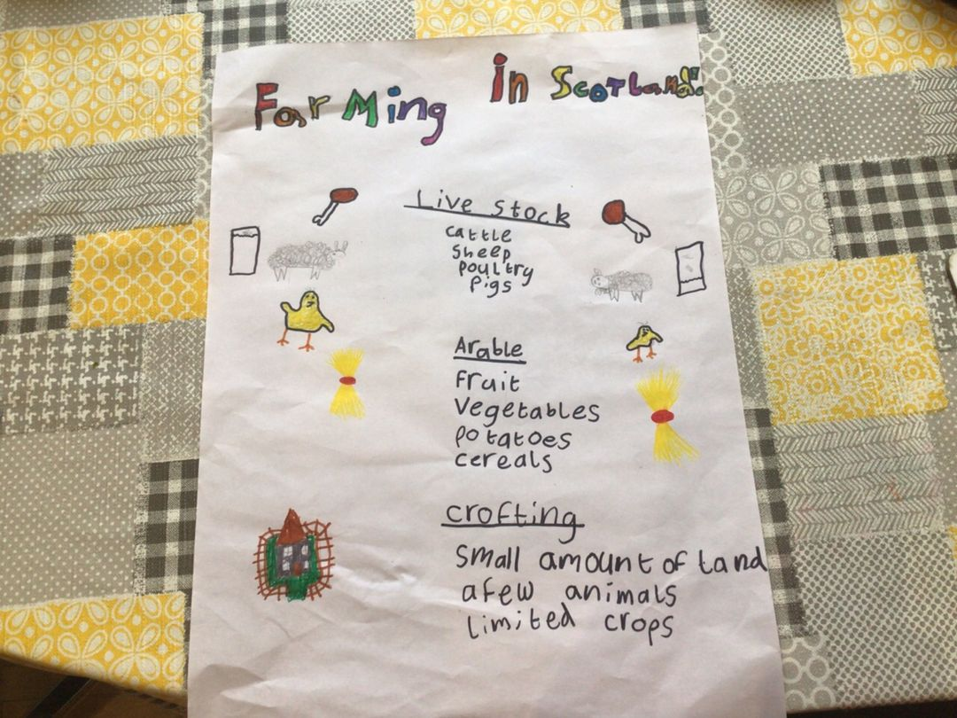
The class learned about the different types of farms we have in Scotland and created posters to display this information.

Slide 7
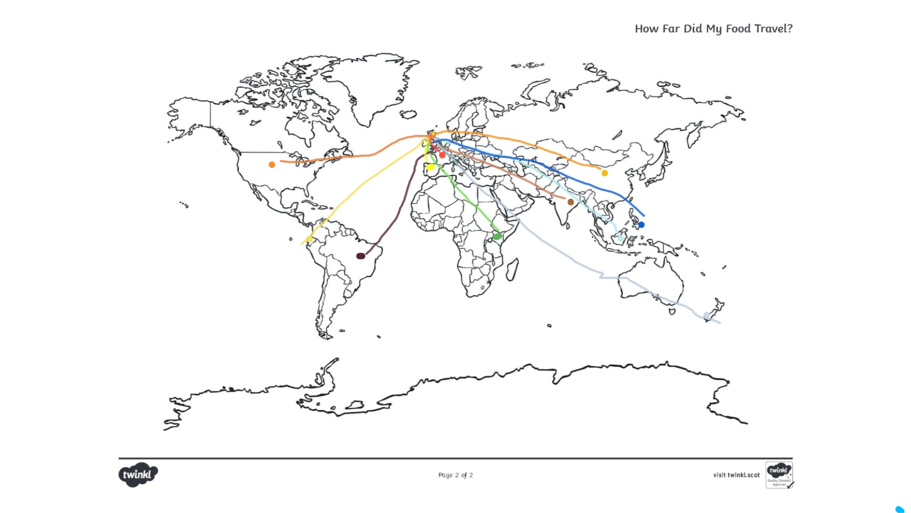
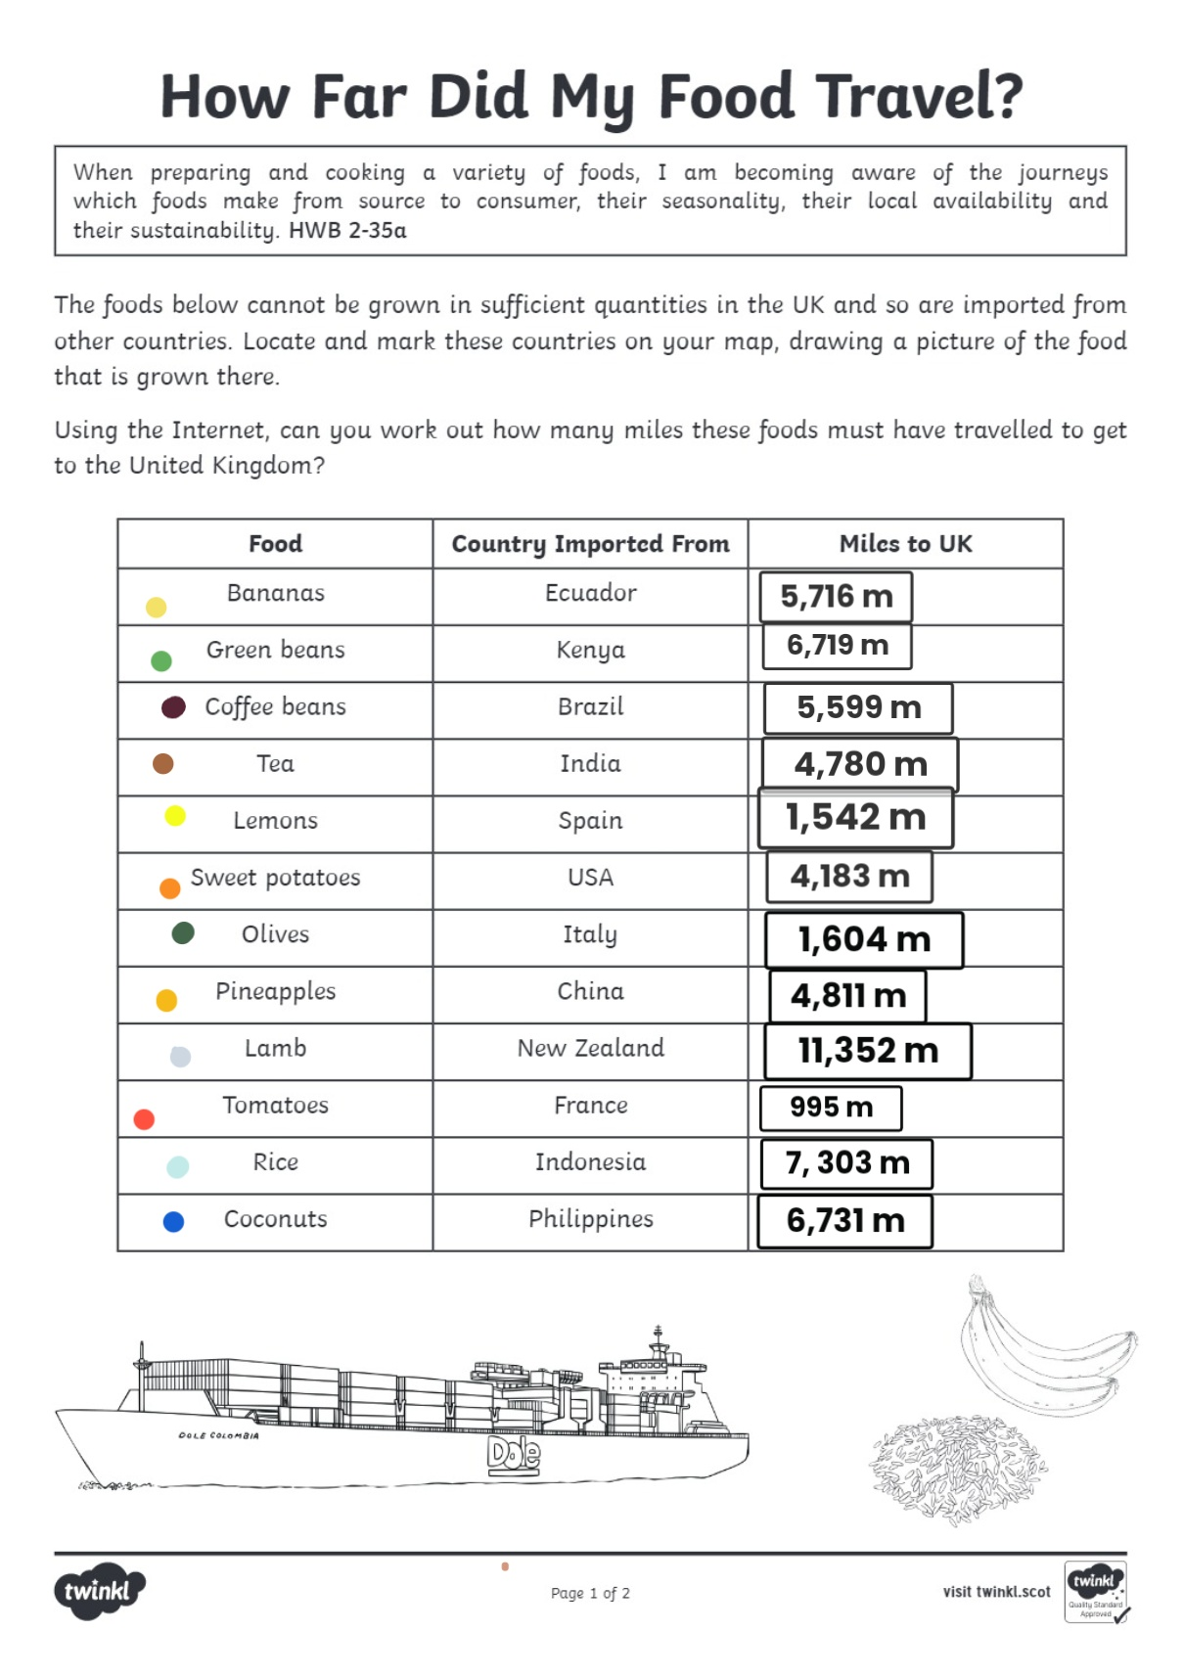
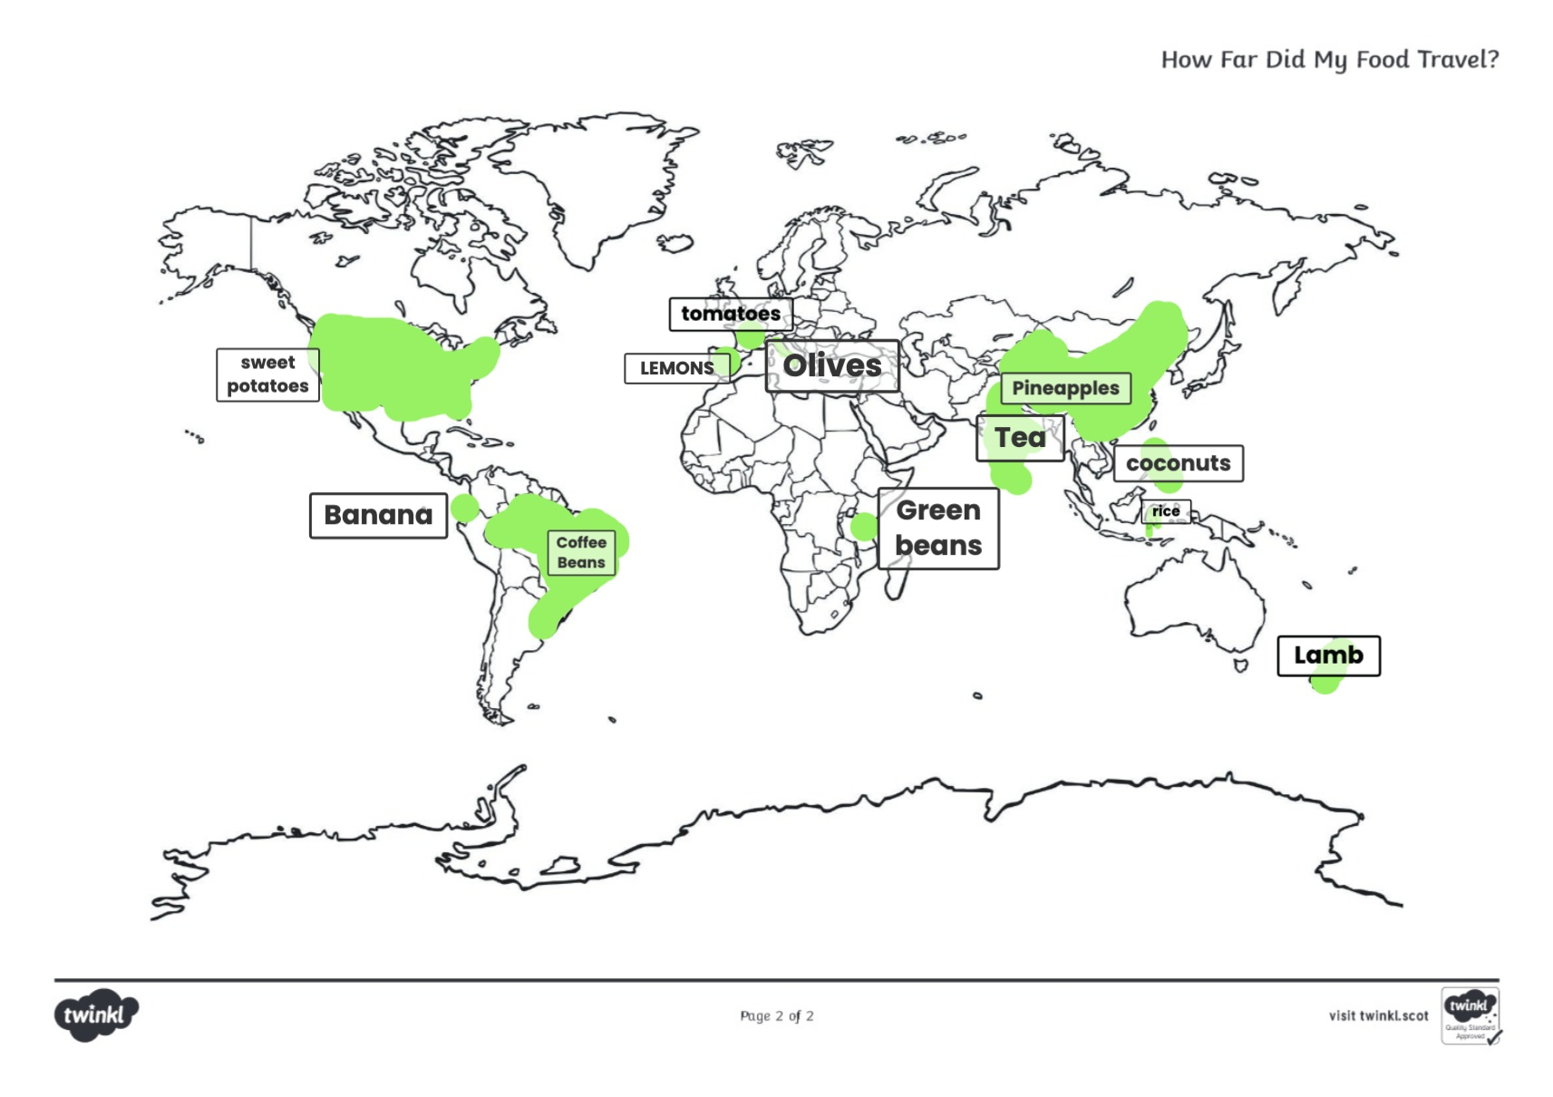
For Health and Wellbeing, learners investigated food journeys and how far food has travelled to get to us in Blairgowrie and how this supports domestic produce. Children researched distances and worked out where food comes from on maps:

Slide 8
For Health and Wellbeing, learners investigated food journeys and how far food has travelled to get to us in Blairgowrie and how this supports domestic produce. Children researched distances and worked out where food comes from on maps:

Slide 9
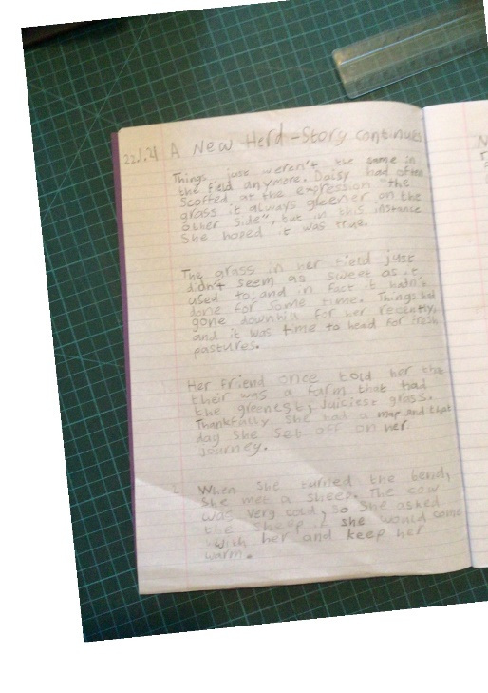
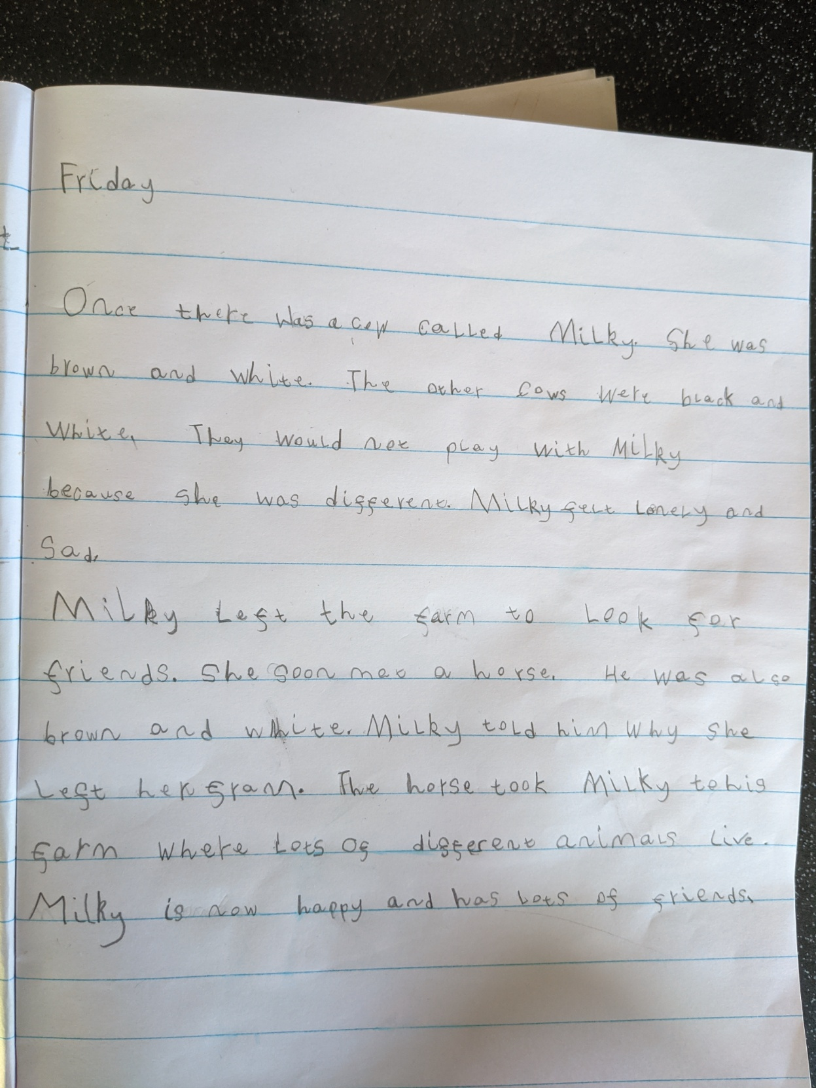
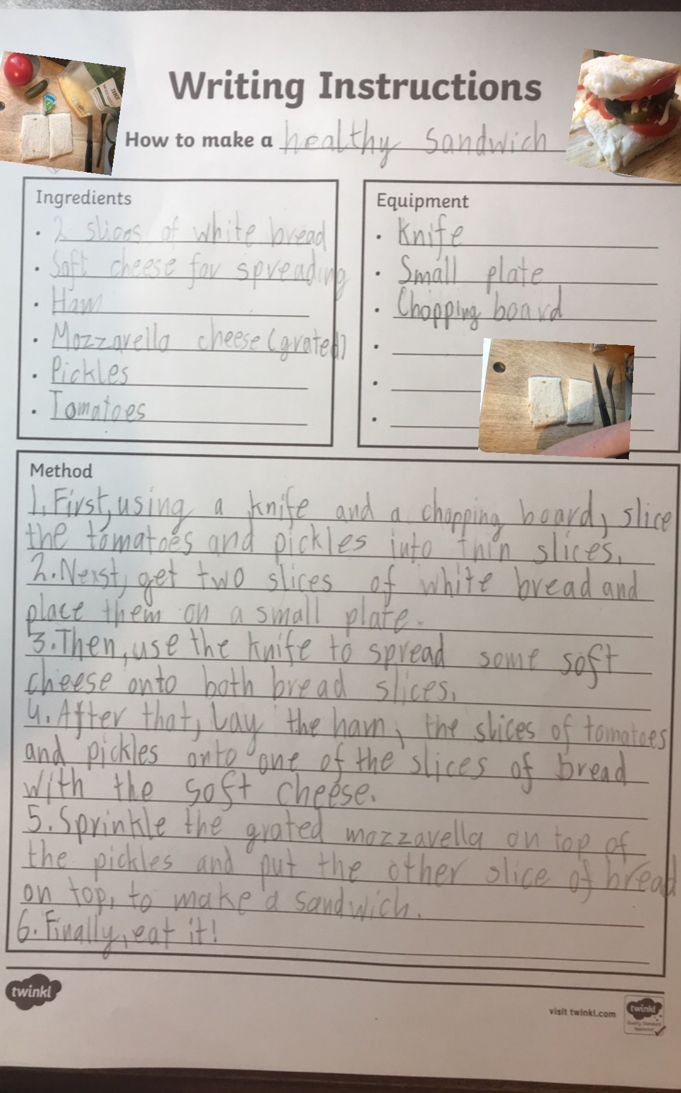
Learners then utilised their knowledge and understanding within a “Farming context” to produce imaginative and functional writing pieces:

Slide 10
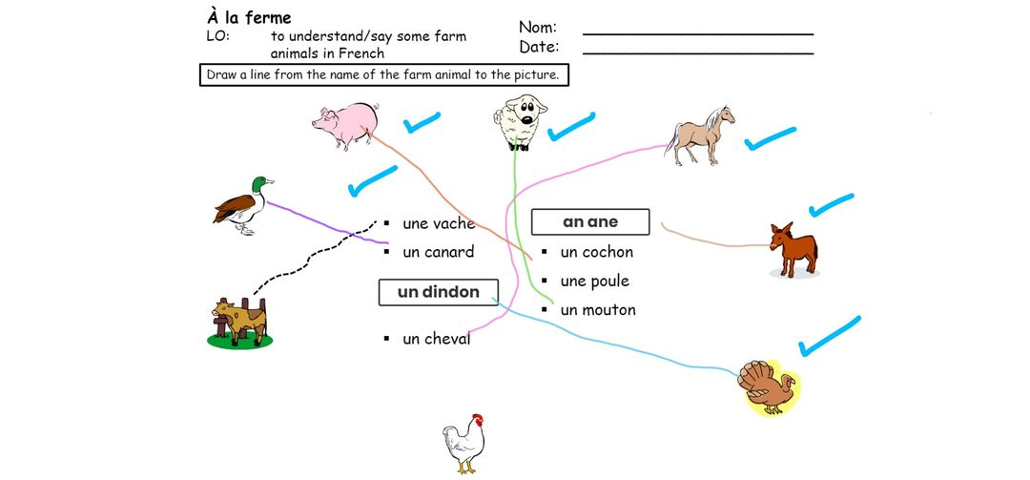
They learned the French vocabulary for farm animals .

Slide 11
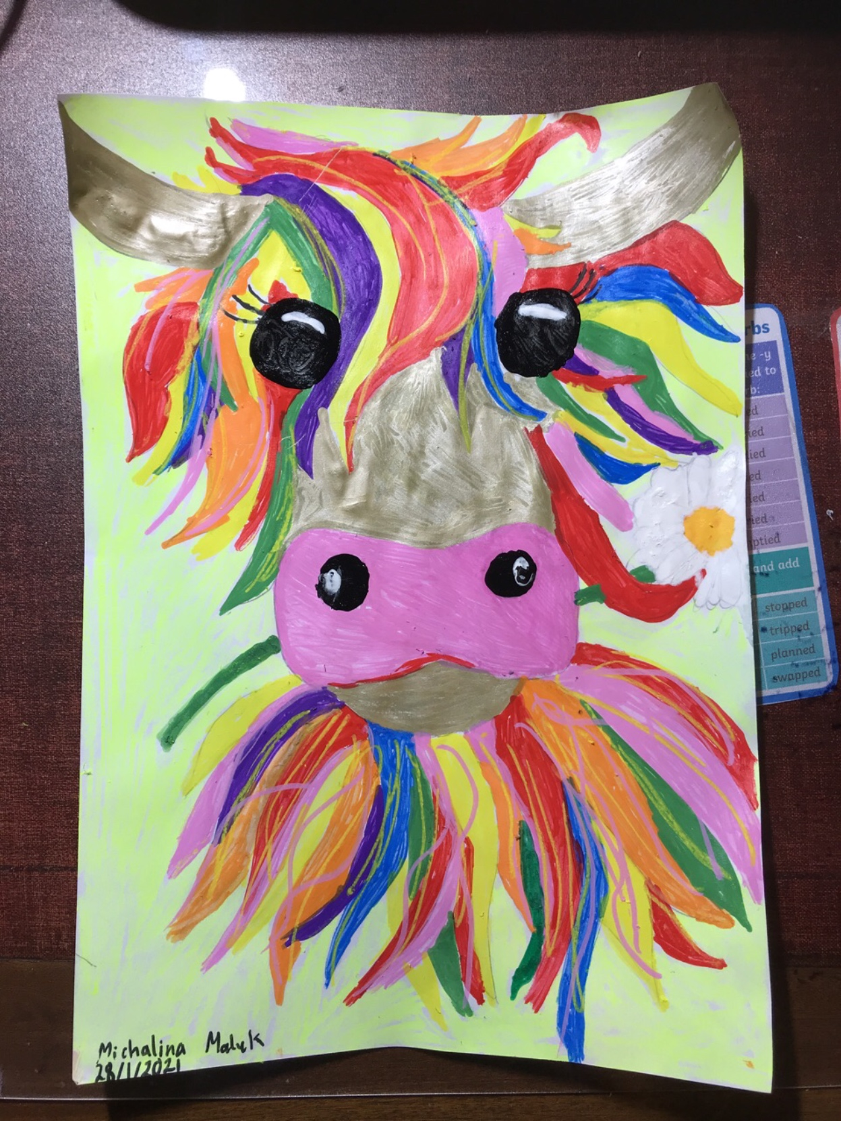
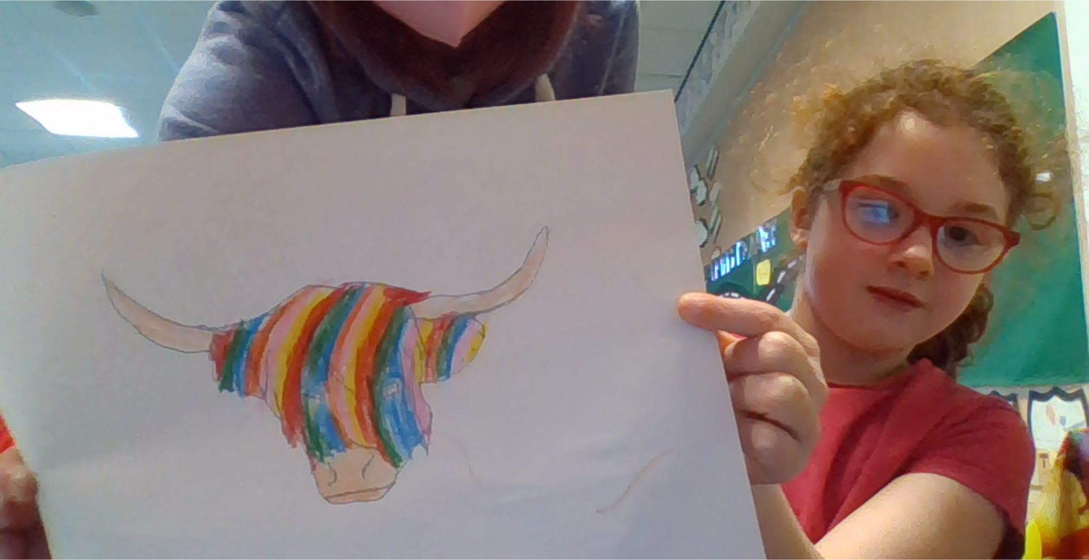
The class also created their own McCoos influenced by the work of Scottish artist Steve Brown:

Slide 12
Plans for transition to secondary
“For transition to secondary we are looking into an alternative to the cancelled residential, this may be a one day retreat in the circumstances. We will be looking into it as our trip to Iona has had to be cancelled.
We will be having Teams meetings with peers in S1 of St John’s who previously attended St Stephen’s to discuss learning in S1.
We hope this creates an insight into the similarities and differences. There are a number of future transition meets for certain learners also. We also hope to have House and Vice-Captain meets with learners from the other feeder schools.”

