Slide 1
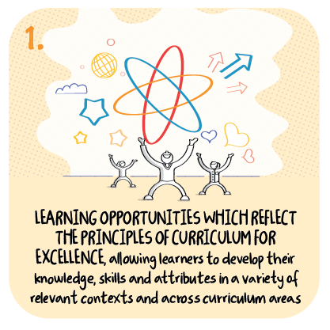

Learning outdoors and in the expressive arts
Braco Primary School, Perth and Kinross Council
>National overviews of practice<

Slide 2
Braco Primary School
Whilst the remote delivery of literacy, numeracy and health and wellbeing was prioritised, commendably, opportunities for children to access other areas of the curriculum include music, science or expressive arts learning episodes.
Very positively, teachers encourage children to be active and outdoors is part of the remote learning offer, to continue with their Forest School approach.
This includes allowing children to choose aspects of the topic they would like to focus on and the method they wish to undertake and share their learning.
Staff are monitoring children’s work that is submitted, with a focus on quality feedback. Senior leaders supportively encourage colleagues and link in with live lessons throughout the week.
The following information has been shared from the school to further illustrate their approach.

Slide 3
Outdoor Opportunities during Remote Learning
Outdoor learning is an integral part of the curriculum at Braco Primary School. We recognise it as a tool to enhance health and wellbeing whilst developing skills and supporting our children to become Successful Learners, Confident Individuals, Responsible Citizens and Effective Contributors. During our time of Remote learning, we recognise outdoor learning as an essential part of the curriculum to develop and build upon. Therefore, when providing our children with remote learning experiences we are acutely aware that they must have a balance of digital interactions, a chance to lead their own learning, to be creative and have opportunities to explore their outdoor environment. Braco school and nursery offer our learners outdoor learning opportunities such as engaging our community in an interactive bird trail using QR codes allowing learners to explore the sounds of birds and local walks in their community. Learners were asked to explore their creativity by building a snow sculpture to develop team building and leadership skills. Children built upon their data handling skills by engaging in bird surveys. In addition to this, to support numeracy they have been encouraged to use natural materials found in their gardens, e.g. sticks, for tasks such as counting and estimation and measuring.

Slide 4
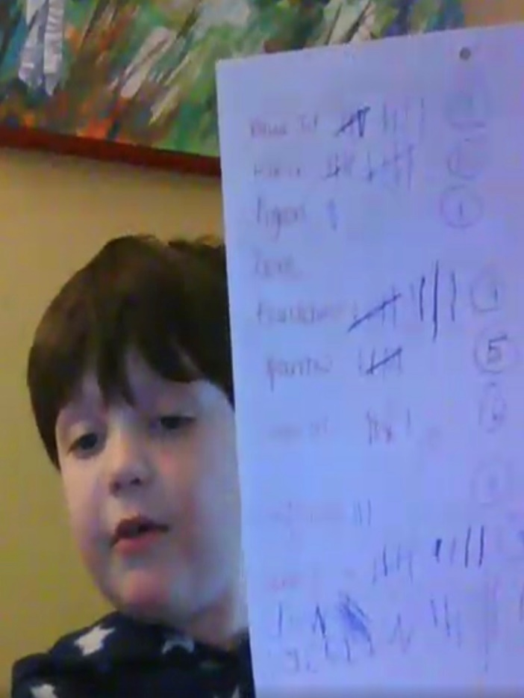
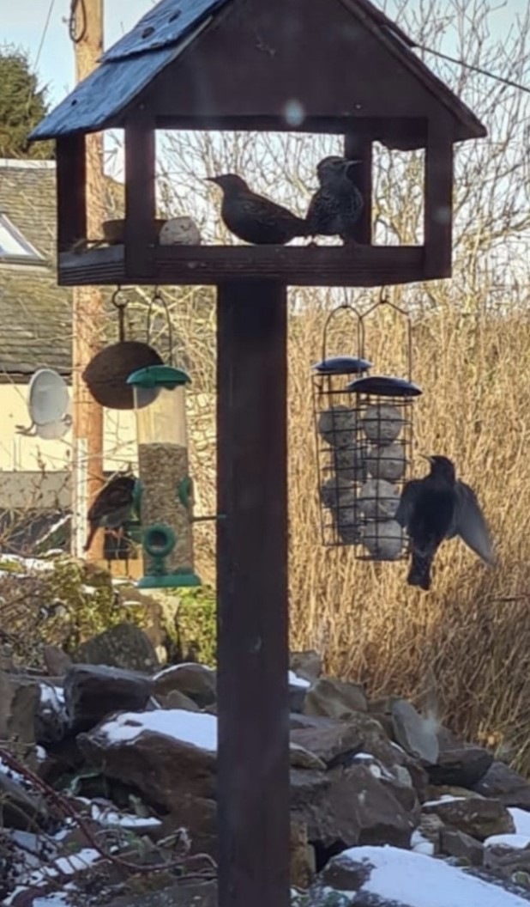
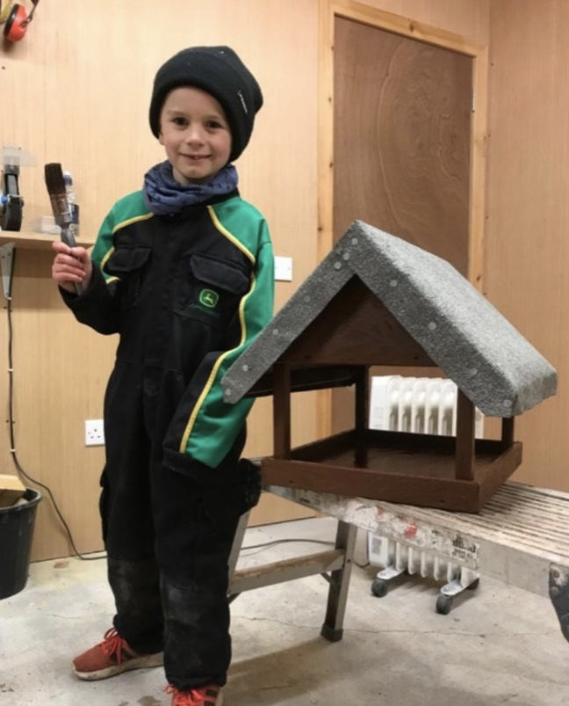
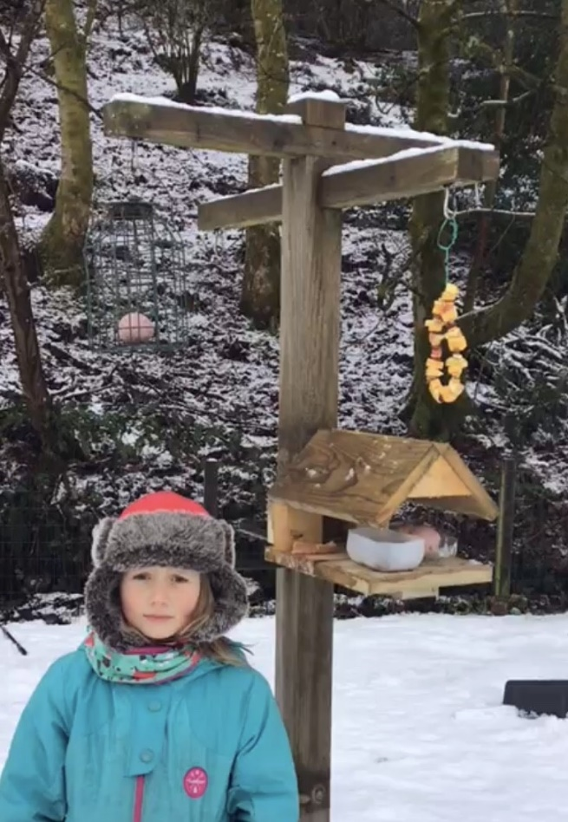
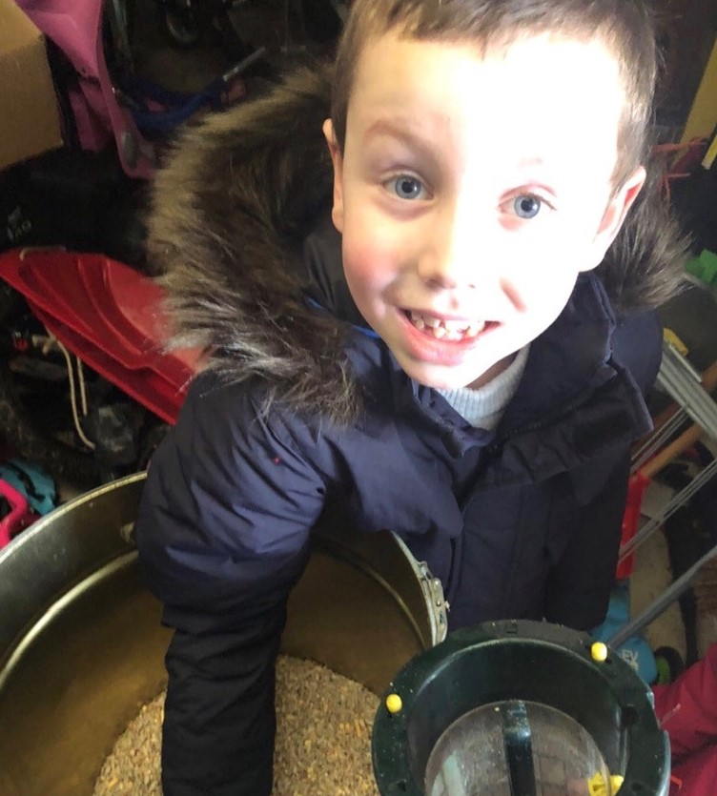

Slide 5
Expressive Arts Opportunities during
Remote Learning
During our first Lockdown experience it was noted the expressive arts were a way that many of our children looked after their mental health and wellbeing. This has been built upon by providing opportunities for our learners to demonstrate their creativity and express their emotions through music and art. Pre-recorded Art lessons have provided our learners with opportunities to experiment with colour and collage using their natural environment or materials such as junk mail and also to learn about famous artists providing opportunities for personal research. Live music lessons have been a particular hit with our P6/7 class who have been exploring different types of song, bothy ballads, Gaelic walking songs and using Makaton. We are all looking forward to seeing our Scots Poetry Finalists perform live on our digital learning platform at our Scot’s assembly.

