Slide 1
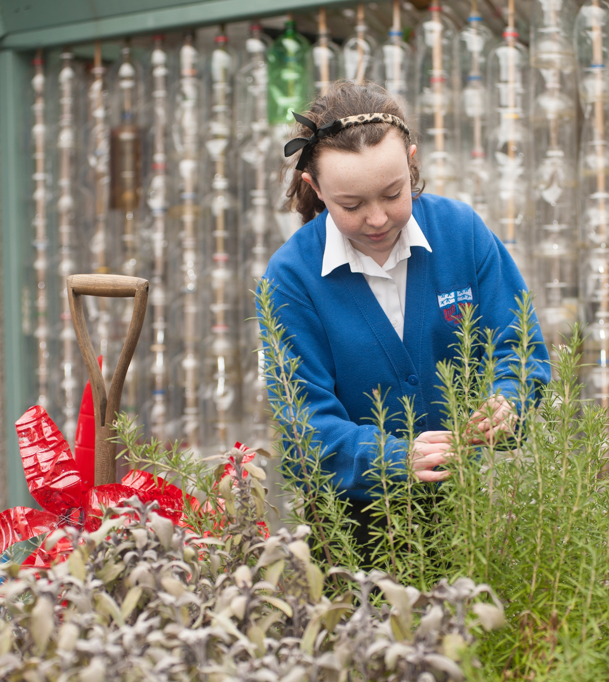

For Scotland’s learners, with Scotland’s educators
Inspection Findings: Developing the Young Workforce
2018-19
Notes:
This is a front cover page and can only be used once. Use the corresponding green internal and back pages if you are using this page. You may add a title and a subtitle if needed only. Do not add anything else or move elements around.

Slide 2
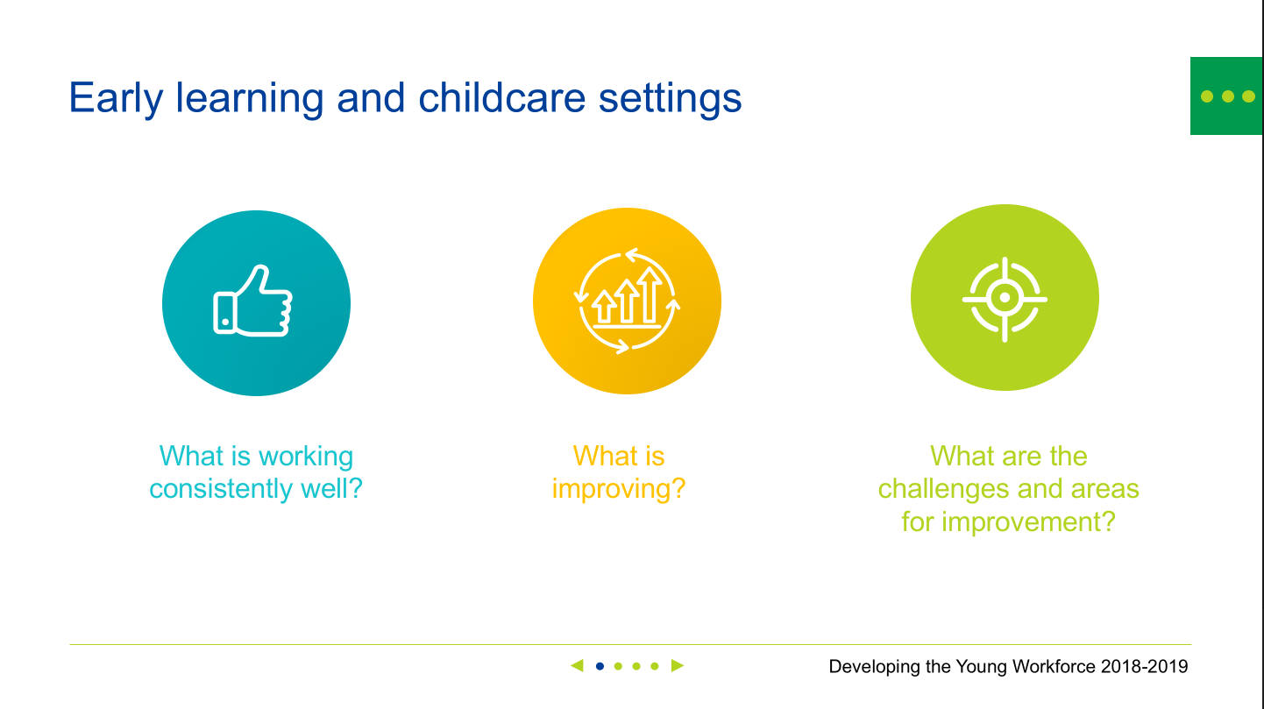

How does this presentation work?
  Quickly navigate to different
  sections by using the menu at
  the top left hand corner.
This presentation is designed to enable you to view and revisit sections depending on your focus and how much detail you would like.
It has a number of interactive features and menus to enhance your navigation through the presentation. It can also be used as a standard click through.
Make sure you view in slide show mode to benefit from the interactive features.
◀ • • • • • ▶
Click these buttons to navigate to areas of interest within each QI
What is working consistently well?
Use the navigation to move forwards or backwards through the slides.
Notes:
This is a front cover page and can only be used once. Use the corresponding green internal and back pages if you are using this page. You may add a title and a subtitle if needed only. Do not add anything else or move elements around.

Slide 3

Overall inspection findings: Developing the Young Workforce
Examples across all sectors of staff supporting children and young people well to develop skills for learning, life and work.
Strategic leadership within secondary schools for the development and implementation of the priorities of DYW has improved overall.
The pace of progress continues to be too slow and implementation is not yet consistent across schools/settings.

Slide 4
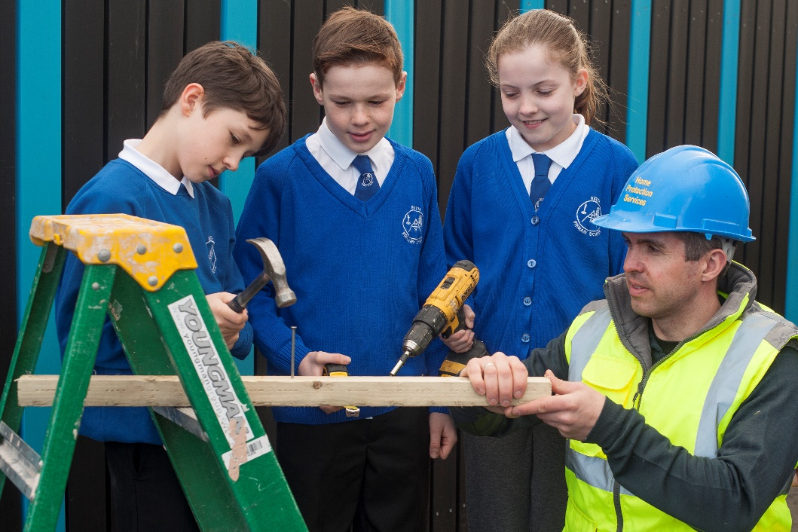
Inspection evidence
Early learning and childcare settings
Primary schools
Special schools
Secondary schools

Slide 5


Early learning and childcare settings
What is working consistently well?
What is
improving?
What are the challenges and areas for improvement?
◀ • • • • ▶

Slide 6
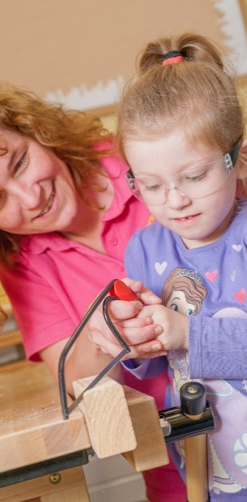
What is working consistently well?
Early learning and childcare settings
Children benefit from opportunities to engage in imaginative play which helps to develop their understanding of the world of work.
Practitioners, in consultation with children, develop play-based contexts which enable children to explore different jobs.
EARLY LEARNING AND CHILDCARE SETTINGS
◀ • • • • ▶

Slide 7
What is improving?
Early learning and childcare settings
Increasingly, practitioners are encouraging children to learn about a wider range of careers, for example, in architecture and science.
Positive relationships are developing with local businesses and community resourCareer Education Standard 3-18 which help to promote children’s understanding of the world of work.
EARLY LEARNING AND CHILDCARE SETTINGS
◀ • • • • ▶

Slide 8
What are the challenges and areas for improvement?
Early learning and childcare settings
Further development of children’s understanding of how the skills they are learning link to the world of work.
Development of partnership working with employers to increase the number and range of partners and support the curriculum and develop children’s skills.
Increased use of the Career Education Standard 3-18 to integrate learning about a diverse range of careers into children’s play.
EARLY LEARNING AND CHILDCARE SETTINGS
◀ • • • • ▶

Slide 9
Primary schools
What is working consistently well?
What is
improving?
What are the challenges and areas for improvement?
◀ • • • • ▶

Slide 10
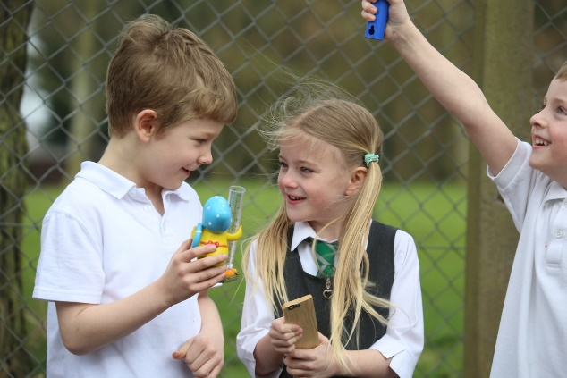
What is working consistently well?
Primary Schools
Teachers provide useful learning opportunities through a variety of planned experiences, including real-life contexts within local communities.
Children benefit from opportunities to learn about the skills required in a range of careers and professions and in the best practice, they talk confidently about life and work skills.
PRIMARY
SCHOOLS
◀ • • • • ▶

Slide 11
What is improving?
Primary Schools
Positive progress in supporting children to understand and develop skills for learning, life and work.
Increasing focus on engaging parents and partners in talking about their work.
PRIMARY
SCHOOLS
◀ • • • • ▶

Slide 12
What are the challenges and areas for improvement?
Primary Schools
Using the Career Education Standard 3-18 so children can learn about a wider range of careers.
Developing and embedding DYW and skills for learning, life and work within the curriculum.
Developing a progressive skills framework to support tracking of skills for learning, life and work.
PRIMARY
SCHOOLS
◀ • • • • ▶

Slide 13
Special schools
What is working consistently well?
What is
improving?
What are the challenges and areas for improvement?
◀ • • • • ▶

Slide 14
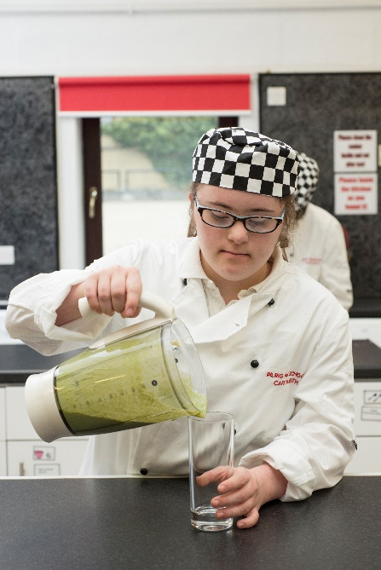
Special Schools
What is working consistently well?
The focus on developing skills for learning, life and work supports young people to sustain post school destinations.
Partnership working with business and industry to support children and young people to learn in meaningful real-life contexts.
The focus on improving communication, self-regulation and independent living skills for those learners with the most complex additional support needs.
SPECIAL
SCHOOLS
◀ • • • • ▶

Slide 15
Special Schools
What is improving?
The development of productive links with businesses and local colleges providing more bespoke pathways and opportunities for learners in the senior phase to achieve vocational qualifications.
Work with Skills Development Scotland is helping staff and learners to gain knowledge of local labour market intelligence and tailor learning pathways accordingly.
SPECIAL
SCHOOLS
◀ • • • • ▶

Slide 16
Special Schools
What are the challenges and areas for improvement?
Making the link with skills for work more explicit in planning learning.
Making better use of the Career Education Standard 3-18 to ensure children and young people have access to experience of the world of work.
Making better use of the Work Placement Standard to ensure the quality of work-based learning experiences for young people.
SPECIAL
SCHOOLS
◀ • • • • ▶

Slide 17
Secondary schools
What is working consistently well?
What is
improving?
What are the challenges and areas for improvement?
◀ • • • • • • • • • • • ▶

Slide 18
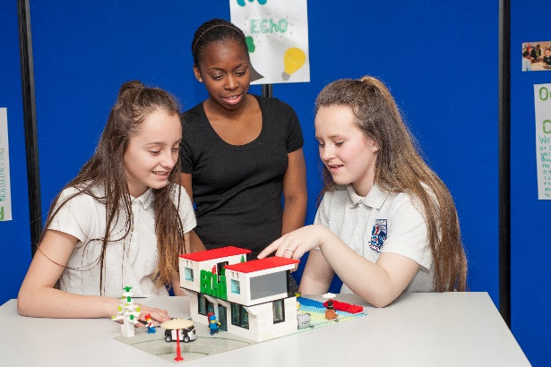
Secondary Schools
What is working consistently well?
Strategic leadership for the development and implementation of the priorities of DYW has improved overall.
Young people value the experience of the world of work provided in the senior phase.
Young people have opportunities to achieve more widely, develop their skills for learning, life and work, and support creativity and employability.
SECONDARY
SCHOOLS
◀ • • • • • • • • ▶

Slide 19
What is working consistently well?
Young people benefit from wider choice of learning pathways through effective and agile partnership-working with local colleges, CLD and third sector providers.
Schools have strengthened partnerships with local employers
Young people have good access to careers advice and guidance services
SECONDARY
SCHOOLS
◀ • • • • • • • • ▶

Slide 20
What is improving?
Staff awareness of DYW priorities has improved as a result of focused career-long professional learning (CLPL).
An increasing number of young people are using My World of Work resources for career planning and access to positive destinations.
SECONDARY
SCHOOLS
◀ • • • • • • • • ▶

Slide 21
Secondary Schools
What are the challenges and areas for improvement?
Increasing the pace of progress and consistency of implementation across curriculum areas.
Linking learning activities to the needs of the local and national economies.
Aligning school improvement plans and DYW plans to support progress in implementation.
SECONDARY
SCHOOLS
◀ • • • • • • • • ▶

Slide 22
Secondary Schools
What are the challenges and areas for improvement?
Ensuring the impact of professional learning about DYW on learning and teaching practice.
Using the Work Placement Standard to relate young people’s learning on work placements to their wider learning in school.
Supporting staff to embed Career Education Standard 3-18 and MyWoW within lessons.
SECONDARY
SCHOOLS
◀ • • • • • • • • ▶

Slide 23
Secondary Schools
What are the challenges and areas for improvement?
Involving partners in the use of data to plan for improvement and design and evaluate the curriculum.
Monitoring young people’s development of skills through personal achievement activities and linking these skills development to their wider learning.
SECONDARY
SCHOOLS
◀ • • • • • • • • • ▶

