Slide 1
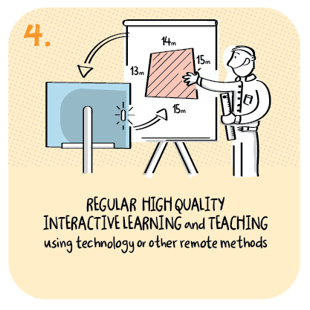

Using data to inform flexible approaches
Kilpatrick School,
West Dunbartonshire Council
>National overviews of practice<

Slide 2
Kilpatrick School
The headteacher uses quantitative and qualitative data to help staff provide personalised learning for children and young people. The headteacher reports that clear, shared expectations have led successfully to staff using flexible approaches to meet individual children’s needs. A recent survey of parents and learners identified clearly the need for children and young people to see teachers, peers and to feel connected. This led to staff delivering more live and recorded lessons and encouraged creative approaches, for example using green screen technology, which the school reports is well received by parents.
Additionally, staff are using interactive class apps and creative live sessions using jamboards, boardmaker symbols and face to face meetings with pupils enabled everyone’s voice to be heard. Sharing ideas and solutions at professional learning twilights has supported staff to offer younger children opportunities to learn alongside their parents.
Data also identified a range of practical issues, for example access to equipment and learning packs, that were resolved quickly.
The school has used data gathered from weekly engagement surveys to identify groups of children and young people who were not engaging with learning. As a result, they have put in place personalised arrangements which have increased children’s and young people’s engagement in learning and improved their wellbeing. The headteacher reports that almost all learners have now accessed class meetings, live lessons, and recorded lessons.
Staff report that the regular and focused gathering of data from parents and learners has improved home school communication. The school plans to build on this learning, and retain and develop approaches developed during remote learning

