Slide 1
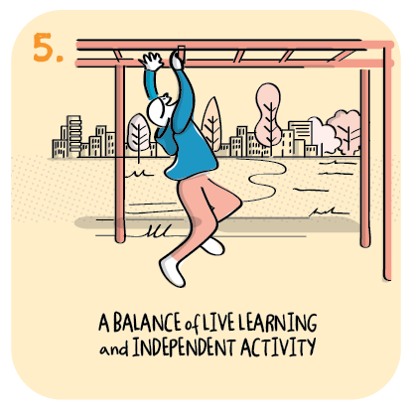

Listening to parents and children to increase motivation and engagement
Cunningsburgh Primary School, Shetland Islands Council
>National overviews of practice<

Slide 2
Cunningsburgh Primary School – case study
Staff at Cunningsburgh Primary School built on their strong relationships with parents and carers to inform their approach to engaging and motivating learners. Gathering the views of parents and carers and taking these into consideration when designing remote learning is one of the main areas that has made a difference in increasing motivation, participation and engagement in learning. The headteacher values parents’ and carers’ input as key to ensuring children engage with the school during lockdown.
The school has been able to address the challenges that parents and carers had identified during the first lockdown in 2020, and to build on successes. Many parents and carers felt that learning away from a screen was just as valuable as online learning. Therefore, between August and December 2020, staff focused on developing and encouraging children’s independent learning skills.
They created an ‘independent learning folder’ covering all curricular areas and used it in class. Staff feel this was good preparation for the current context, as children were used to working through a programme of work independently and subsequently have been able to replicate this routine at home. In addition, the headteacher responded to individual children’s and families’ needs by promoting teacher contact either in small groups or by one-to-one support to motivate and encourage participation. Staff wrote to younger children at home and delivered ‘play packages’ to motivate and encourage engagement in learning and to maintain a level of individual contact for children with their teacher. School staff continue to monitor individual participation and take steps to engage with families if a child needs further encouragement and support.

