Slide 1
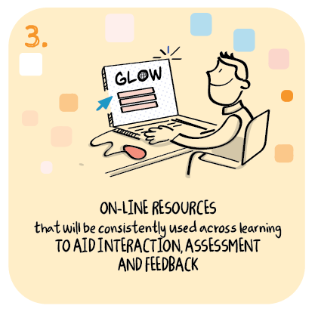

Local authority support for schools in the consistent use of digital resources
Angus Council
>National overviews of practice<

Slide 2
Angus Council
In August 2020 a small team of ‘digital officers’ were appointed to support remote learning and enhance the professional learning offer and work of the Angus Virtual School (AVS).
Angus Council has taken a collaborative approach to quality assuring the effectiveness of remote learning, building on existing quality improvement approaches and system leadership through the AVS.
Headteachers collaborate in triads or quads to support collective improvements. Since August 2020, these grouping have continued to meet in these well- established forums, to discuss and peer review the quality of remote learning.
Headteachers report that this approach is enabling the sharing of issues and approaches which is helping to improve consistency.
An AVS officer and a digital officer facilitate these triad/quad meetings. The authority recognises the value of digital officers continuing to have a teaching commitment, as they are draw on their own experience and expertise to inform the professional learning needs of the wider workforce.

Slide 3
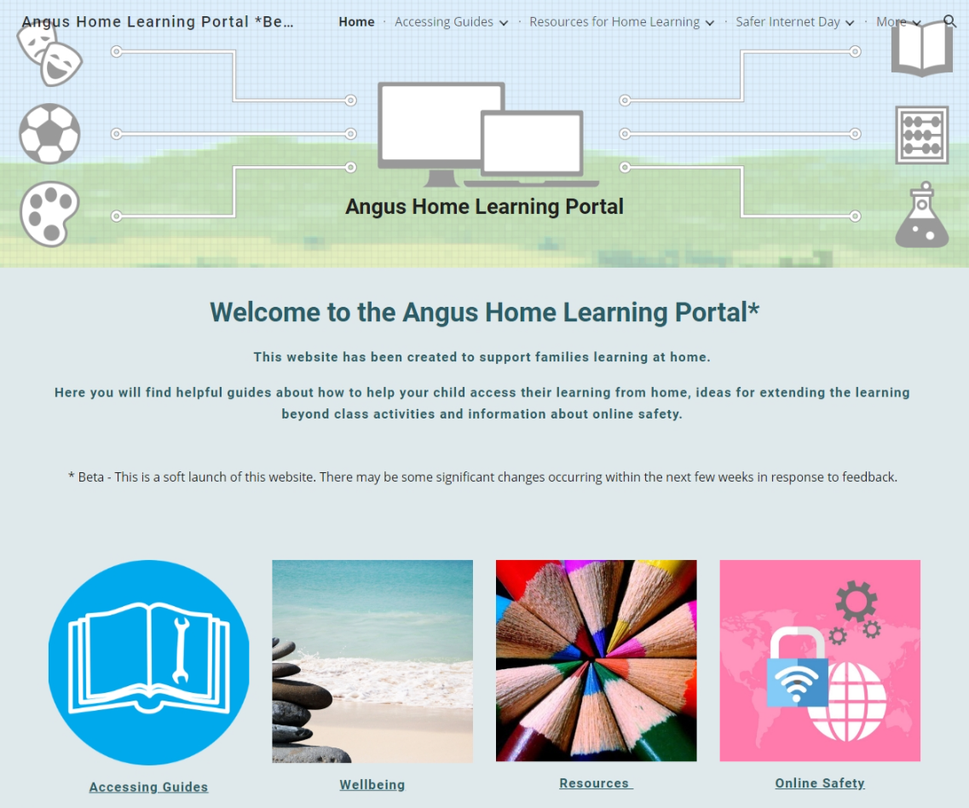
Angus Council have developed a home learning portal to support families learning at home.
Visit:
https://sites.google.com/an.glow.scot/angus-home-learning-portal/home

Slide 4

Practitioners in Angus are being supported to use consistent online resources during this period of remote learning through the newly developed #AngusDigiLearn website.
Visit:
https://sites.google.com/an.glow.scot/angusdigilearn/home

