Slide 1
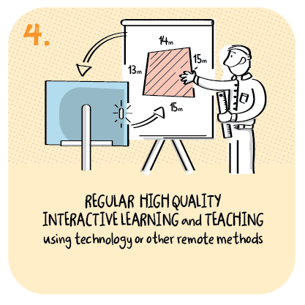

Monitoring engagement through shared lesson observations
Douglas Academy,
East Dunbartonshire Council
>National overviews of practice<

Slide 2
Douglas Academy – case study
Staff at Douglas Academy have built on their existing practice of shared lesson observations, adapting approaches to focus on learner engagement during remote learning. The school had previously introduced a collaborative enquiry model which supports teaching staff to conduct lesson observations with the purpose of reviewing and improving the quality of learning and teaching. They have adapted this approach to observe remote learning. A small group of staff meet to agree a focus in the form of a question. Each member of staff in turn teaches a lesson while the rest of the group observe a young person involved to review their experience of, and participation in, learning and teaching.
Observing staff use the agreed focus as the basis for evaluating the young person’s learning experience. After each lesson, staff share observations and identify learning and teaching approaches and strategies which positively impacted on individual learner’s participation, motivation and engagement in the lesson. This information is then used to plan appropriate resources, learning tools and approaches in future lessons. Once all of the lesson observations are completed, staff share their overall findings and conclusions with the wider staff team. Collectively, they use these findings to identify whole school action points to improve learner’s experiences overall, which results in positive impact on engagement, participation and motivation.

Slide 3
Douglas Academy continued
As staff continue to adapt to using digital platforms as a key tool in remote learning, this approach has allowed staff to build confidence and be creative in a safe and supported environment. Using online observation, staff focus on a range of indicators of engagement, such as whether young people unmute during live lessons to make comments, how well they answer questions and their interaction with other young people during group work. The first question constructed for enquiry was: “what can teachers do to enhance pupil engagement and develop young people’s accountability and independent learning skills?”. Staff have already reported different strategies and approaches which are having a positive impact on young people and are gathering findings and evidence to share with staff.
This approach is empowering staff to lead school improvement which is based on the needs and responses of young people within their school community. This has resulted in continuous conversation about how the experience of learners can be improved within the remote learning context. Monitoring of learner engagement in this way enables the school to show positive trends in improved participation by specific cohorts of pupils. The school team is reflecting on how they continue to adapt and use this model as pupils return to school.

