Slide 1
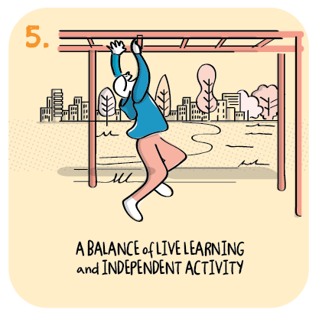

Remote learning journey
Muiredge Primary School,
South Lanarkshire Council
>National overviews of practice<

Slide 2
Muiredge Primary School
The school’s strategic approach has increased the engagement and participation of families in remote learning.
Moving homework onto google classroom, and effective contingency planning from August 2020 has increased the confidence and skills of parents and children in learning remotely.
As a result engagement and participation in learning is high.
The headteacher feels participation is high as the content, teaching and activities are now high quality learning experiences, having developed from initial online registration and whole school activities to individuals teaching whole classes live twice per day.
Following live lessons teachers target specific groups and individuals to work with.
Initially the school rightly focused on the delivery of core learning. They now offer IDL contexts that are school wide.
A particular strength has been the school’s ability to sustain their whole school passion for music.
Whole class live teaching, followed by group and individual support for children is working well.
The following information has been shared from the school to further illustrate their journey.

