Slide 1


Supporting wellbeing
Aberdeen City Council
>National overviews of practice<

Slide 2
Aberdeen City Council
The wellbeing of staff is a central focus for Aberdeen City Council. How staff are supported has been reviewed and addressed to enable them to have the strength, skills and abilities to manage their own wellbeing and that of others. The Building Capacity Team, within the Quality Improvement Team, has played a significant role in supporting staff and wider school communities during the pandemic. Working closely with internal and external partners, including professional learning, probationer support and support for health and wellbeing has been vital.
Sways have been produced which focus on identified areas of the health and wellbeing curriculum, supporting a system-wide approach to wellbeing during lockdown and the return to in-school learning. As well as examples of professional learning for staff, there are also newsletters for parents on the parent learning hub. Examples include wellbeing and learning outdoors in the early learning and childcare Sway, or supporting inclusive practices.
The following information has been shared by the local authority to illustrate some of this work.

Slide 3
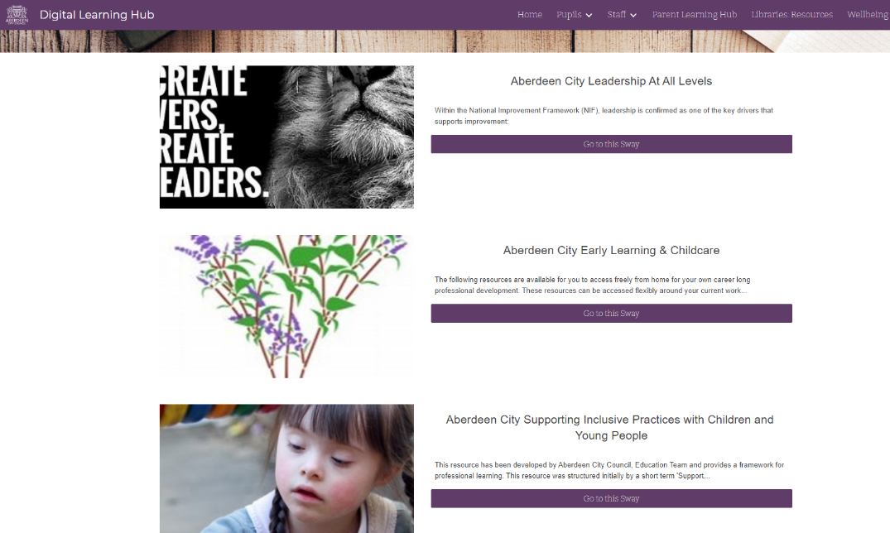
Staff Professional Learning Sways can be seen on the Aberdeen City Digital Learning Hub.

Slide 4

See examples of parent newsletters at the Aberdeen City Parent Learning Hub.

