Slide 1
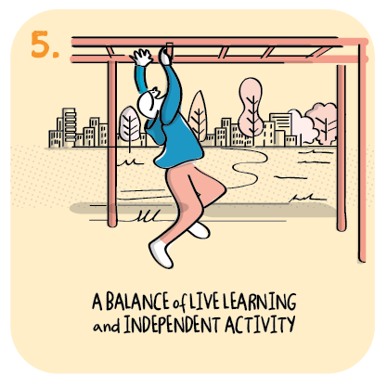

Virtual nature school
Sandhead and Drummore Primary Schools, Dumfries and Galloway Council
>National overviews of practice<

Slide 2
Sandhead and Drummore Primary Schools
Since the first lockdown, both primary schools have continued to review and adapt the remote learning offer as a result of national and local guidance and feedback from staff, parents and pupils. During the first period of remote learning, teachers shared with senior leaders their concerns from conversations with children identifying that they were spending quite a lot of time on gaming devices. This concern was also shared by parents who were reluctant to have their children in front of a screen for prolonged periods of time. The school took these views on board and adapted their plans and delivery of remote learning to improve the balance of “on and off screen learning.” As a team, staff agreed that from August 2020, the school would provide virtual nature schools to increase time outdoors and offer inquiry-based learning. This has now been included as a school improvement priority for 2020/21. Using a small test of change (see below), the school agreed the following objectives: • In response to positive parental feedback, continue to provide flexible, inquiry-based learning opportunities for families to engage with. (decrease in screen time); • To sustain levels of home-school communication and engagement established during lockdown; • To equip practitioners with the knowledge and skills to deliver high-quality outdoor learning

Slide 3
Sandhead and Drummore Primary Schools continued
In order to realise the vision for more ‘off screen’ learning the school wanted to ensure there were no barriers to learning outdoors. Funding was provided by the Parent Council and community groups. This ensured every pupil was issued with their own set of outdoor clothing. “Weather is no longer a deterrent or an excuse!” The school reports that children are now actively outdoors more often and are receiving high quality outdoor experiences. This is welcomed by staff, parents and learners. Formal evaluation of the success of these improvements will become evident as part of the school improvement planning process and in the school’s Standards and Quality Report using a variety of data to measure impact.
The following information has been shared from the school to further illustrate their approach.

Slide 4
Virtual Nature Schools to reduce screen time during remote learning - Small Test of Change - www.virtualnatureschool.org
Plan What is our objective? In response to positive parental feedback, continue to provide flexible, inquiry-based learning opportunities for families to engage with (decrease in screen time); To sustain levels of home-school communication and engagement established during lockdown; To equip practitioners with the knowledge and skills to deliver high-quality outdoor learning | Changes - What ? Will we do? Commit, via our school improvement priorities, to providing virtual nature schools as part of the blended model of learning; Release 3x staff members every afternoon from 1pm, to work with families, engage in professional dialogue and moderation with other providers and engage with materials for the following day. This will be for a period of 6 weeks when schools return and 2 weeks at the end of the holidays; Staff members have committed to beginning training and delivery in the last 2 weeks of the summer holidays and beyond – PEF allocation to reimburse/cover supply costs; Use grants and donations to provide resources to support outdoor learning e.g. loose parts, den kits, waterproofs, wellies, gardening, outdoor play sheds etc. | Who Will facilitate this and who will benefit? Teacher in each school identified
 |  | When July 2020 – June 2021
 |  | How (triangulation of evidence) Will we know we are making a difference? Quantitative data – monitoring family engagement levels over the time period People’s view –feedback from staff, parents and pupils Observations – regular opportunities for professional dialogue and moderation supported by Mindstretchers PLA. Increases in inquiry-based offerings (opportunities for child-led learning)
Do Carry out the plan Document problems Analyse the data | Week 1 – training week and promotion to families via social media platforms Weeks 2-8 practical work with families - The focus is open-ended inquiries so that older siblings can be included so that the whole family engage. The inquiries are nature-based and will be presented to all families through short films by Dr. Claire Warden. Upskill staff through training Beyond week 8 – share the learning with all practitioners and use same model to provide nature schools and rich, outdoor learning experiences to facilitate learning across the curriculum and led by children’s interests.
Study Compare data to the predictions Summarise what was learned | Ongoing
Act What changes will we make for the next test cycle? | Ongoing

Slide 5
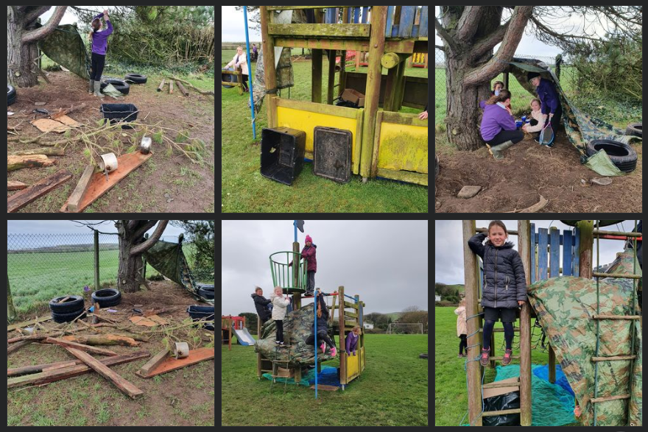
Drummore Primary – Den Building using loose parts (stimulus from Nature Schools training)

Slide 6
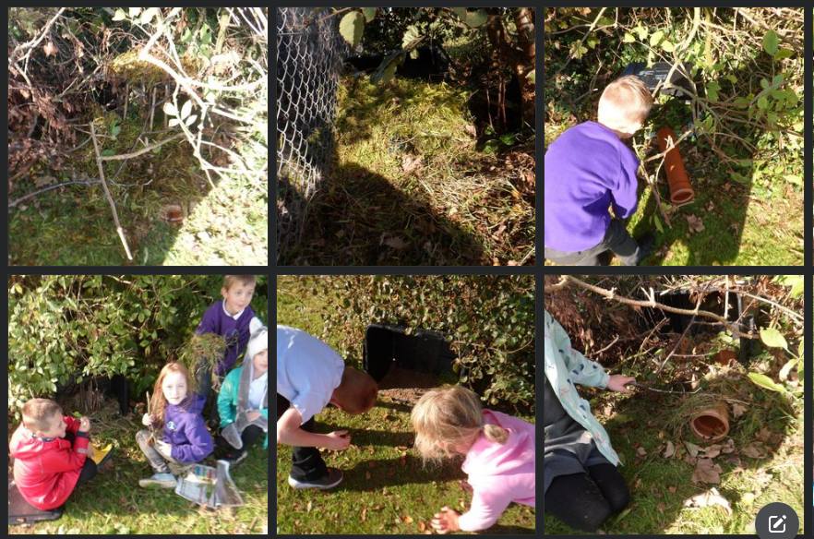
Drummore Primary – Making Bug Houses / Animal Dens (stimulus from Nature Schools training)

Slide 7
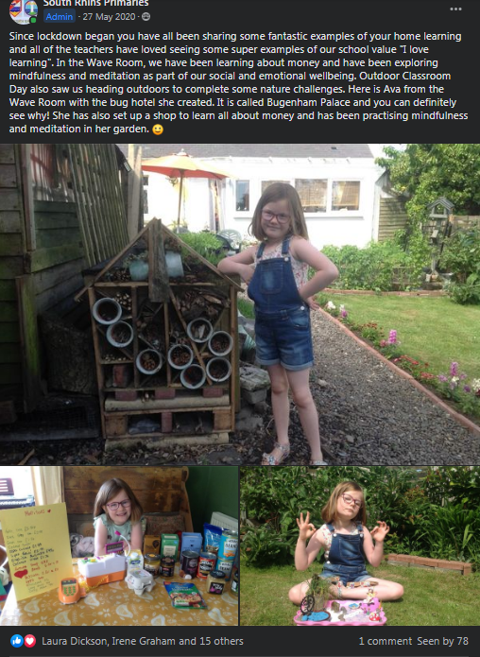
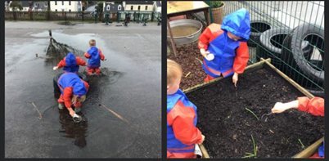
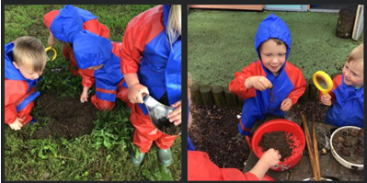
Sandhead Primary – promotion of Outdoor Classroom Day – parents sharing examples with us.
Drummore Primary – Waterproofs and Wellies for all (through grant applications) - looking for Superworm (inspired by the book/children’s interest) and James’ love of worms! Every child has waterproofs and wellies so we can go outdoors in all weather.

