Slide 1
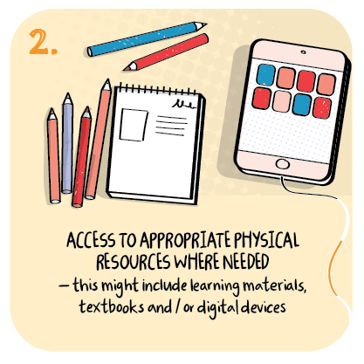

Supply of hardware and software to support children and families
Dundee City Council
>National overviews of practice<

Slide 2
Dundee City Council
Headteachers appreciate the roll out of a national offer of hardware and Wi-Fi for most children, particularly for those facing socioeconomic hardship.
Most schools and units use pupil equity funding to augment hardware for families to access.
Partners, such as supermarkets and third sector organisations, also contributed suitable hardware.
In a few schools, reconditioned devices were acquired to ensure that every home had at least one tablet computer available for use.
Almost all schools and units recognise the need to be able to provide accessible communication with parents via online platforms.
A few parents speak English as an additional language. Schools and units value online platforms that enable translations of spoken videos into the many languages parents use to communicate (up to 40 different languages).
Other parents appreciate local authority officers translating teacher’s planning grids and guidance documents into British Sign Language (BSL).

Slide 3
Dundee City Council…continued
Digital literacy of staff is improving because of opportunities for remote learning. Staff are more confident to deliver the majority of remote learning via online live sessions as well as providing recorded sessions.
Other remote learning resources include activity sheets for outdoor learning, messy play and arts and crafts. A few schools and units send home recipes and ingredients for home cooking activities accompanied by ’how to’ instructional videos. Others send home visual timetables, and social stories to support children and young people make sense of their learning at home.
Staff appreciate the local authority’s Hub where quality assured local and national materials are available to supplement teachers’ planned activities and tasks.
Parents value support from school and unit staff in helping them improve digital literacy their skills.
Parents speak highly of staff helping them to setup laptops. Training from the school and development worker helps parents remotely to understand how they can support their child’s learning.
In a few schools, fortnightly surveys help staff identify parents who need further guidance to support their children’s learning.
In other schools and units, daily or weekly telephone calls, tailored to the needs of parents, help support improved parental digital literacy.

