Slide 1
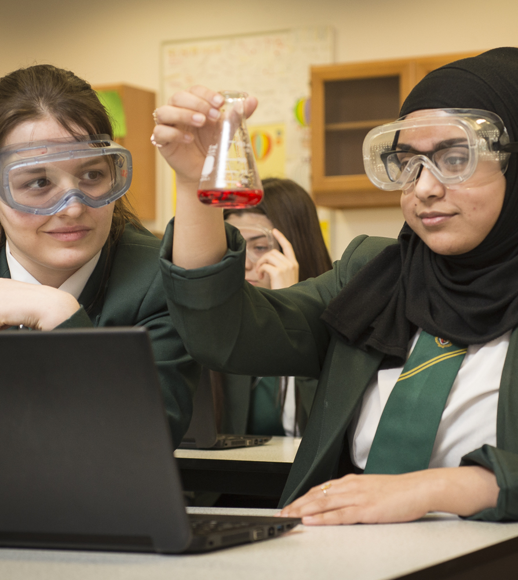

School
inspection
findings
2018-19
BRIEFING 1 – February 2020
Notes:
This is a front cover page and can only be used once. Use the corresponding green internal and back pages if you are using this page. You may add a title and a subtitle if needed only. Do not add anything else or move elements around.

Slide 2
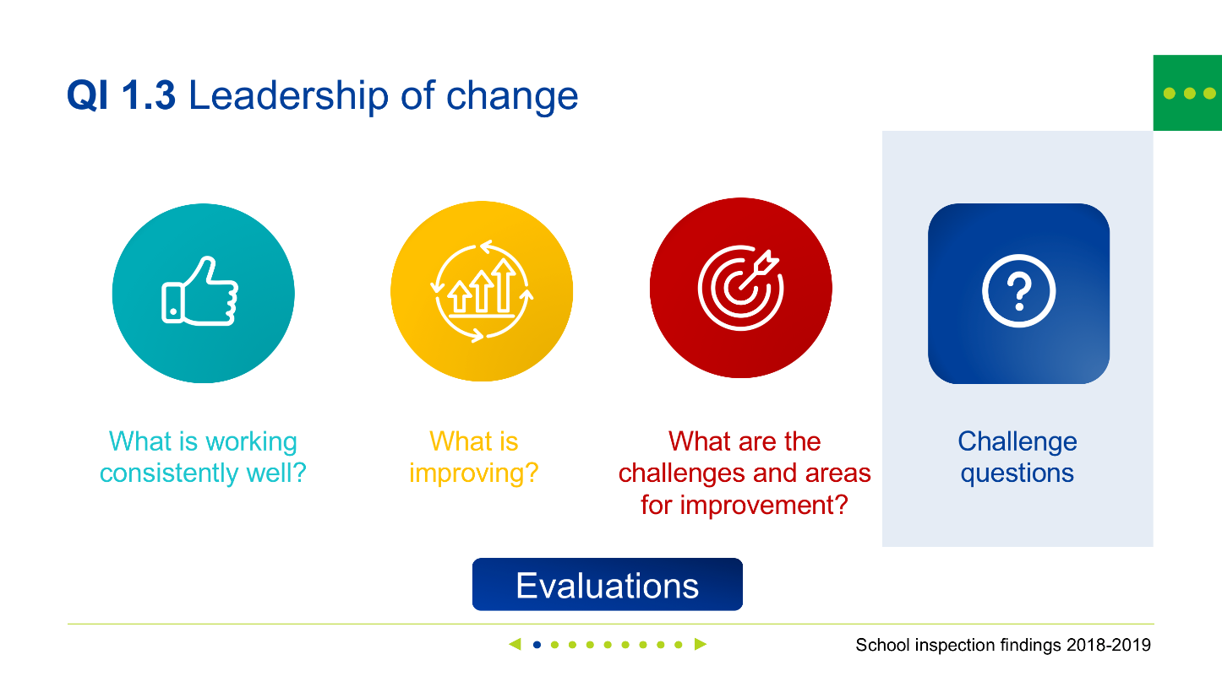

How does this presentation work?
  Quickly navigate to different
  sections by using the menu at
  the top left hand corner.
This presentation is designed to enable you to view and revisit sections depending on your focus and how much detail you would like.
It has a number of interactive features and menus to enhance your navigation through the presentation. It can also be used as a standard click through.
Make sure you view in slide show mode to benefit from the interactive features.
◀ • • • • • ▶
Click these buttons to navigate to areas of interest within each QI
What is working consistently well?
Use the navigation to move forwards or backwards through the slides.
Notes:
This is a front cover page and can only be used once. Use the corresponding green internal and back pages if you are using this page. You may add a title and a subtitle if needed only. Do not add anything else or move elements around.

Slide 3
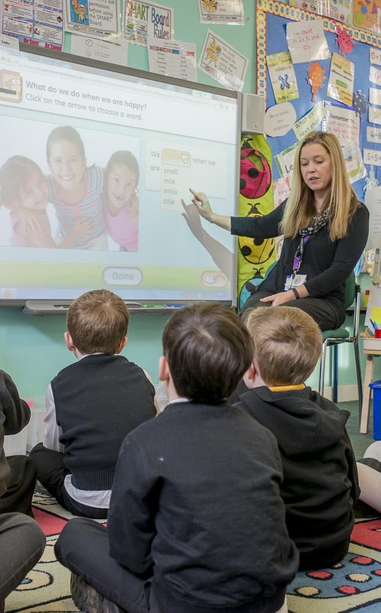




Inspection evidence
QI 1.3
Leadership of change
QI 2.3
Learning, teaching and assessment
QI 3.1
Ensuring wellbeing, equality and inclusion
QI 3.2
Raising attainment and achievement

Slide 4



QI 1.3 Leadership of change
What is working consistently well?
What is
improving?
What are the challenges and areas for improvement?
Challenge
questions
Evaluations
◀ • • • • • • • • • ▶

Slide 5

Leadership of change
QI 1.3 What is working consistently well?
Effective school leadership is ensuring:
the need for change is well understood
a strong emphasis on raising attainment and addressing the poverty-related attainment gap.
Evidence from self-evaluation is being used more effectively to identify changes required.
◀ • • • • • • • • • ▶

Slide 6
Leadership of change
QI 1.3 What is improving?
Through effective collaboration and participation in career-long professional learning (CLPL):
staff have a clearer understanding of the social, economic and cultural context of the school community
◀ • • • • • • • • • ▶

Slide 7
Leadership of change
QI 1.3 What is improving?
CLPL is increasingly being used well to guide and inform school improvement and change.
Schools are continuing to develop approaches to empower staff, children and young people to lead change in aspects of school improvement.
◀ • • • • • • • • • ▶

Slide 8
Leadership of change
QI 1.3 What are the challenges and areas for improvement?
Gathering and taking account of a range of data and evidence to monitor and evaluate the impact of change and improvement on outcomes for learners
Fully involving stakeholders in contributing to and evaluating school improvement
◀ • • • • • • • • • ▶

Slide 9
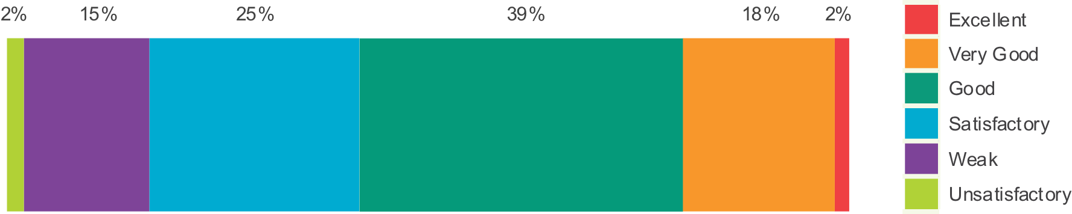
Leadership of change
QI 1.3 Evaluations
Evaluations of 1.3 Leadership of change (2018-2019)
122 schools
◀ • • • • • • • • • ▶

Slide 10
Leadership of change
QI 1.3 Challenge questions
How do we use our understanding of the social, economic and cultural context of the school to inform and shape planning for improvement?
In what ways do we gather and take account of a range of evidence from self-evaluation to monitor and evaluate the impact of change and improvement, including priorities related to the use of Attainment Scotland Fund?
◀ • • • • • • • • • ▶

Slide 11
Leadership of change
QI 1.3 Challenge questions
How effective are our approaches to empowering staff, children and young people, parents and partners to contribute to and evaluate school improvement?
How effective is our use of evidence and data to prioritise improvements to address any attainment gaps, including the poverty-related attainment gap, or gaps related to additional support needs or protected characteristics?
◀ • • • • • • • • • ▶

Slide 12
Leadership of change
QI 1.3 Challenge questions
How are we taking account of DYW priorities in our planning for continuous improvement?
◀ • • • • • • • • • ▶

Slide 13
QI 2.3 Learning, teaching and assessment
What is working consistently well?
What is
improving?
What are the challenges and areas for improvement?
Challenge
questions
Evaluations
◀ • • • • • • • • • • • ▶

Slide 14

Learning, teaching and assessment
QI 2.3 What is working consistently well?
The culture and ethos across most school communities, with very positive relationships between learners and staff, continues to be a strength.
Staff provide a wide range of motivating learning environments which support children and young people to engage well and to apply and reinforce their learning.
◀ • • • • • • • • • • • ▶

Slide 15
Learning, teaching and assessment
QI 2.3 What is improving?
Most schools are focusing on improving the consistency of the quality of learning and teaching across classes in order to improve outcomes for children and young people.
Teachers are using digital technologies to enhance learning and teaching.
The quality of oral feedback to children and young people is improving.
◀ • • • • • • • • • • • ▶

Slide 16
Learning, teaching and assessment
QI 2.3 What is improving?
Staff now use a wider range of assessment information and engage in a range of moderation approaches within and beyond schools.
Staff use data more effectively to target support and to put in place suitable interventions within literacy and numeracy to address gaps in attainment and achievement.
◀ • • • • • • • • • • • ▶

Slide 17
Learning, teaching and assessment
QI 2.3 What are the challenges and areas for improvement?
Improving learners’ quality of use of digital technologies remains an area for further development.
More needs to be done to ensure learners are clear about their next steps in learning.
Achieving consistently high-quality learning and teaching across all sectors remains a priority for improvement.
◀ • • • • • • • • • • • ▶

Slide 18
Learning, teaching and assessment
QI 2.3 What are the challenges and areas for improvement?
Staff need to build on moderation work to continue to improve the reliability and validity of teachers’ judgements of children’s and young people’s progress and achievement across all learning.
The sharing of effective practice in the use of tracking and monitoring in all areas of the curriculum in the broad general education (BGE) across all school sectors is needed.
◀ • • • • • • • • • • • ▶

Slide 19
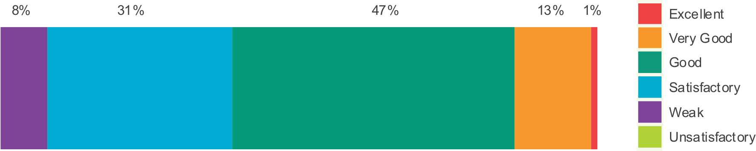
Learning, teaching and assessment
QI 2.3 Evaluations
Evaluations of 2.3 Learning, teaching and assessment (2018-2019)
252 schools
◀ • • • • • • • • • • • ▶

Slide 20
Learning, teaching and assessment
QI 2.3 Challenge questions
What actions are we taking to ensure learning and teaching is of a consistently high quality?
How do we plan learning to effectively meet all learners’ needs and to ensure appropriate pace and challenge in learning?
◀ • • • • • • • • • • • ▶

Slide 21
Learning, teaching and assessment
QI 2.3 Challenge questions
How well do we enable learners to articulate their developing skills and value these in terms of future learning and career pathways?
How effective are our planned opportunities for learners to discuss and reflect on their learning to empower them to lead and take increasing responsibility for their own learning?
◀ • • • • • • • • • • • ▶

Slide 22
Learning, teaching and assessment
QI 2.3 Challenge questions
How effectively do we actively involve learners in planning and leading their own learning?
How effective is our use of digital technologies to enhance learning and develop skills for learning, life and work?
◀ • • • • • • • • • • • ▶

Slide 23
Learning, teaching and assessment
QI 2.3 Challenge questions
How effective are our approaches to monitoring and tracking across all curriculum areas, using data to:
  set learning targets with children and young people;
  evaluate their progress; and
  put in place appropriate interventions to raise attainment and close any gaps?
◀ • • • • • • • • • • • ▶

Slide 24
Learning, teaching and assessment
QI 2.3 Challenge questions
How are our approaches to moderation and use of National Benchmarks improving the validity and reliability of professional judgements of learners’ progress and attainment?
To what extent do we use assessment information in the planning of learning and teaching?
◀ • • • • • • • • • • • ▶

Slide 25
QI 3.1 Ensuring wellbeing, equality and inclusion
What is working consistently well?
What is
improving?
What are the challenges and areas for improvement?
Challenge
questions
Evaluations
◀ • • • • • • • • • • ▶

Slide 26

Ensuring wellbeing, equality and inclusion
QI 3.1 What is working consistently well?
Supporting and improving children’s and young people’s wellbeing is a high priority for schools.
Children and young people who require additional support for learning have their needs identified well in most schools.
Contributions from a range of partners including health professionals effectively support the wellbeing of individuals and groups of learners and their progress in learning.
◀ • • • • • • • • • • ▶

Slide 27
Ensuring wellbeing, equality and inclusion
QI 3.1 What is working consistently well?
Across sectors, established systems and processes are in place to support staff in:
delivering their statutory duties in relation to wellbeing, equality and inclusion; and
developing their practices in line with codes of practice.
◀ • • • • • • • • • • ▶

Slide 28
Ensuring wellbeing, equality and inclusion
QI 3.1 What is improving?
An increasing focus is given to developing children’s and young people’s emotional and mental wellbeing and resilience.
More children, young people and staff are aware of the rights of children as stated in the UNCRC.
◀ • • • • • • • • • • ▶

Slide 29
Ensuring wellbeing, equality and inclusion
QI 3.1 What is improving?
Increasingly children and young people benefit from opportunities to express their views and influence decision making.
Across sectors, staff are developing children’s and young people’s understanding and awareness of diversity and equality based on their local context.
◀ • • • • • • • • • • ▶

Slide 30
Ensuring wellbeing, equality and inclusion
QI 3.1 What are the challenges and areas for improvement?
Planning approaches are not always reviewed regularly enough and children’s and young people’s views do not sufficiently inform planning.
Improvements are required to further develop children’s and young people’s understanding of diversity so they are more able to challenge stereotypes and discrimination.
◀ • • • • • • • • • • ▶

Slide 31
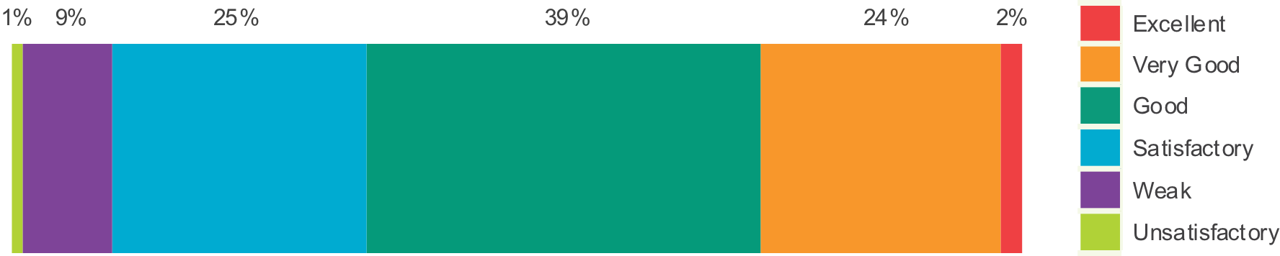
Ensuring wellbeing, equality and inclusion
QI 3.1 Evaluations
Evaluations of 3.1 Ensuring wellbeing, equality and inclusion (2018-2019)
122 schools
◀ • • • • • • • • • • ▶

Slide 32
Ensuring wellbeing, equality and inclusion
QI 3.1 Challenge questions
How effective are our approaches to supporting children’s and young people’s wellbeing?
Is evidence of progress in wellbeing collected and evaluated to demonstrate impact on improving outcomes for all learners?
◀ • • • • • • • • • • ▶

Slide 33
Ensuring wellbeing, equality and inclusion
QI 3.1 Challenge questions
How do we evidence progress in the wellbeing of learners facing challenging circumstances, those requiring additional support and those from protected characteristic groups?
What do we do to support care-experienced children and young people to attain well?
◀ • • • • • • • • • • ▶

Slide 34
Ensuring wellbeing, equality and inclusion
QI 3.1 Challenge questions
How well do we ensure that planned strategies to support learners requiring additional support are implemented across the school to enable children and young people to achieve and attain well?
How well do we support children and young people to learn about all aspects of equality and diversity in a progressive and relevant way?
◀ • • • • • • • • • • ▶

Slide 35
QI 3.2 Raising attainment and achievement
What is working consistently well?
What is
improving?
What are the challenges and areas for improvement?
Challenge
questions
Evaluations
◀ • • • • • • • • • • • ▶

Slide 36

Raising attainment and achievement
QI 3.2 What is working consistently well?
Schools promote and celebrate children’s and young people’s achievements in and outwith school.
Schools have gained confidence and knowledge in identifying the poverty-related attainment gap in their local context.
◀ • • • • • • • • • • • ▶

Slide 37
Raising attainment and achievement
QI 3.2 What is improving?
Overall, in primary schools children’s attainment in literacy and English and numeracy and mathematics, including the attainment of children with additional support needs is improving.
◀ • • • • • • • • • • • ▶

Slide 38
Raising attainment and achievement
QI 3.2 What is improving?
Schools continue to improve the reliability of their data on attainment of Curriculum for Excellence (CfE) levels in literacy and numeracy during the BGE.
The percentage of young people attaining at SCQF level 4 or better in literacy and numeracy by the time of leaving school is improving.
◀ • • • • • • • • • • • ▶

Slide 39
Raising attainment and achievement
QI 3.2 What is improving?
Almost all primary and secondary schools are now tracking the attainment of children and young people in literacy and numeracy during the BGE.
Staff in almost all schools continue to increase their confidence in the use and analysis of data to plan for improvements and put in place targeted interventions.
◀ • • • • • • • • • • • ▶

Slide 40
Raising attainment and achievement
QI 3.2 What is improving?
Emerging evidence indicates that these targeted interventions are leading to improved outcomes for children and young people with barriers to their learning.
This includes improved attainment in literacy and numeracy and progress in health and wellbeing.
◀ • • • • • • • • • • • ▶

Slide 41
Raising attainment and achievement
QI 3.2 What are the challenges and areas for improvement?
Most schools do not yet have reliable data on children’s and young people’s progress and achievement of CfE levels across other curriculum areas across the BGE.
Tracking attainment across the curriculum during the BGE remains an area requiring further work.
◀ • • • • • • • • • • • ▶

Slide 42
Raising attainment and achievement
QI 3.2 What are the challenges and areas for improvement?
The development of approaches to tracking of the skills that are being gained would help learners take increasing responsibility for ensuring they continue to add value to their achievements.
◀ • • • • • • • • • • • ▶

Slide 43
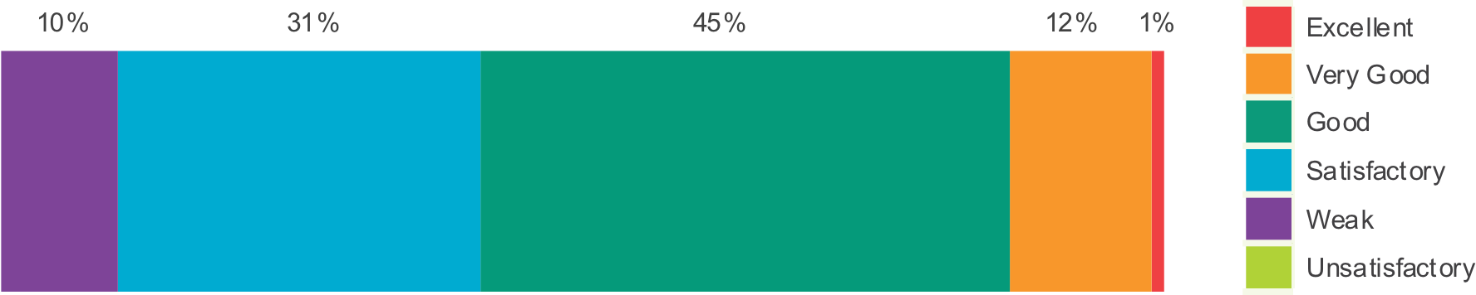
Raising attainment and achievement
QI 3.2 Evaluations
Evaluations of 3.2 Raising attainment and achievement (2018-2019)
252 schools
◀ • • • • • • • • • • • ▶

Slide 44
Raising attainment and achievement
QI 3.2 Challenge questions
What are our approaches to raising attainment and closing the poverty-related attainment gap across all areas of the curriculum?
How valid and reliable are teachers’ judgements about learner’s progress and achievement of CfE levels across all areas of the curriculum?
◀ • • • • • • • • • • • ▶

Slide 45
Raising attainment and achievement
QI 3.2 Challenge questions
How effective are approaches to monitoring and tracking of progress and attainment over time across all areas of the curriculum to:
  analyse trends;
  identify any under attainment; and
  put in place appropriate interventions to support improvements?
◀ • • • • • • • • • • • ▶

Slide 46
Raising attainment and achievement
QI 3.2 Challenge questions
How well are we developing staff confidence and skills in the use of data to identify and implement approaches to raise attainment for all learners?
How effective are our strategies and interventions to reduce the impact of any barriers to learning and to raise attainment of learners requiring additional support or those from protected characteristic groups?
◀ • • • • • • • • • • • ▶

