Slide 1
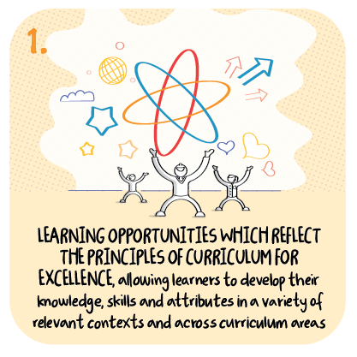

Learning opportunities across the four contexts
Dyce Primary School, Aberdeen City Council
>National overviews of practice<

Slide 2
Dyce Primary School
Children and their families are offered a monthly curriculum overview, outlining the main theme for the month and suggested activities children can undertake independently and with their families.
Each Wednesday children can choose from a series of linked activities that offer opportunities for personal achievement, and that promote the ethos and life of the school as a community.
The overview also highlights the focus for the four set days of learning across the curriculum on Google Classroom.
The interdisciplinary learning theme for February has a strong focus on social studies, learning about the past in their local area.
Children across the school are working together to create a virtual museum ‘ A Walk in the Past at Dyce’
The following information has been shared from the school to further illustrate their approach.

Slide 3
