Slide 1
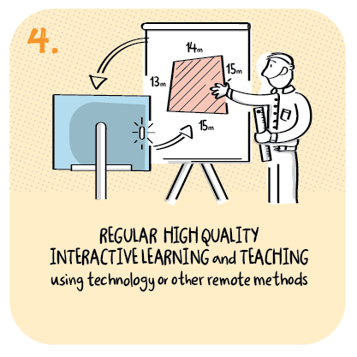

Using feedback to adapt and make improvements to the delivery and quality of remote learning
James Young High School, West Lothian Council
>National overviews of practice<

Slide 2
James Young High School
As a result of feedback the school has made a number of changes which are impacting positively on remote learning. These include: • amendments to the timetable and curriculum • the establishment of a pupil engagement team, and • the appointment of a principal teacher of pedagogy. After the first lockdown, young people expressed that the ‘normal’ 32 period weekly timetable was not working for them. The BGE timetable was amended to ensure that young people can now enjoy their full curriculum over a two week period. Space has been created in the timetable to ensure that young people’s wellbeing needs, such as spending time with their families and spending time outdoors, are prioritised. The Senior Phase curriculum continues to include extended periods of time in subjects: a change that was initiated as a result of feedback during the first lockdown.

Slide 3
James Young High School continued
The pupil engagement team was established in response to parental feedback: parents were uncertain as to whether young people were engaging effectively. This team has worked hard to increase young people’s engagement: the percentage of young people engaging has improved considerably from the first lockdown. The appointment of a principal teacher (PT) of pedagogy was made to support staff after the first lockdown. Staff had gained much confidence at this time in using digital technologies; however, during the second lockdown they expressed that they were not confident in delivering, for example, live learning. The PT has worked with staff to enable them to deliver high-quality teaching and learning more easily. The headteacher identified that tracking and monitoring data continues to be used to determine young people’s progress. As a result, the school is confident that its current offer is supporting young people to progress well. Young people are also able to talk about their learning in a similar way to the way in which they would have been able to do prior to lockdown.

Slide 4
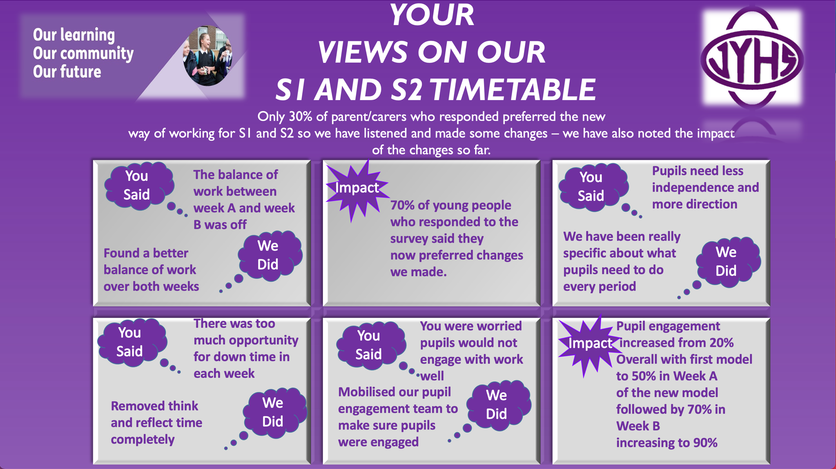

Slide 5
