Slide 1
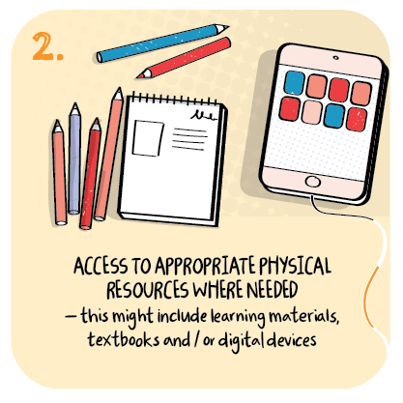
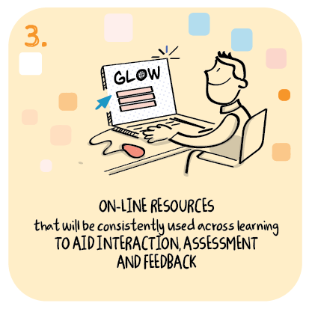

Shared online learning hub to support remote learning
Langlands School, Ashton School and Linburn Academy, Glasgow City Council
>National overviews of practice<

Slide 2
Langlands School, Ashton School and Linburn Academy
A group of schools for children and young people with complex learning needs created an online hub to support remote learning.
Staff in schools recognised the challenges in identifying appropriate resources and activities to meet the needs of children with complex needs and that parents and carers can easily deliver at home.
Staff across schools supported each other and the remote learning of pupils by sharing activities within the hub. Activities such as music, art and physical education were particularly well received.
Staff in one school recognised the challenges for parents to deliver physical education and created imaginative and enjoyable physical activities that were inclusive of children and young people with specific communication and mobility needs.
The creation of the hub has also resulted in collegiate working and collaboration within the senior leadership teams of the schools involved.
They have developed opportunities for weekly meetings to share information related to remote learning and the phased return of pupils.

