Slide 1
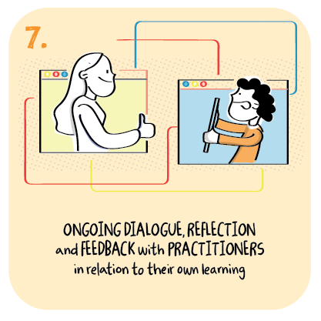

Ongoing feedback and dialogue with learners and their parents
St Duthus School, The Highland Council
>National overviews of practice<

Slide 2
St Duthus School
Teachers and support staff make use of a closed Facebook group to effectively communicate with parents. The parent council chose this as the primary method of daily communication and it works well with both teachers and families.
Google meet is used to facilitate the popular circle time, which is a live lesson. Children and young people engage virtually, with some attending from school and others from home.
Teachers set ‘independent’ work, to be completed alongside family members. Children and young people need assistance with all learning, so consultation takes place with families to decide on lessons which are relevant and achievable.
Vital teacher feedback is given through Facebook and google classrooms. Through this, children and young people see their work is valued and maintain a link to their teacher and PSA.
Written feedback is provided to families; video messages are also sent in order that children see a face and hear a voice.
Google Cast (via google classrooms) allows teachers to present video lessons, and simultaneously respond to learners needs.

