Slide 1


Secondary Inspection Findings: Secondary
Curriculum 2016-19
Insert new slide with front cover of Secondary Curriculum Briefing cover

Slide 2

Scrutiny findings
Context for curriculum change
Curriculum empowerment
Developing the school curriculum rationale for S1-S6
Providing a coherent curriculum
Providing a broad general education S1-S3
◀ • • • • • • • • • • • • • • • • • • ▶

Slide 3
Scrutiny findings
Providing flexible progression pathways in the senior phase
Using the four contexts of the curriculum
Providing the universal support entitlement
Conclusions and recommendations
◀ • • • • • • • • • • • • • • • • • • ▶

Slide 4

Secondary curriculum
1. Context for curriculum change
Over period 2015 -18 :
Introduction of National Benchmarks and SNSAs
Updated national guidance on expectations of S3
Qualifications continued to evolved and develop
Priority given to excellence and equity in education
◀ • • • • • • • • • • • • • • • • • • ▶

Slide 5


Secondary curriculum
2. Curriculum empowerment
Embracing empowerment to design and deliver curriculum to meet local needs
Strong senior leadership, effective self-evaluation and professional learning are key drivers in delivering high-quality curriculum
PTs and FHs are key leaders of learning, teaching and curriculum
More involvement of families and young people
◀ • • • • • • • • • • • • • • • • • • ▶

Slide 6

Secondary curriculum
3. Developing the school curriculum rationale
Clear curriculum rationale linked to vision values and aims
Using wide range of evidence and information to inform curriculum development
Decisions about the curriculum framework within the school’s local context take account of a number of factors to support improvement
◀ • • • • • • • • • • • • • • • • • • ▶

Slide 7
Secondary curriculum
3. Developing the school curriculum rationale
Examples of factors influencing curriculum rationale - how to:
Raise attainment and achievement
Build on prior learning, support interest and aspirations
Increase range of learning pathways
◀ • • • • • • • • • • • • • • • • • • ▶

Slide 8
Secondary curriculum
3. Developing the school curriculum rationale
Examples of factors influencing curriculum rationale - how to:
Develop skills through opportunities for personal achievement
More time for in-depth learning
Debate about number of subjects/courses in any one year in senior phase
◀ • • • • • • • • • • • • • • • • • • ▶

Slide 9

Secondary curriculum
4. Providing a coherent curriculum 3-18
Effective pastoral transitions from primary to secondary schools
Curriculum not yet experienced as coherent whole when moving from P7 to S1
Further work required across all curriculum areas to jointly plan programmes of learning across primary and secondary
◀ • • • • • • • • • • • • • • • • • • ▶

Slide 10
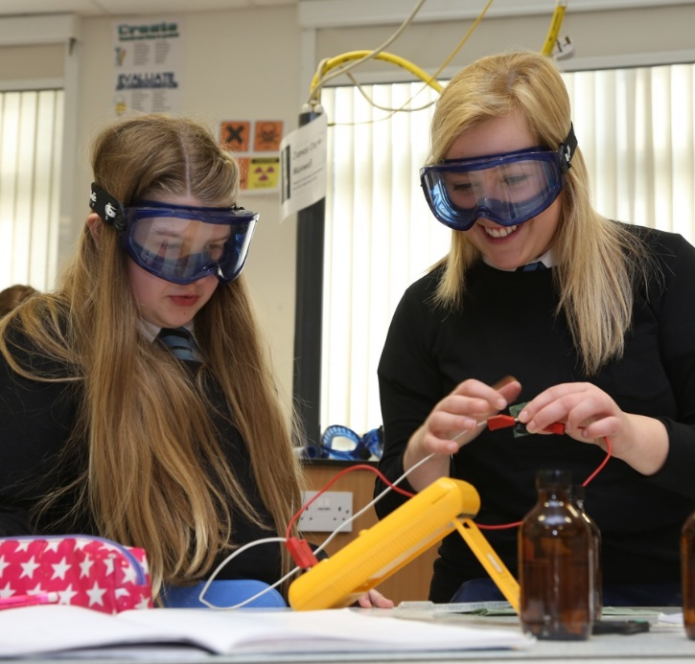
Secondary curriculum
5. Providing a broad general education S1-S3
Reviewing BGE as driver to raise attainment:
Need to achieve better balance between teacher-led and learner-led activities
Provision of personalisation and choice does not always provide appropriate progression and challenge
Need to review points of specialisation S1-S3 to avoid limiting choices for progression in senior phase
◀ • • • • • • • • • • • • • • • • • • ▶

Slide 11
Secondary curriculum
5. Providing a broad general education S1-S3
Improving S3 to support transition to senior phase:
Progression routes through BGE not always supporting smooth progression to senior phase
Balance between specialisation to support depth and challenge while ensuring young people continue to receive entitlement to BGE
S3 is not about a curriculum dominated by the assessment standards for qualifications
◀ • • • • • • • • • • • • • • • • • • ▶

Slide 12
Secondary curriculum
5. Providing a broad general education S1-S3
Monitoring and tracking in BGE to ensure appropriate provision of learning pathways:
Lack of valid and reliable assessment information about progress and achievement across all curriculum areas
Can result in young people undertaking courses leading to qualifications at inappropriate SCQF levels
◀ • • • • • • • • • • • • • • • • • • ▶

Slide 13

Secondary curriculum
6. Providing flexible progression pathways in the senior phase
Designing the curriculum framework/model:
Quality of leadership
The ‘enacted curriculum’
Effectiveness of BGE in supporting progression to senior phase
Range and quality of learning pathways to meet young people’s needs
◀ • • • • • • • • • • • • • • • • • • ▶

Slide 14
Secondary curriculum
6. Providing flexible progression pathways in the senior phase
Approaches to maximising senior phase offer:
Structural changes to timetable and column choices
Collaboration with other schools and providers
Planning S4-S6 as one cohort
Multi-level classes
Use of technology
◀ • • • • • • • • • • • • • • • • • • ▶

Slide 15
Secondary curriculum
6. Providing flexible progression pathways in the senior phase
Using self-evaluation evidence to inform the curriculum offer
Monitoring and tracking in senior phase to support
appropriate interventions to support young people
decisions about level of qualifications young people are most likely to succeed in
informed decision making across all learning
◀ • • • • • • • • • • • • • • • • • • ▶

Slide 16
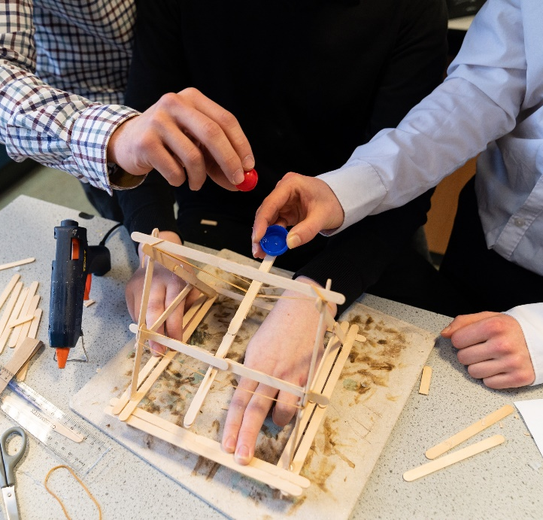
Secondary curriculum
7. Using the four contexts of the curriculum
Curriculum framework mainly based around courses within curriculum areas and subjects
Need to develop further IDL so young people can apply and consolidate learning
Learning pathways not planned as coherent experience across four contexts
Young people need supported to make connections across their learning
◀ • • • • • • • • • • • • • • • • • • ▶

Slide 17

Secondary curriculum
7. Using the four contexts of the curriculum
Developing SLLW :
Development of literacy and numeracy skills across different contexts requires improvement
Health and wellbeing as a whole school responsibility is at an early stage of implementation
Considerable work remains to embed the use of digital technology to develop digital literacy and support learning
◀ • • • • • • • • • • • • • • • • • • ▶

Slide 18
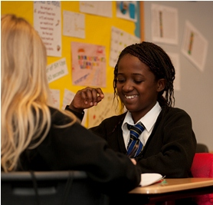
Secondary curriculum
8. Providing the universal support entitlement
Teachers recognise their responsibilities to provide universal support
Increasingly, high-quality conversations encourage dialogue between subject teachers and young people
Variability of data on progress and attainment in BGE not supporting young people in making informed choices for progression in senior phase
◀ • • • • • • • • • • • • • • • • • • ▶

Slide 19
Secondary curriculum
8. Providing the universal support entitlement
Arrangements are in place to provide range of careers advice
Insufficient information on progression opportunities for those requiring additional support
A clearer whole school approach to delivering the universal support entitlement is required
Need to review role of pastoral care teachers, effectiveness of tutor periods and universal support periods
◀ • • • • • • • • • • • • • • • • • • ▶

Slide 20



Secondary Curriculum: Conclusions and recommendations
What is
improving?
What are the challenges and areas for improvement?
What is working consistently well?
◀ • • • • • • • • • • • • • • • ▶

Slide 21

Secondary curriculum
What is working consistently well?
Within a context of constant change over recent years, secondary schools have continued to develop and evolve their curriculum.
Senior leaders and teachers continue to be committed to designing and delivering a curriculum, which meets their own school’s local context, afforded by CfE.
◀ • • • • • • • • • • • • • • • ▶

Slide 22
Secondary curriculum
What is working consistently well?
Senior leaders:
Appreciate that their schools need to make important decisions to deliver their school’s curriculum rationale
within the constraints of staffing and resources
Are aware that there is no ‘one size fits all’
decisions need to focus on providing learning pathways that meet the needs of all their young people
◀ • • • • • • • • • • • • • • • ▶

Slide 23
Secondary curriculum
What is working consistently well?
Senior leaders:
Play an important role in managing the pace of change within schools to bring about sustained improvements in outcomes for learners.
◀ • • • • • • • • • • • • • • • ▶

Slide 24
Secondary curriculum
What is improving?
Secondary schools becoming more flexible and innovative in the range of provision on offer in the senior phase.
Effective partnerships with other schools, colleges, employers and third sector organisations are enhancing the curriculum offer, including to provide vocational pathways.
◀ • • • • • • • • • • • • • • • ▶

Slide 25
Secondary curriculum
What is improving?
An increased learner-centred focus by building senior phase learning pathways around young people’s choices, needs and aspirations.
Positive relationships creating a supportive climate for learning in secondary schools with the wellbeing of young people at the heart of the ethos and life of schools.
◀ • • • • • • • • • • • • • • • ▶

Slide 26
Secondary curriculum
What is improving?
Young people having a wide range of opportunities for achievement beyond the classroom.
An increase in the percentage of young people moving from school to a positive destination.
◀ • • • • • • • • • • • • • • • ▶

Slide 27
Secondary curriculum
What is improving?
These positive improvements in the secondary curriculum mean schools are well placed to realise the full benefits of school empowerment in relation to curriculum leadership.
Now need to be more creative and innovative in developing and delivering a curriculum to meet the needs of learners and the local context.
◀ • • • • • • • • • • • • • • • ▶

Slide 28
Secondary curriculum
What are the challenges and areas for improvement?
Improving further improve the quality of the BGE curriculum:
as a driver to raise attainment both in S1-S3 and in the senior phase
by providing a range of learning pathways for young people from S1-S3 which build on their prior learning and achievement.
◀ • • • • • • • • • • • • • • • ▶

Slide 29
Secondary curriculum
What are the challenges and areas for improvement?
Developing approaches to monitoring and tracking of young people’s attainment and achievement in the BGE in order to:
analyse progress
evaluate the success of interventions for raising attainment of young people
ensure appropriate progression pathways into the senior phase.
◀ • • • • • • • • • • • • • • • ▶

Slide 30
Secondary curriculum
What are the challenges and areas for improvement?
Ensuring learning pathways:
are planned as a coherent experience across all aspects of the curriculum
support young people to make better connections across their learning.
◀ • • • • • • • • • • • • • • • ▶

Slide 31
Secondary curriculum
What are the challenges and areas for improvement?
Building on the approaches to supporting young people in gaining and improving their skills:
through opportunities for personal achievement
by planning learning as part of a coherent and progressive experience.
◀ • • • • • • • • • • • • • • • ▶

Slide 32
Secondary curriculum
What are the challenges and areas for improvement?
Continuing to improve approaches to providing the universal support entitlement for young people:
to better support them in reflecting on and reviewing their progress, attainment and achievement
across all their learning
in making informed choices.
◀ • • • • • • • • • • • • • • • ▶

Slide 33
Secondary curriculum
What are the challenges and areas for improvement?
Increase the pace of progress in the implementation of DYW priorities in order to realise its ambitions.
Better support young people to understanding the range of learning pathways and courses available to them, particularly vocational courses.
◀ • • • • • • • • • • • • • • • ▶

Slide 34
Secondary curriculum
What are the challenges and areas for improvement?
Further developing approaches to ongoing evaluation of curriculum development and change:
to ensure the curriculum continues to evolve to take account of:
the needs of the differing cohorts of young people
the changing external environment.
◀ • • • • • • • • • ▶

