Slide 1
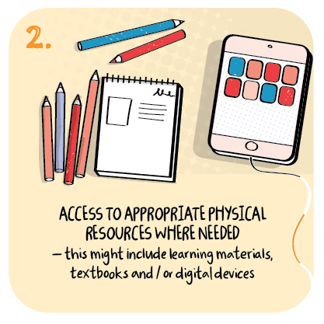
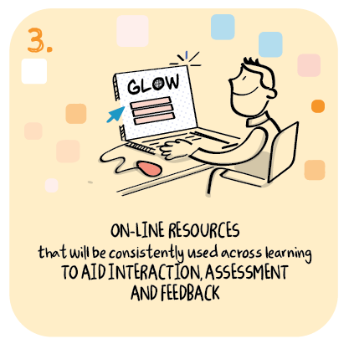

Consistent resources to support communication
Kirkriggs School, Glasgow City Council
>National overviews of practice<

Slide 2
Kirkriggs School
Staff at Kirkriggs primary are encouraging parents and carers to embrace the use of pictorial communication systems, which staff in the school use to enhance language acquisition for learners with complex learning needs.
Within the school, teachers and support staff use a Total Communication Environment (TCE) to improve interaction and understanding for children with language and communication difficulties. The system aims to make communication easier for children and helps them to express preferences, make requests and participate in reciprocal communication.
Kirkriggs school use their PEF money to employ a Principal Teacher whose remit includes developing the use of total communication where appropriate. The teacher encourages parents and carers to use the same methods at home and has recorded tutorial videos to explain how to use an educational app (Choice Board Creator) to create a bespoke TCE in the home.
The parents learn about the use of Objects of Reference, word signs and symbols through the assistive technology app which can be downloaded on IPads or iPhones.

Slide 3
Kirkriggs School continued
Parents are encouraged to make choice boards for their children, who will use similar resources when learning in school.
The learning resource for parents is a pre-recorded video tutorial which demonstrates the use of the Choice Board Creator app. It Explains how to make a choice board and how it can be used in certain situations e.g. when choosing a snack. Parents are encouraged to contact the school and ask any questions about how the app can be used to improve communication or to ask for technical help.
The approach encourages consistency across learning contexts and prepares the children for the use of resources which will be part of the learning environment when they return to the school building. The hope is that when children return, they will have retained some of the communication skills learned within the school building and that parents and carers will also have adopted some of those approaches to improve communication at home.

