Slide 1
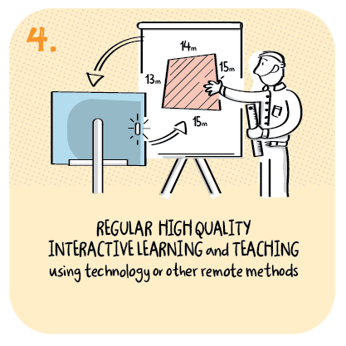

Transition to remote learning has been smoother due to the school being well on the way to being a digital school
Cramond Primary School, The City of Edinburgh Council
>National overviews of practice<

Slide 2
Cramond Primary School
In the remote learning discussion with Cramond Primary School, HM Inspectors noted that:
Since March 2020, the headteacher and staff have continued to review and adapt the remote learning offer. Professional learning sessions and materials provided by the local authority and by the headteacher have supported staff to become more confident and skilled in using digital technology.
Staff ensure a strong focus on literacy, numeracy and health and wellbeing. In addition, they ensure children access other areas of the curriculum through topic work, weekly outdoor challenges and live art lessons. Learning activities reflect the principles of curriculum design.
Staff provide a range of ways to support learning such as paper-based activities, live and recorded lessons. They use various online channels to support remote learning such as online learning journals and Microsoft Teams.
Children upload their work and share their achievements through the various channels. This includes the use of breakout rooms for groups of children to share their learning and experiences with each other.
The following slides are created by Cramond Primary School – they illustrate the school’s approach – Cramond Learns Anywhere

Slide 3


To Infinity and beyond..
Our Cramond Learns anywhere learning & teaching revolution continues.

Slide 4


If we could turn back time... pre March 2020
What do you now miss that we took for granted then?
What are our biggest worries in school now?

Slide 5

Impact of COVID 19 on learning & teaching
NOT a temporary quick fix until we go back to normal – new normal developing daily.
Can't control events around us – can control learning at Cramond & your class.
Seize the day – rip up the rule book – dare to do things differently. Don't look back!
Jetison the excess baggage - do more of what matters - ditch the brain drains.
Multipurpose tasks & delegate to pupils

Slide 6

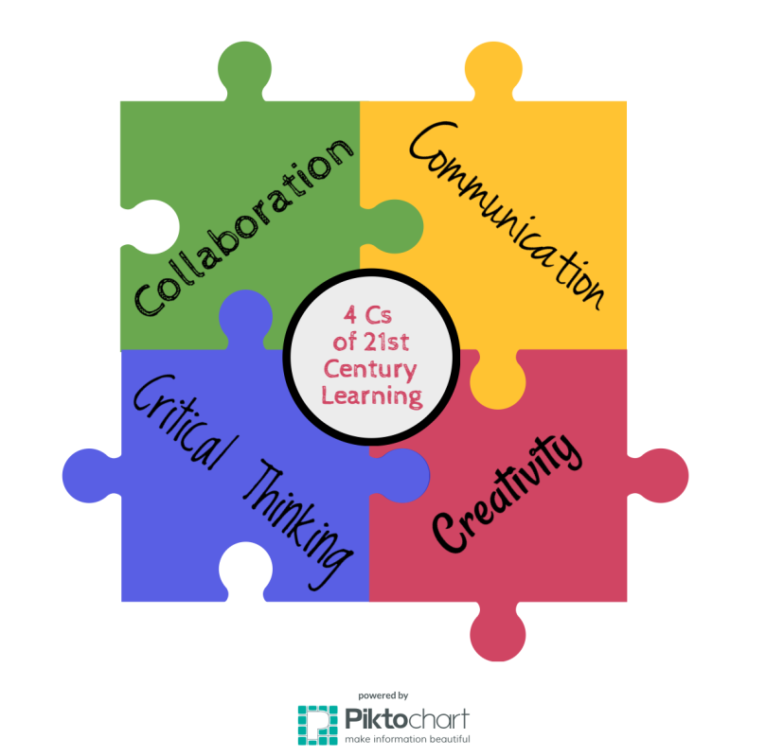

Time to rethink education in general - learning in particular
Adult guided learning
Learning at home
Learning in school
Self-directed Learning
Things we thought we knew to be important no longer are.
Dismantled traditional schooling but did not dismantle learning.
It has revealed the great digital divide and highlighted inequalities
School closures, lockdown and self-isolation shift learning from school to learning irrespective of PLACE or ADULT.
Hybrid model needed – not just to plug a learning gap until school or class reopens – REWIRING – education.

Slide 7

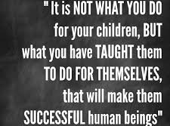

Teaching differently is now a necessity not an option.

Slide 8
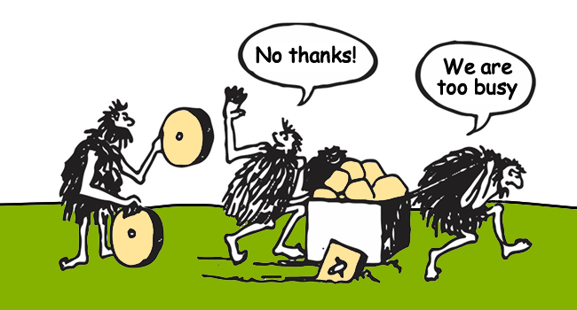

Slide 9
Cramond
Big Thinkers
&
Effective Learners
Friday 28th September

Slide 10
Being Prepared for the Year Ahead
Lockdown or isolation scenario
Changing our learning and teaching style
Changing education …. thinking abour the positives and changes we can make

Slide 11

Setting up well organised (digital) classroom
Our Learning management system is Teams: an easy to navigate hub where pupils and parents go to find teaching plans, resources, and assignment. It is also the meeting ground where pupils can ask questions to be answered by teacher or peers (@mention)

Slide 12
If we could turn back time... pre March 2020
What do you now miss that we took for granted then?
What are our biggest worries in school now?

Slide 13
Impact of COVID 19 on learning & teaching
NOT a temporary quick fix until we go back to normal – new normal developing daily.
Can't control events around us – can control learning at Cramond & your class.
Seize the day – rip up the rule book – dare to do things differently. Don't look back!
Jetison the excess baggage - do more of what matters - ditch the brain drains.
Multipurpose tasks & delegate to pupils

Slide 14
Time to rethink education in general - learning in particular
Adult guided learning
Learning at home
Learning in school
Self-directed Learning
Things we thought we knew to be important no longer are.
Dismantled traditional schooling but did not dismantle learning.
It has revealed the great digital divide and highlighted inequalities
School closures, lockdown and self-isolation shift learning from school to learning irrespective of PLACE or ADULT.
Hybrid model needed – not just to plug a learning gap until school or class reopens – REWIRING – education.

Slide 15
Teaching differently is now a necessity not an option.

Slide 17
Cramond
Big Thinkers
&
Effective Learners
Friday 28th September

Slide 18
Being Prepared for the Year Ahead
Lockdown or isolation scenario
Changing our learning and teaching style
Changing education …. thinking abour the positives and changes we can make

Slide 19
Setting up well organised (digital) classroom
Our Learning management system is Teams: an easy to navigate hub where pupils and parents go to find teaching plans, resources, and assignment. It is also the meeting ground where pupils can ask questions to be answered by teacher or peers (@mention)

Slide 20
Video conferencing – virtual meeting
come to together as a class to launch lessons and revisit concepts, engage in interactive activity or address questions
emphasise key points, check in with pupils and address and misunderstandings use of interactive tools such as padlet and kahoot
encourage active participation of all and check understanding

Slide 21
Supporting Learners – The 5 E's
Engage
Explore
Explain
Elaborate
Evaluate

Slide 22
Flipped Learning
Pre-recorded video messages can be a more effective and equitable way to deliver learning and instructions.
Students and families can watch them on their own time, at their own pace, and can rewind and replay them over again if necessary.

Slide 23
Creative use of apps
Use apps to engage pupils in meaningful tasks
Project based learning
Demonstrate what they know
Passion project – self-directed learning

Slide 24
Making Learning / Thinking Visible
Padlet as an online bulletin board
Flipgrid – respond to prompt via video
Use of Learning Journals – videos and photos

Slide 25
Sharing Learning
Sharing learning on Learning Journals is personal to child or stage – what has been achieved rather than what is going to be done
Sharing learning on Teams to showcase achievements and final products – passion projects
Padlet – use photo and give feedback

Slide 26
(Virtual)
Office Hours
Being on call at a specific time
Messages and 2 way dialogue
Conversational and informal
1:1 or group chats to check-in

Slide 27
Providing meaningful feedback
Timely and efficient
Be selective about what your choosing to give feedback on
For quick formative assessment that automatically mark work such as forms, quizzes, Sumdog
Pupils give feedback using chat function
Record audio files – talking is quicker than tying

Slide 28
Building relationships with families
Feedback using Learning Journals
Message feature to keep in touch
Feel free to pick up the phone
1:1 chat if need be

Slide 29
Power of Reflection
“We do not learn from experience….we learn from reflecting on experience.” – John Dewey
Reflection coupled with goal setting can help embed learning
Journal – physical or virtual
Ideas - Video reflection, Padlet,Book Creator

Slide 30

Task – Create a structure for a day
If you were teaching from home...
What would your day look like?
How would you share your learning?
How would you check in with your learners?

