Slide 1
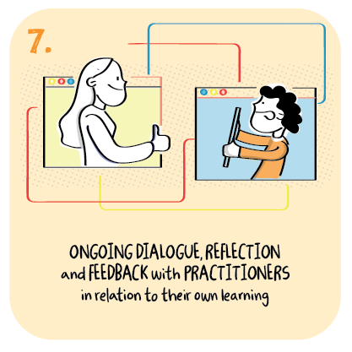

Engaging with learners and families about learning
Alloa Academy, Clackmannanshire Council
>National overviews of practice<

Slide 2
Alloa Academy
Alloa Academy’s Extended Additional Support Needs (ESAN) faculty has been creative in its approaches to support learners and their parents during the period of remote learning.
Regular phonecalls with key members of staff ensure a clear focus on the wellbeing of children, young people and their families. Staff recognise that familiar faces are vital to help support the engagement of learners with complex learning needs.
In addition to recorded and live teaching sessions, staff make regular physically distanced door-stop visits to families to drop off physical resources for supporting learning at home. This helps to maintain learners’ engagement in learning, as well providing support to families, including food parcels.
Enabling the digital literacy of learners and their parents has also been an important focus of which has entailed a lot of effort to support families. As well a regular telephone calls, the Manager provides a monthly newsletter for parents. These highlight useful webinars from Call Scotland and other resources to help parents to support their child’s learning at home.
Staff also make good use of social media platforms to share video clips and other useful information.
Families for whom English is an additional language have been very well supported using visual symbols and pictures to aid communication. As well as supporting parents to engage in their child’s learning, this approach has also encouraged parents to engage in their own learning of English. Effective partnership working with colleagues in Community Learning and Development and housing is supporting this on-going work.

