Slide 1
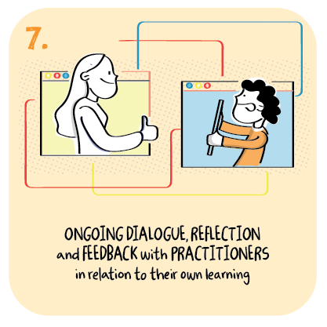

Approach to ensuring high engagement of children with remote learning and the role of feedback
Glenboig Primary School, North Lanarkshire Council
>National overviews of practice<

Slide 2
Glenboig Primary School - case study
There have been multiple contributing factors in ensuring our high level of engagement in learning. The volume and structure of ‘live lessons’ are a significant contributory factor to our engagement. These maintain relationships, support HWB and the learning process. Live lessons are whole class, differentiated or one to one.
MSTeams has been organised to support quality feedback which is given in good time, ensure dignity for children and provides consistency across all stages.
Feedback is given promptly, helping children progress learning and giving a purpose to their work. Feedback is accessible to all by using voice notes where appropriate.
The school invested time training parents prior to the first lockdown, holding workshops on MS Teams. Pupils created MS Teams ‘How To’ video guides for further reference. We created Whole School and P1 Parent Support Dashboards, allowing access to all support information in one place. To further support parents we held online training sessions and received feedback from parents on a fortnightly basis, ensuring we continue meeting needs and are aware of changes in circumstances. We have a rigorous system where SMT contact parents to support engagement and hold weekly meetings with our Digital Leader pupils, seeking their feedback. Our plan for supporting vulnerable children maintains engagement.

Slide 3
Glenboig Primary School - continued
We have restructured our curriculum, considered the resources and ensured there is a balance between live and independent learning activity. We plan learning across levels, however maintain differentiation where appropriate, to move learning forward and ensure pace and challenge. 99% of parents felt the level of work was appropriate. Remote after-school clubs provide further choices in learning, allowing children to work across ages and stages. We continue to target 2 live PE sessions per week and our school assemblies.
We continue our school ethos of being a transparent, community school. Our MSTeam Family Friday Nights consist of Film Club Premiere, Nativity Screening, Burns Night and Valentines, allowing the school community to come together. Parents have continued their close relationships with the school.
Our vision statement Dream Big, Work Hard, Shine Bright permeates our remote learning. The impact of the combined factors is 100% engagement, continued over the first 3 weeks of term.

Slide 4
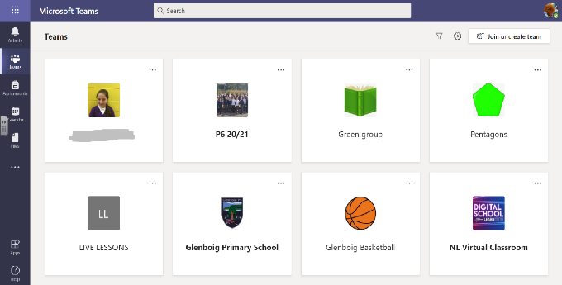

Slide 5
