Slide 1
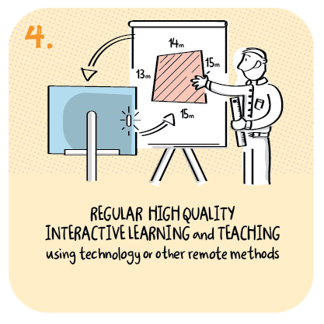

Meeting the individual needs of P1 learners with complex autism during remote learning
Kingspark School, Dundee City Council
>National overviews of practice<

Slide 2
Kingspark School
Dundee City Council has a higher than average number of learners with additional support needs. For some leaners their needs are deemed to be best met in specialist provisions. Children and young people with very complex multiple additional support needs have these needs met in an all age special school. Classes in the school are broadly designed to meet the needs of learner’s age and specific needs. Almost all children in P1 have autism, are nonverbal and work at a pre early level of Curriculum for Excellence.
Teachers know the individual needs of learners at P1 very well. They use a variety of in school and remote learning activities effectively to engage children fully in learning.
Remote learning provides good opportunities for teachers to plan live and recorded learning sessions. Live sessions enable teachers to check in on their learners and families, talk through expectation for the day and ensure that children are happy, safe and ready to learn.
Recorded lessons enable teachers to better meet the individual needs of learners well. Teachers focus on literacy through communication, numeracy and health and wellbeing. Engagement in these sessions is high
Teachers offer social activities for parents and their children focusing on life skills, arts and crafts, and outdoor learning. These sessions are well received by parents. Online games, sensory stories, videos and links to learning broadcasts are proving children with a daily routine when working at home.

Slide 3
Kingspark School …continued
Online assemblies, signing choir and Hot Chocolate Friday, with staff delivering the chocolate ingredients to the home, help children to keep in touch with daily school life.
Resource packs of sensory resources and specialist equipment are provided so that physiotherapy and speech and language therapy can continue at home. Partners are available remotely to guide parents to support their child. Most children engage well in remote learning for most of the time. Tablet computes and access to Wi-Fi helps parents support their child’s learning at home.
A family development worker supports families very well to set up and access on line learning. A doorstep, socially-distanced talk- and –teach session can be used to check in where that is seen to be an appropriate approach.
Teachers regularly contact parents to review learning and update access to specialised applications to help support children’s access to learning further. (Such as Clicker 4 and Board maker). Staff recognise the quality of support almost all parents provide to help children develop resilience during this period of uncertainty.
Teachers adapt curriculum home learning grids to ensure that learner are not at risk of missing out on important learning targets. Progress is assessed against children’s learning targets and parents are fully involved. Teachers use this information to plan individualised work for learners as a next step.

Slide 4
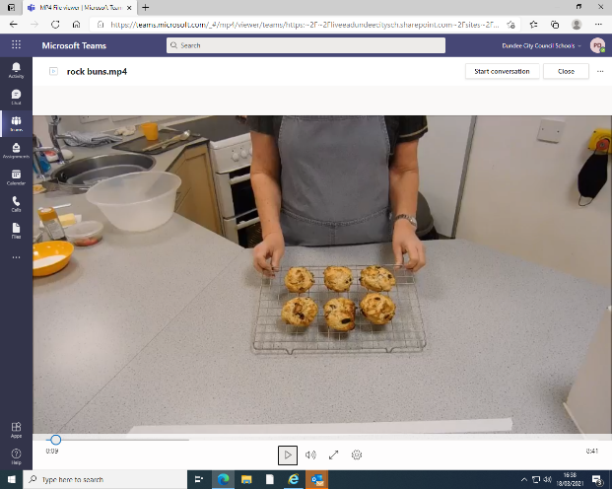
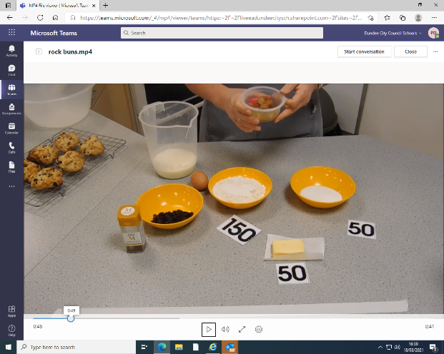

Slide 5
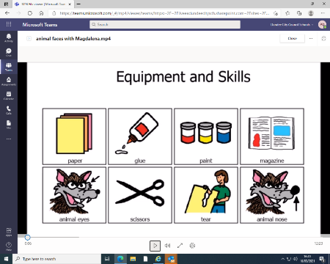
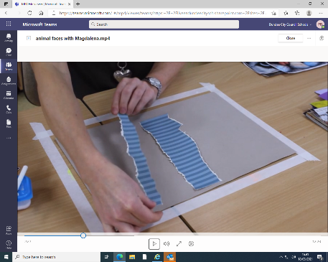
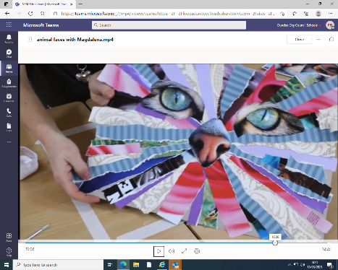

Slide 6
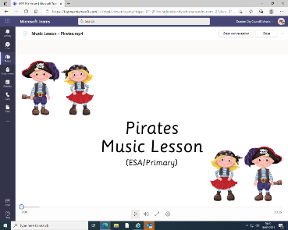
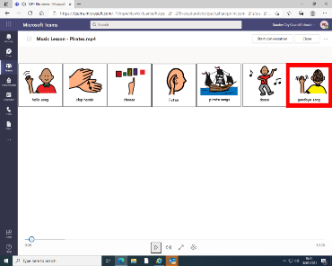
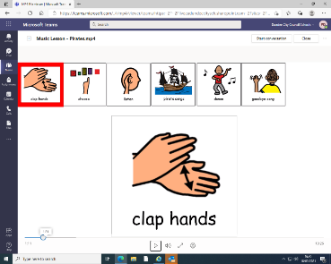
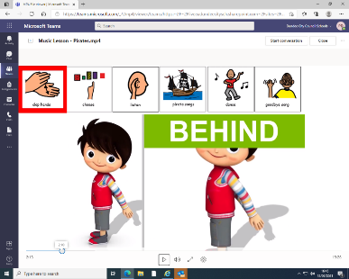
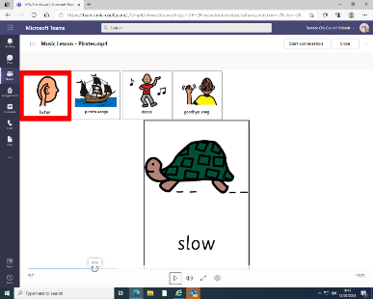

Slide 7
