Slide 1
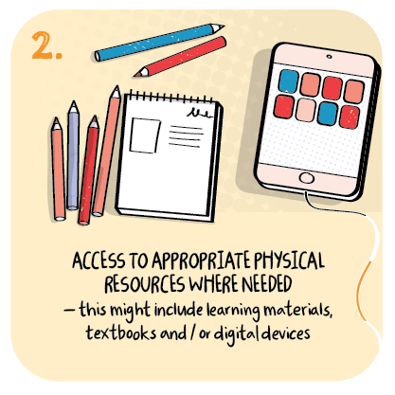

Individual learning packs tailored to each learner’s needs and parental feedback
Lochies School, Clackmannanshire Council
>National overviews of practice<

Slide 2
Lochies School
The school has developed a framework “Lochies Remote Learning Relay”. which is helping the school to plan deliver and evaluate the effectiveness of its remote learning offer.
The approach is centred around the child and has a clear focus on providing learners with the opportunity to maintain where possible familiar daily routines with known and trusted adults.
Class teachers lead planning for both in-class and remote learners. This includes a wider range of learning approaches such as live, recorded, independent and class-based lessons across the week.
Planned learning focuses on individual targets set within Individual Education Plans. As a result, children have personalised, relevant and varied learning activities.
There is a strong sense of ensuring effective communication with families, in the way that is best suited to their needs. Teachers are supported well by teams within the “Lochies Remote Learning Relay” to resource, engage with families and gather evaluations of learning. For example, seeking the views of parents though regular phone calls and weekly evaluation forms.
Staff deliver individualised learning packs and weekly learning grids which take account of feedback from families and are tailored to maximise learning.
As result, learners are engaging well and families have been able to maintain positive and trusting relationships with the school.
The following pages contain information shared from the school to help illustrate their remote learning approach.

Slide 3
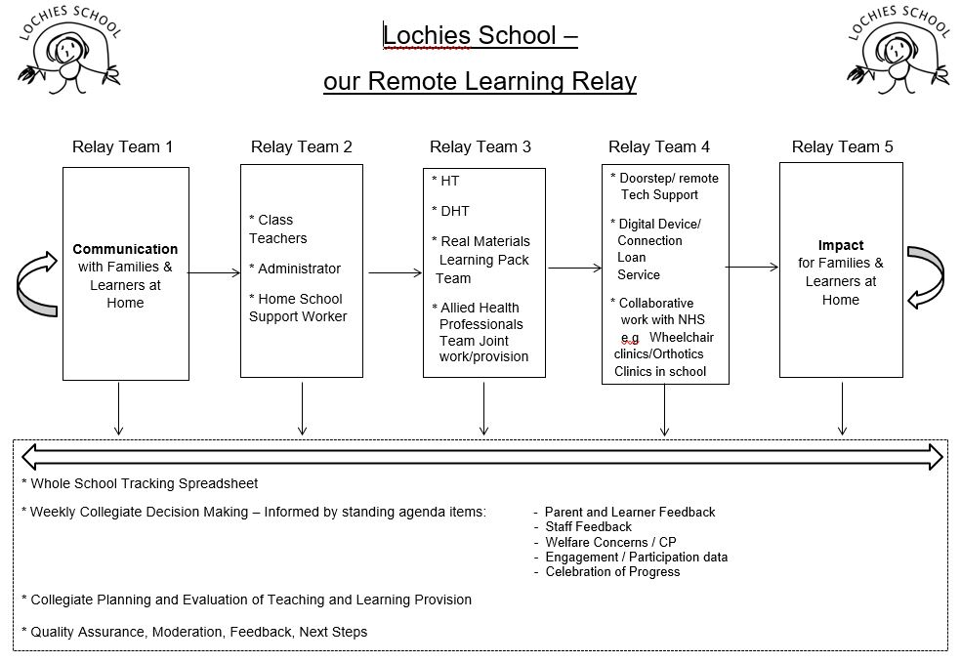

Slide 4
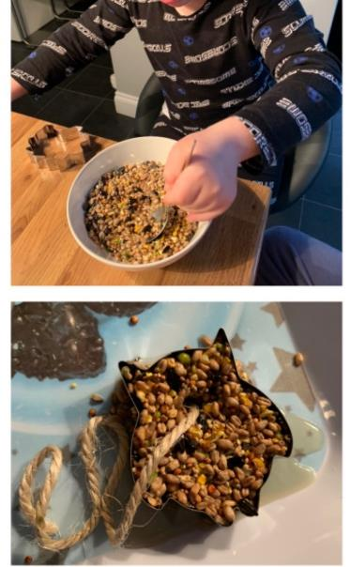
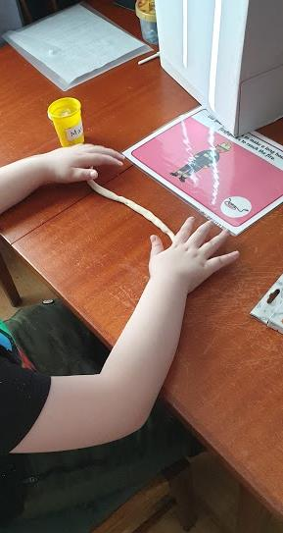
Individual learning packs are delivered which take account of feedback from families and are tailored to maximise learning.

Slide 5
