Slide 1
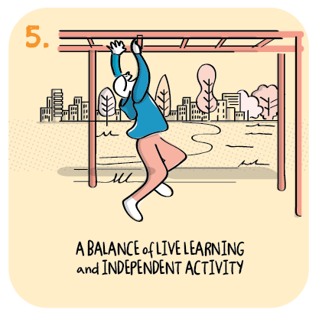

A planned approach to ensuring a balance of live learning and independent activity
Insch Primary School,
Aberdeenshire Council
>National overviews of practice<

Slide 2
Insch Primary School
A weekly learning grid of twelve activities is provided for all children at the start of each week. This includes three literacy and three numeracy focused tasks.
The times of live learning sessions linked to key learning tasks are identified on the grid. This approach allows families the flexibility they have asked for but also provides the necessary structure and routine the school has identified as being important.
Skills are highlighted across the grid. Teachers assess learning against benchmarks and during live sessions identify children requiring extra support. These children stay online at the end of a planned live session with the teacher so they can receive further support before tackling a task.
The school plans whole school theme weeks which help everyone feel connected.
The school’s newly developed digital platform provides regular high quality face to face learning experiences for children.
Children with additional support needs are supported in small groups by additional support for learning teachers and pupil support assistants. This support is targeted and carefully planned. Pupil support assistants who deliver support remotely report that they feel valued and that they feel they are making a difference.
The school have shared example learning grids for P1 and P3/4 as well as the quality assurance checklist used by SLT with teaching staff.

