Slide 1
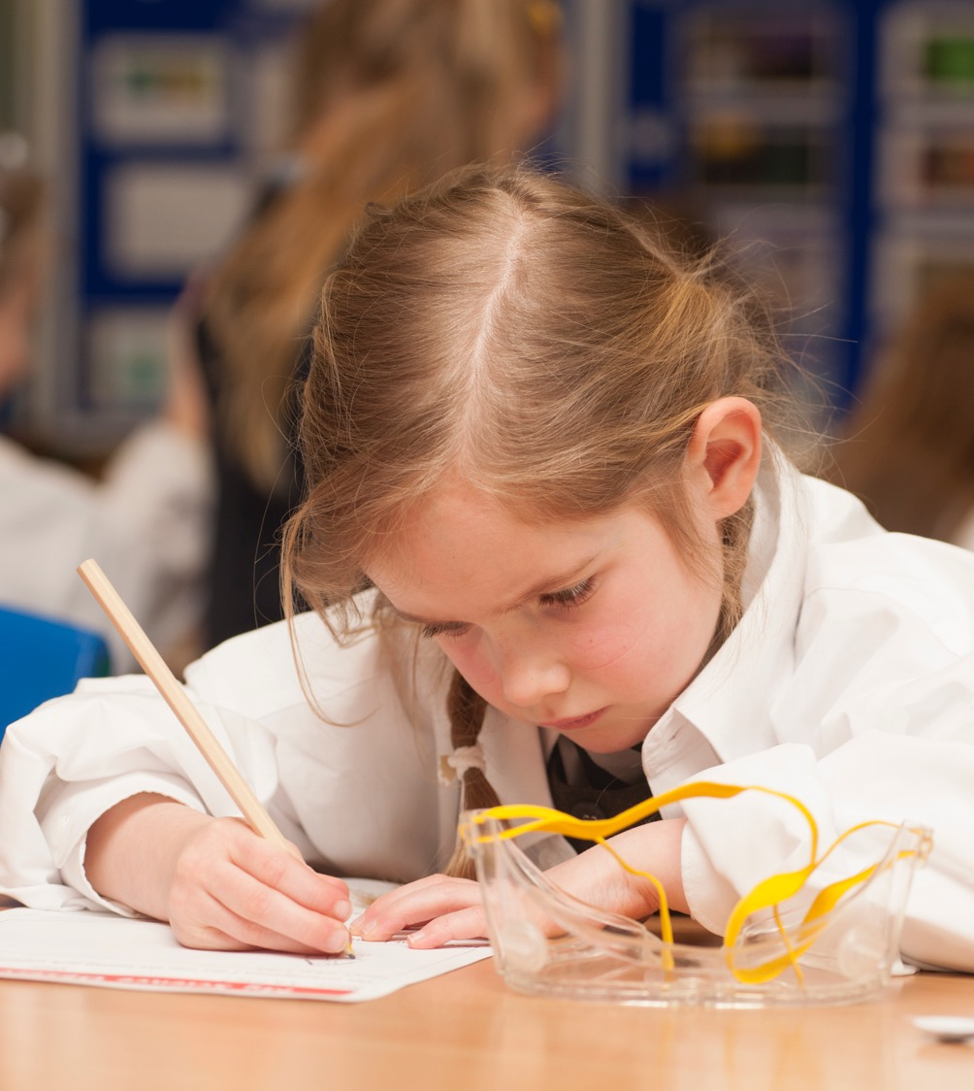

Insert new slide with front cover of Secondary Curriculum Briefing cover
Primary Inspection Findings: Primary Curriculum 2018-19
December 2020

Slide 2
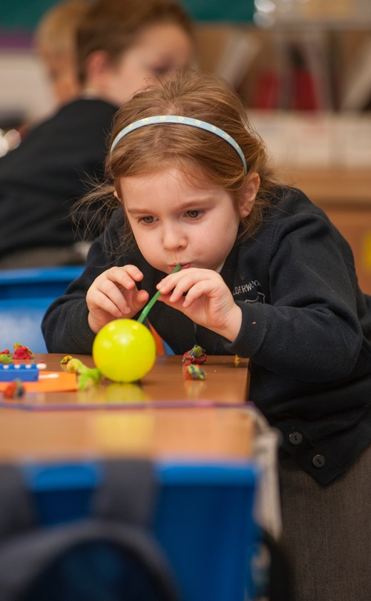
Scrutiny findings
Background and context
Curriculum leadership and development
Raising attainment and improving equity
Curriculum planning
Transitions
Assessment
◀ • • • • • • • • • • • • • ▶

Slide 3

Primary curriculum
1. Background and context
Over period 2016 - 19:
Introduction of National Benchmarks and Scottish National Standardised Assessments (SNSA).
Headteachers’ Charter for School Empowerment, 2019 – lead collaborative co-design of curriculum, learner pathways and transitions for local context.
Refreshed Narrative on Scotland’s Curriculum, 2019 – central importance of the four capacities, knowledge, skills and attributes.
◀ • • • • • • • • • • • • • ▶

Slide 4
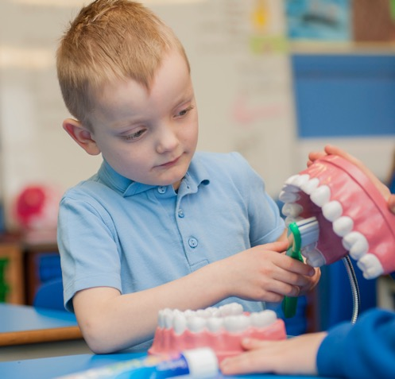
Primary curriculum
2. Curriculum leadership and development
Key messages from 2018-19 Inspection findings:
The majority of schools have a broad, relevant curriculum rationale, which has been created in consultation with the community.
The best examples of these reflect the design principles, four contexts of the curriculum and the local context.
More needs to be done to develop staff’s understanding of interdisciplinary learning.
◀ • • • • • • • • • • • • • ▶

Slide 5
Primary curriculum
2. Curriculum leadership and development
Headteachers and staff feel empowered to work with pupils, parents and partners.
Staff now need to collaborate more with parents, pupils and wider partners on the design and evaluation of the curriculum.
The United Nations’ Convention on the Rights of the Child is reflected in school values and the curriculum in the majority of schools.
◀ • • • • • • • • • • • • • ▶

Slide 6
Primary curriculum
2. Curriculum leadership and development
A culture of leadership for learning, quality professional learning and collaboration supports progression within the curriculum and consistency in learning, teaching and assessment.
Programmes in Science, Technology, Engineering and Mathematics (STEM) help children make connections and offer relevant and interesting contexts for learning.
◀ • • • • • • • • • • • • • ▶

Slide 7
Primary curriculum
2. Curriculum leadership and development
Children need more opportunities to lead their own learning.
Play-based learning, enquiry-based approaches and a shared approach across early level are key areas for development.
Further work is required to implement the 1+2 languages policy, which will support children’s acquisition, and engagement of two additional languages by the end of P7.
◀ • • • • • • • • • • • • • ▶

Slide 8
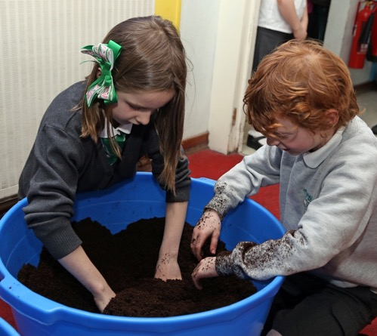
Primary curriculum
3. Raising attainment and improving equity
Key messages from 2018-19 Inspection findings:
Overall, attainment is improving, including for children with additional support needs.
Tracking literacy and numeracy attainment has improved. There is now a need to focus on tracking progress across all areas of curriculum.
Staff confidence in identifying the poverty-related attainment gap in their own context has increased.
◀ • • • • • • • • • • • • • ▶

Slide 9
Primary curriculum
3. Raising attainment and improving equity
There is emerging evidence of improved outcomes for children with barriers to learning.
Attainment Scotland Fund is used to develop targeted interventions in literacy, numeracy, health and wellbeing in almost all schools.
Children’s wider achievements are being promoted and celebrated.
The tracking of achievements should link to the skills being developed.
◀ • • • • • • • • • • • • • ▶

Slide 10

Primary curriculum
4. Curriculum planning
Key messages from 2018-19 Inspection findings:
Use of national guidance is leading to relevant and motivating learning experiences for children.
Improving use of the four contexts for learning is enriching children’s learning experiences.
Progression pathways support planning and progression in children’s skills, knowledge & understanding.
◀ • • • • • • • • • • • • • ▶

Slide 11
Primary curriculum
4. Curriculum planning
Joint collaborative planning and moderation activities support shared understanding of National Benchmarks.
Children’s learning about the world of work is enhanced by community partnerships in most schools.
There is a need to develop children’s knowledge of skills through skills progression frameworks and the Careers Education Standard.
◀ • • • • • • • • • • • • • ▶

Slide 12
Primary curriculum
4. Curriculum planning
Outdoor learning (OL) and learning for sustainability are enriched when planned and delivered with community partners.
The purpose of OL needs to be understood by all staff and children need opportunities to extend and transfer their learning.
Digital technology enhances and supports the curriculum in most schools. Digital literacy skills now need to be planned in a progressive way.
◀ • • • • • • • • • • • • • ▶

Slide 13
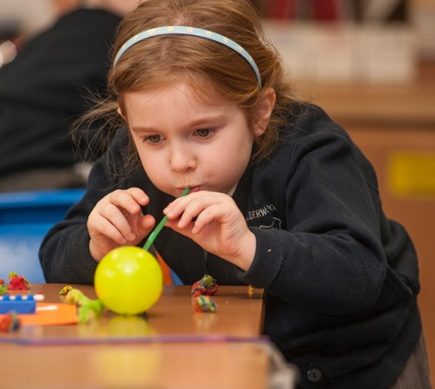
Primary curriculum
5. Transitions
Key messages from 2018-19 Inspection findings:
Transitions from nursery to P1, from stage to stage, from P7 to S1, and enhanced transitions are well-planned and support learner’s progress.
Communication between P1 staff and early learning and childcare practitioners is improving.
Continuity and progression in learning across the early level remains a key area for development across Scotland.
◀ • • • • • • • • • • • • • ▶

Slide 14
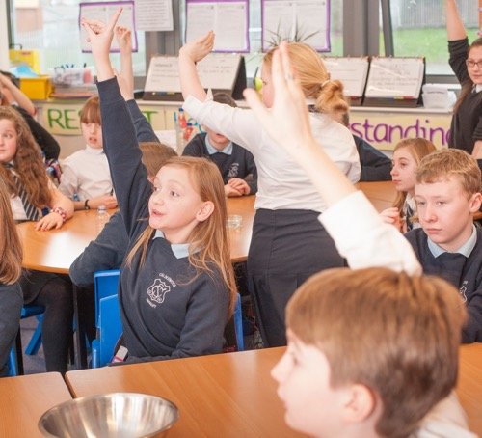
Primary curriculum
6. Assessment
Key messages from 2018-19 Inspection findings:
There is a greater emphasis on professional learning and moderation activities throughout the year. This supports staff to have regular opportunities to review the impact of their approaches to assessment.
Development of progression frameworks leads to shared understanding of progress through and achievement of a level.
◀ • • • • • • • • • • • • • ▶

Slide 15
Primary curriculum
6. Assessment
In most schools staff make good use of National Benchmarks to support assessment of children’s progress.
Teachers are broadening the range of assessment evidence they gather.
Increasingly staff use evidence from in-class assessments and standardised assessments such as, SNSA, to support their judgement on progress through the CfE levels.
◀ • • • • • • • • • • • • • ▶

Slide 16
Primary curriculum
6. Assessment
Data on progress and achievement across curriculum areas outwith literacy and numeracy during the BGE is not yet reliable.
There is a need to improve reliability and validity of teacher judgements across all aspects of learning, including all curricular areas.
◀ • • • • • • • • • • • • • ▶

Slide 17



Primary Curriculum: Conclusions and recommendations
What is
improving?
What are the challenges and areas for improvement?
What is working consistently well?
◀ • • • • • • • • • • • ▶

Slide 18

Primary curriculum
What is working consistently well?
Most schools have an appropriate curriculum rationale in place which guides the curriculum to achieve their shared aspirations for children.
In a majority of schools staff adapt the curriculum well to support them to close the poverty related attainment gap.
Almost all headteachers and staff feel empowered to make decisions about their curriculum to meet their needs in their local community.
◀ • • • • • • • • • • • ▶

Slide 19
Primary curriculum
What is working consistently well?
Senior leaders develop distributive leadership, and, as a result, staff feel empowered.
Progression pathways (created by either the school or local authority) are used effectively in the majority of schools for literacy, numeracy and health and wellbeing.
Increasingly local authorities are creating progression frameworks for all curricular areas.
◀ • • • • • • • • • • • ▶

Slide 20
Primary curriculum
What is improving?
There has been significant improvement in how parents and partners are involved in developing the curriculum rationale.
Parents and partners are now more aware of what the school is trying to achieve through the curriculum.
Staff should now build on this to collaborate further with parents, pupils and partners to design and evaluate the curriculum.
◀ • • • • • • • • • • • ▶

Slide 21
Primary curriculum
What is improving?
In the majority of schools, programmes in Science, Technology, Engineering and Mathematics (STEM) subjects help children make connections across different curriculum areas.
In most schools, staff make good use of digital technology to enhance learning and support the curriculum. More now needs to be done to develop children’s digital literacy skills in a planned and progressive way.
◀ • • • • • • • • • • • ▶

Slide 22
Primary curriculum
What is improving?
Pastoral transitions from early years to P1 are good. The majority of schools are beginning to develop shared approaches to pedagogy across the early level.
Increasingly staff use evidence from in-class assessments and standardised assessments such as, SNSA, to support their judgement on progress through the CfE levels in literacy and numeracy.
◀ • • • • • • • • • • • ▶

Slide 23
Primary curriculum
What are the challenges and areas for improvement?
Most schools engage with parents and partners to support children’s understanding of careers. This now needs to be better linked to the Career Education Standard.
In almost all schools, children experience two hours of physical education each week. However, this is not always of a consistently high quality in a majority of schools.
◀ • • • • • • • • • • • ▶

Slide 24
Primary curriculum
What are the challenges and areas for improvement?
Children need more opportunities to lead their own learning and further meaningful opportunities for personalisation and choice.
There is a need to develop further the implementation of the Scottish Government’s 1+2 languages policy, which will support children’s acquisition, and engagement of two additional languages by the end of P7.
◀ • • • • • • • • • • • ▶

Slide 25
Primary curriculum
What are the challenges and areas for improvement?
Schools need to continue to improve the reliability and validity of teacher judgements of children’s progress and achievement across all aspects of their learning, including all curriculum areas.
In a minority of schools, further work is required to embed fully assessment within planning for learning and teaching.
◀ • • • • • • • • • • • ▶

Slide 26
Primary curriculum
What are the challenges and areas for improvement?
More needs done to develop a coherent and progressive approach to interdisciplinary learning in the majority of schools.
Most schools need to develop further their approaches to play-based and enquiry-based learning to provide meaningful curricular experiences for young primary-aged children.
◀ • • • • • • • • • • • ▶

Slide 27


Education Scotland
Denholm House
Almondvale Business Park
Almondvale Way
Livingston EH54 6GA
enquiries@educationscotland.gov.scot
E enquiries@educationscotland.gsi.gov.uk
For Scotland's learners, with Scotland's educators
Notes:
This is a back cover page in blue. You may edit the address if needed only. It can only be once and at the end of the PowerPoint presentation. Use the corresponding blue internal and back pages if you are using this page.

