Slide 1


Learning outdoors
Shortlees Primary School, East Ayrshire Council
>National overviews of practice<

Slide 2
Shortlees Primary School
School staff work closely with the local authority’s outdoor learning provider to design engaging and motivating learning programmes for children and their families. This work is linked to the school’s health and wellbeing framework with a specific focus on emotional wellbeing.
Staff are enhancing children’s skills and confidence through various coaching sessions which take place outdoors. These are delivered in both live sessions but also as part of remote learning which takes place outdoors. Staff share their own fitness and mental health support strategies with parents to help promote the developing ethos and culture of the school.
As a result of participation in the programme, families report benefits to their mental health and wellbeing.
Staff also observed that increased numbers of children were managing their own emotions and behaviours and overcoming feelings of distress and anxiety more easily when learning outdoors.
Seventeen families participated in the John Muir Learning Award by following a programme provided by the school and modelled by teachers.
The culture surrounding the importance of outdoor learning within the establishment has provided a platform for the school to plan future changes and inform their improvement journey.
The following information has been shared from the school to further illustrate their approach.

Slide 3
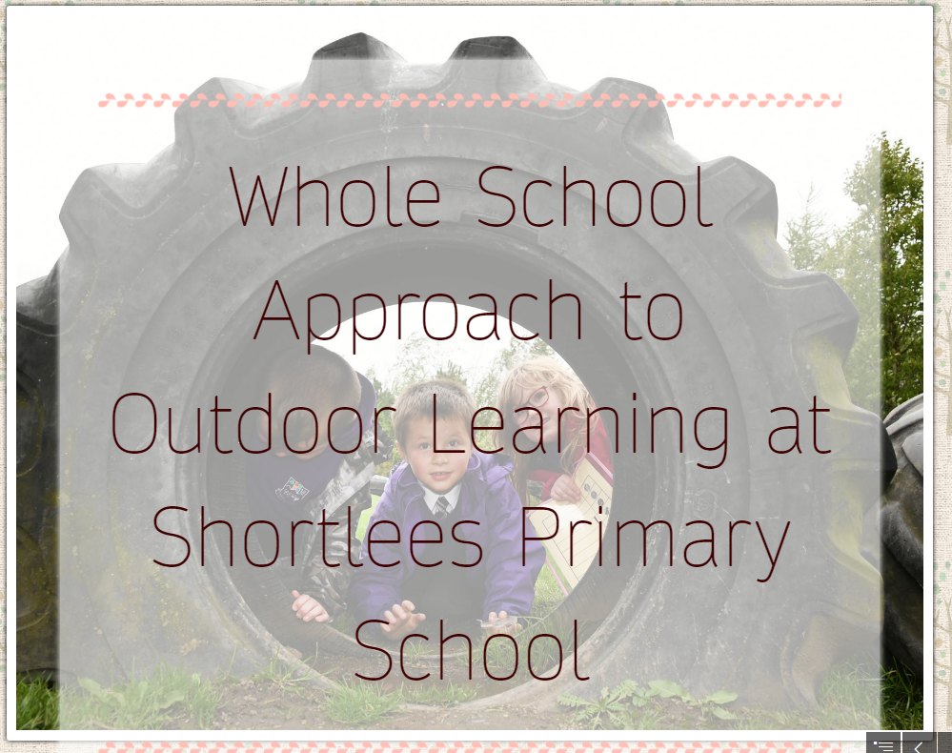
Shortlees staff have created a Sway to tell more about the whole school approach to outdoor learning at Shortlees Primary School.
Visit the Shortlees Primary School Sway here:
https://blogs.glowscotland.org.uk/ea/shortlees/pupil-groups/outdoor-education/

