Slide 1
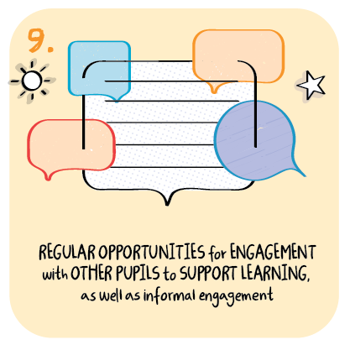

Engagement with other learners
Hill of Beath Primary School and St Joseph’s Primary School
Fife Council
>National overviews of practice<

Slide 2
Hill of Beath Primary
Two schools from Fife outlined their approaches to providing regular opportunities for
engagement with other pupils to support learning, as well as informal engagement.
St. Joseph’s Primary
The school’s Parent Council has supported, provided and sustained a number of well-planned, innovative opportunities to support children and families’ informal engagement. In January, they organised a remote celebration for Scots language with a variety of special features. They created a sway, which included a local piper who recorded music. The children were able to recite and share their reading of Burns poetry as part of a competition. Matthew Fitt, a Scottish author, took part in remote judging and provided resources to support learning more about Scots language.
Across the local cluster, sports leaders and physical education, physical activity and sport (PEPAS) representatives in each school designed sports challenges where pupils and families competed to win sports equipment for their schools. The principal teacher reports this was very popular with families, increased engagement across the schools and developed further a sense of community. To promote further engagement, P6 and P7 classes link with Kelty Community Cinema and have started a ‘Film Friday’. Children and families are creating their own films at home to share as part of an ongoing media competition.

