Slide 1


Supporting transitions for vulnerable learners returning to school, including children and young people with complex learning needs
Educational Psychology Service,
Orkney Islands Council
>National overviews of practice<

Slide 2
As a direct result of partnership working across The Northern Alliance, Orkney’s Educational Psychology Service has created guidance and delivered professional learning to support transitions for vulnerable learners returning to school, including children and young people with complex learning needs (CYPCLN). The view is that transition is not a single event and can be a protracted, flexible process to take account of needs. The delivery of professional learning in relation to the transition guidance has built capacity of staff working with CYPCLN. They have adopted a range of approaches and resources to ensure successful transitions, engagement and learning opportunities during the remote learning period. School staff supporting CYPCLN report the transition guidance from the authority is particularly helpful. Furthermore, it has influenced school approaches to designing learning opportunities, developing individualised packages of support and in how they approach staffing allocations to meet needs.
School and central staff are learning from what has gone well for CYPCLN when they have been learning at home to inform what will happen when they return to school. All of this is centred on wellbeing of children and young people and the formation of positive relationships with parents. School-based staff stress the importance of involving parents and finding out what is going to work for them when learning at home. Staff with specialities, for example in autism or communication, work with families using videoconferencing to reinforce school programmes and help with self-care. When planning significant transitions, for example moving from primary to secondary, additional planning is in place to respond to the current context. Transition videos are in use for some CYPCLN to orient them for the point when they start to physically come into the school. This has reduced anxiety of young people moving from one stage of education to another and increased their engagement during the transition period.
Orkney Islands Council
The following information has been shared by the local authority to illustrate some of this work.

Slide 3
Transition back to school and ELC settings for
Orkney’s Vulnerable Children and Young People
(to accompany Orkney Guidance [June 2020])
August 2020
Orkney Educational Psychology Service

Slide 4
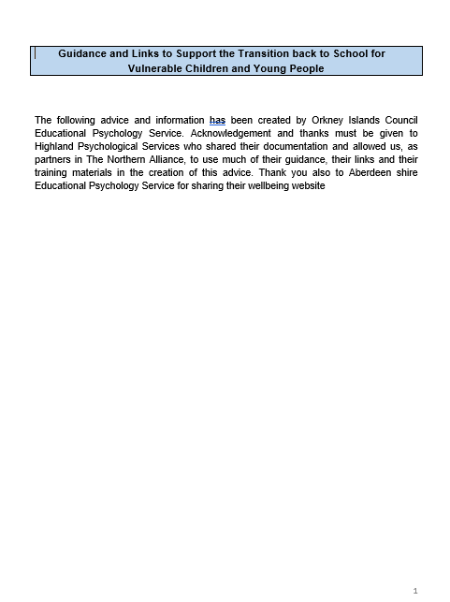
Overview
Welcome back!
Transition – What are the issues?
Transition – What can we do?
Familiarization with transition document:

Slide 5
Transition August 2020 – What are the Issues?
What are the issues for children, young people, and families?
  Fear/Anxiety (e.g. threat of Covid 19; challenge of returning to education setting)
  Loss/Disconnection (sudden unprepared change in March; sense of abandonment; interrupted relationships and sense of belonging)
How can we ‘assess’ the level of need?
  Each pupil and home setting is different.
  It will be important to elicit pupil and family input about their experiences during lockdown, and their feelings about coming back.
What about our own issues?

Slide 6
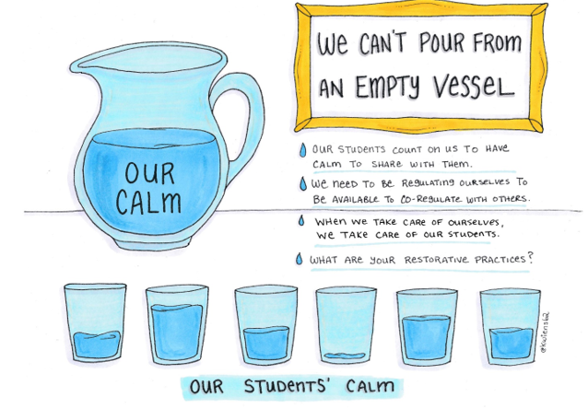
Helping ourselves to help others…
Notes:
Core concept of containment from Attachment-Aware and Trauma-Informed practice.
Each glass represents a pupil – some will be coming back with good resources and resilience topped up; others very close to the edge and with a high level of need for reassurance and nurture.

Slide 7
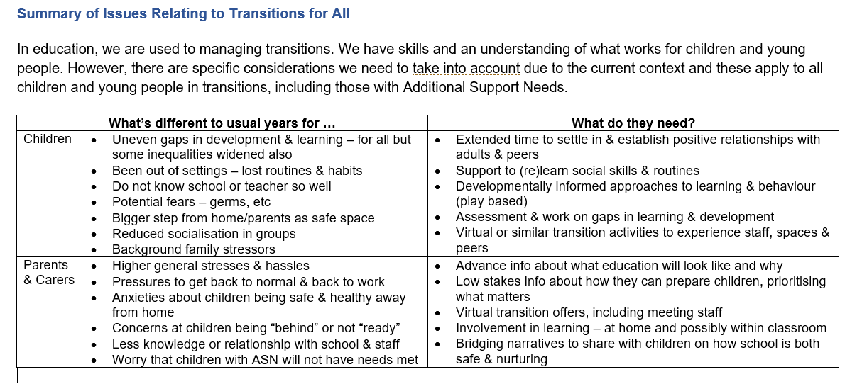
Transition August 2020 – What can we do?
Notes:
Page 9 of document

Slide 8
The five pillars of recovery
Safety
Connectedness
Self and community efficacy
Hope
Calm

Slide 9
Orkney 2020 Transition Guidance
Contents
Contents Page Overview
Appendices and Exemplars Overview
Notes:
Show/Share Screen -

Slide 10
Orkney 2020 Transition Guidance
Links with:
  Legislation
    The Additional Support for Learning (Scotland) Act 2004 (as amended 2009);
    Getting it Right for Every Child as enshrined in the Children and Young People (Scotland) Act (2014)
  School Improvement and Self-Evaluation (especially HGIOS4 – 2.6 Transitions: Theme 1 ‘Arrangements for Transition’)
  recent Scottish Government Guidance (which explicitly addresses issues of Wellbeing linked to Transition back into settings from August 2020)
  Orkney Priorities (especially Relational Approaches and Strengths-Based Practice)
Guiding Principles
  Emotional Literacy
  Relational Approaches
  Positive Psychology
Core Messages
  Clarity (e.g. communication with children, families, and staff)
  Predictability (e.g. routines, timetables, visuals)
  Pace (e.g. tuning-in time; transition as a process)
  Calm (e.g. low arousal approaches; practising self-regulation)
  Physical Environment (e.g. sensory factors; clear demarcation of space; signs and labels)
Notes:
Sensory factors can include: noise level; visual sensory load/clutter;

Slide 11
Transition is a process…
It will take time to re-learn the habits of attending an education setting.
Be patient
Interpret behaviours as communications of emotion
Think…
Connection before Correction
(Dan Hughes)

Slide 12
Transition for
Children and Young People with Autism
This section will help us to engage with recent Scottish Government expectations (in partnership with NAIT [Scottish Government’s National Autism Implementation Team] and the NAS [National Autistic Society]).
Especially, a call for personalized planning for transition back to education settings focused on ASD-related needs.
  More resources at: https://www.thirdspace.scot/nait/covid-19-return-to-school/

Slide 13
Transition for
Children and Young People with other specific conditions
Disability and/or complex ASN
Visual Impairment
Deaf/Hearing-Impaired Pupils
Pupils with Mental Health Issues
Looked After (Care Experienced) Children and Young People
Young Carers
Pupils affected by Bereavement
Pupils with Assistive Technology Needs.
View and plan for the broad range of Neurodevelopmental Conditions (whether diagnosed or undiagnosed) in the same way as diagnosed Autism.
Notes:
Show/Share Screen -

Slide 14
Orkney 2020 Transition Guidance
Appendices and Supplements
Notes:
Show/Share Screen -

Slide 15
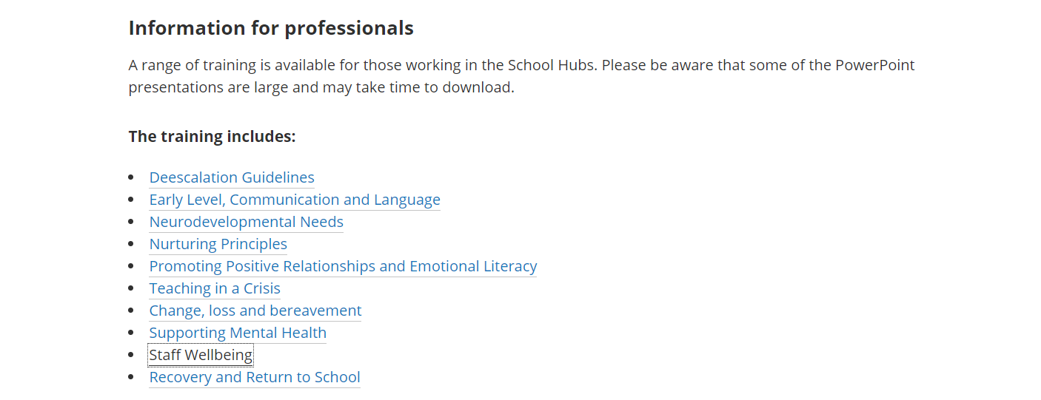
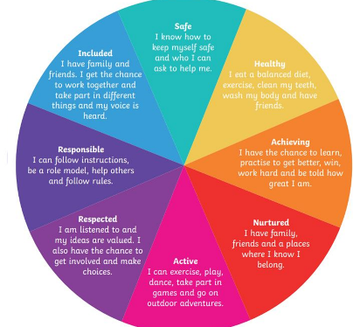
Continuing Focus on our own Wellbeing
Highland Council Educational Psychology Training Powerpoints
- Available at: https://highlandcouncilpsychologicalservice.wordpress.com/covid-19-information-and-resources/
Notes:
Encourage schools/head teachers to use these resources – perhaps in collaboration with the school’s Educational Psychologist – for Staff Meetings, Twilight sessions, etc.

Slide 16
Discussion
(to be continued…)
Some suggested topics:
How can we gauge need for additional transition support in these early days?
Are there children we already know of with specific conditions/needs?
How can we record our focused planning for specific pupils?
What should we do, now and ongoing, to communicate effectively and reduce uncertainty for children and young people, families, and staff?

